Slide 1
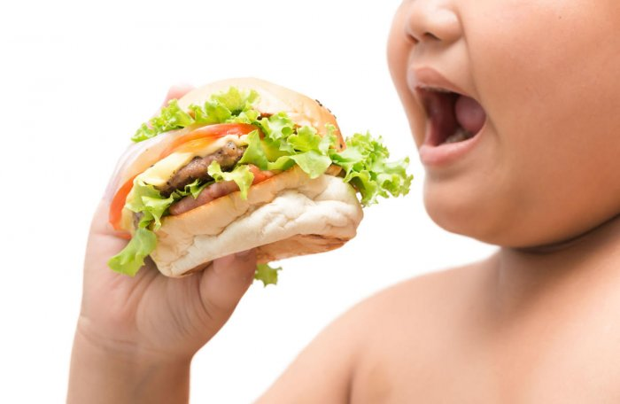
PROPOSAL SLIDE SHOW PRESENTATION
CHILDHOOD OBESITY
Notes:
https://images.app.goo.gl/LGT82dfLQzZ2u6Dt6

Slide 2
I chose this topic because obesity is a huge problem not only to this island but everywhere else. The rate for obesity in children are drastically rising.

Slide 3
Primary Question
Do parents contribute to childhood obesity
Notes:
https://images.app.goo.gl/kATQkQnNENDiTPZh6

Slide 4
Secondary Question
Do wealthy or unfortunate families have more obese children
2. What nationalities are mostly affected by obesity
Notes:
https://images.app.goo.gl/kATQkQnNENDiTPZh6

Slide 5
LIST OF RESOURCES
Encinares, E. (2016, September 2015). Cutting talks about islands’ obesity problem at rotary.
Saipantribune. Retrieved from https://www.saipantribune.com/index.php/cutting-talks-
islands-obesity-problem-rotary/
NMPASI: Rates of childhood obesity in the CNMI on the rise. (2016, August 31). Saipantribune.
Retrieved by https://www.saipantribune.com/index.php/nmpasi-rates-childhood-obesity-cnmi- rise/
Parents blamed for childhood obesity. (2009, February 09). Livescience. Retrieved from
https://www.livescience.com/3293-parents-blamed-childhood-obesity.html
Schmidt, C. W. (2003). OBESITY: A Weighty Issue for Children. Environmental Health
Perspectives, 111(13), A700. https://doi.org/10.1289/ehp.111-a700
Trasande, L., Cronk, C., Durkin, M., Weiss, M., Schoeller, D. A., Gall, E. A., … Gillman, M. W.
(2009). Environment and Obesity in the National Children’s Study. Environmental Health Perspectives, 117(2), 159–166. https://doi.org/10.1289/ehp.11839

Slide 6
Schedule
Literature and Primary Data Schedule
Sunday | Monday | Tuesday | Wednesday | Thursday | Friday | Saturday
Observation, & survey |  | Finding literature & Collecting data |  | Observations, literature & collecting data | Email experts & observations | Observations & survey

Slide 7
Schedule
Writing Schedule
Sunday | Monday | Tuesday | Wednesday | Thursday | Friday | Saturday
Essay writing |  | Essay writing |  | Essay writing |  | Essay writing

