Slide 1
Research E-Portfolio
Introspection: Unconscious Behavior and Relationship Personalities
Researcher: Janine Perez

Slide 2
Table of Contents:
Section I. Preparation
Section II. Final Research Report
Section III. Extended Appendices
Section IV. Reflection

Slide 3
I. Preparation
Brainstorm
Proposal
Outline
Reading Notes
Schedule/Log
Required Draft

Slide 4
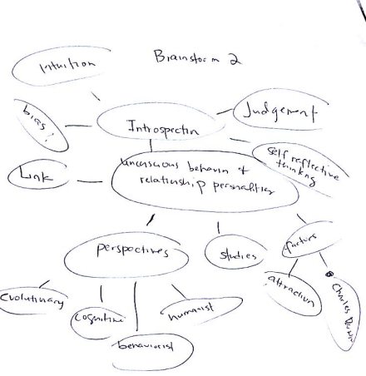
Brainstorm
The purpose of this brainstorm activity is to search for a topic that interests the student researcher. The topic she then chose is introspection.

Slide 5
Proposal
The next slide will feature the student researcher’s proposal prior to her intended topic. The complete proposal may be found in the “Resource” section of her E-Portfolio’s website.

Slide 6
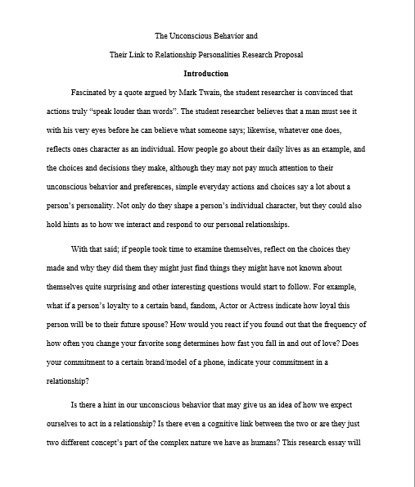
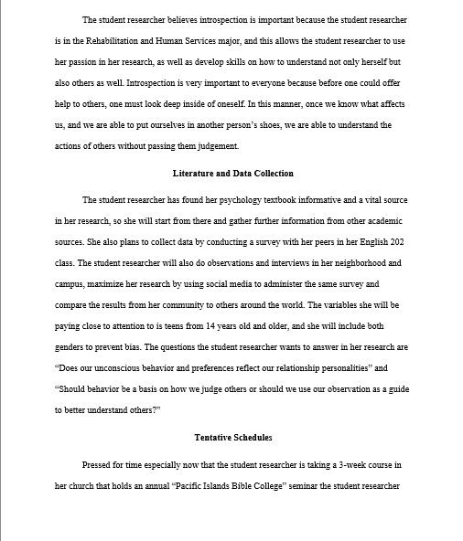
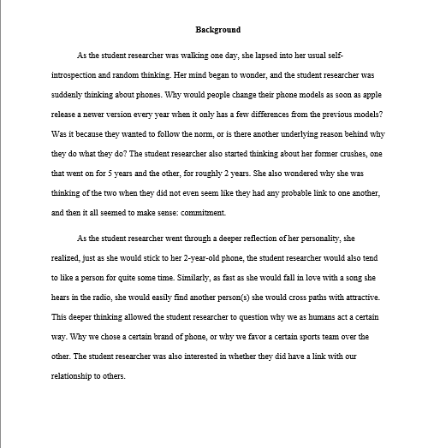
Final Draft of Proposal May be found in the “Resource” section of her E-Portfolio site

Slide 7
Introspection

Slide 8
Background
As Mark Twain says, “Action Speaks Louder Than Words”. The bible says, “As one thinks in his heart, so is he.” Introspection means to reflect or “look inside oneself” for motives behind ones actions, decisions, or way of thinking. I believe that our actions can say a lot about our personality, and if one look closely, one could see a link between our unconscious behavior and relationship with others.

Slide 9
Why is introspection important?
For me, to grow in my chosen career path
To have a better understanding of ourselves and others
To appreciate the individuality of every human being
To have a healthy and reflective mindset (meditation)

Slide 10
Research Questions
Does our unconscious behavior and preferences reflect our relationship personalities?
Should behavior be a basis on how we judge or should we use our observation as a guide to better understand others?

Slide 11
Plan
In order to gather data for my research I will:
Conduct a survey with the class
Interview people in the community
Consult professionals and academic references

Slide 12
Tentative Schedules
Writing Schedule
2:00 pm – 6:00 pm Thursdays
2:00 pm – 6:00 pm Fridays
11:00 am – 4:00 pm Saturdays
Any other time as needed
Research Schedule
8:30 am – 9:00 am Monday - Thursday
11:00 am – 12:00 pm Monday - Thursday
or during my free time

Slide 13
Summary
By the end of my research I will…
Prove my hypothesis that there is a link between our unconscious behavior and relationship personalities.
Convince my readers to implement reflective thinking in their daily lives.
Learn how to better understand myself as well as others.
Help myself, as well as others to refrain from judgement and promote empathy with others.

Slide 14
Outline
Introduction:
Thesis: How often a person changes their phone may determine how committed a person will be to future spouses.
Importance: Detailed: As part of her research the student researcher will examine the relationship between unconscious behavior and relationship personalities.
Detailed: The student researcher will not only examine the human psyche for a possible link between the two, but also encourage everyone to engage in healthy self reflective thinking and observation or “introspection”.

Slide 15
Outline continued
Background
Topic Sentence: It is innate to the human nature to judge, especially develop a stereotype without sound land logical arguments to support their prejudice judgements or claims.
Support: Bargh reports in his work “Unconscious Mind”, it is innate for humans to not only judge others but mimic others. This is to say that when they see someone judging another person they would also do the same.

Slide 16
Outline Continued
Literature Review
The student researcher divided her literature in sections, the first section reviews a source containing different perspectives in relation to how personality is shaped.
The second half of her literature review sections each of her remaining sources according to importance.
Primary & Secondary Questions
Is there a link between unconscious behavior and relationship personalities?
Is mere observation sufficient enough to explain perceived behavior of others?

Slide 17
Outline Continued
Methodology
The student researcher conducted a survey that she administered online to examine personality and the unconscious.
This section will be structured into a process essay format.
Findings
Although 90% of the participants who responded yes to the question do you consider yourself loyal to your special someone, only 60% of the same participants responded yes they were loyal to their favorite band or fandom.

Slide 18
Outline continued
Discussion
The student researcher may be able to use this research in her future career as a counselor as well as apply it in her daily life
This E-Portfolio and report may be found in the designated class site.
Conclusion
Although there appears to be a link between unconscious behavior and relationship personalities due to the phenomena known as “cognitive concepts” observation may not be sufficient enough to explain behavior as it leads to bias an unfair judgement.
Summarizes what happens throughout and findings.

Slide 19
Reading Notes
Throughout the course of her research, the student researcher is required to take notes of her annotated bibliography for support of her research as well as complete a set of literature review that contributed to this research. These notes may be found in the resources section of her site.

Slide 20
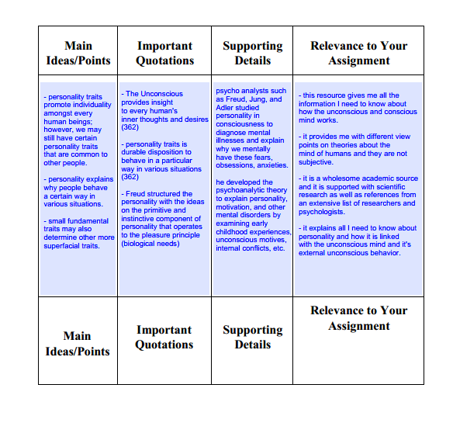
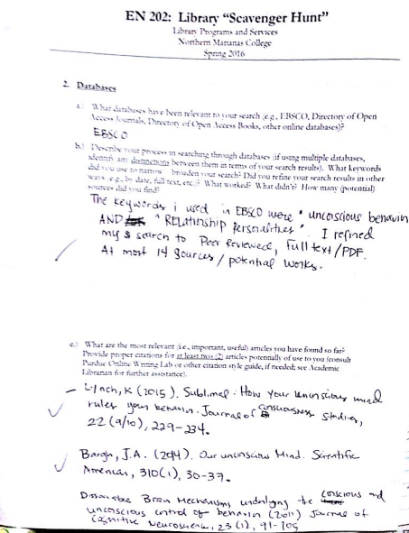
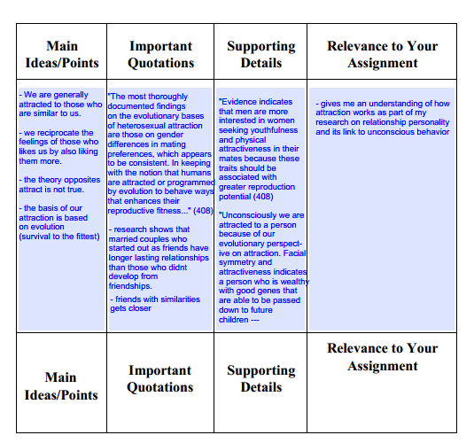
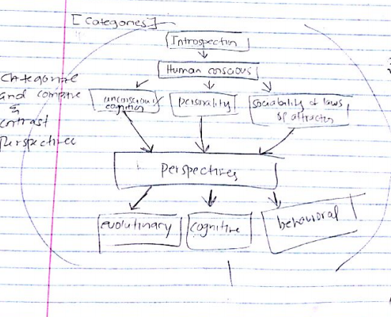

Slide 21
Schedule
Initial schedule may be found in the tentative schedules section in the proposal section of this E-Portfolio however these were modified throughout.

Slide 22
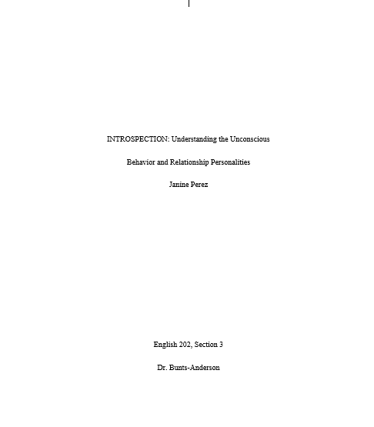
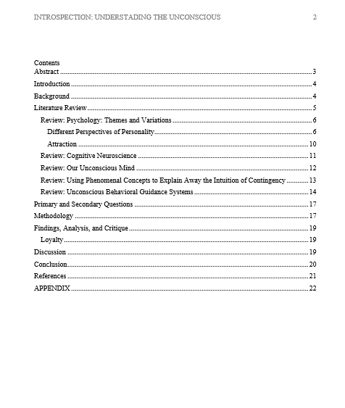
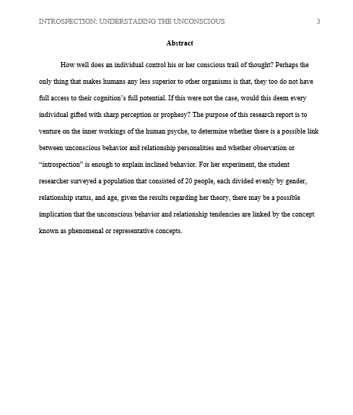
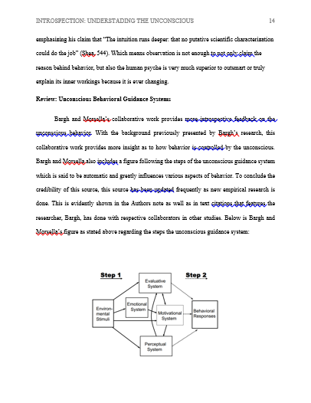
Required Draft
A required draft was written prior to the completion of the student researcher’s research report:

Slide 23
II. Final Research Report

Slide 24
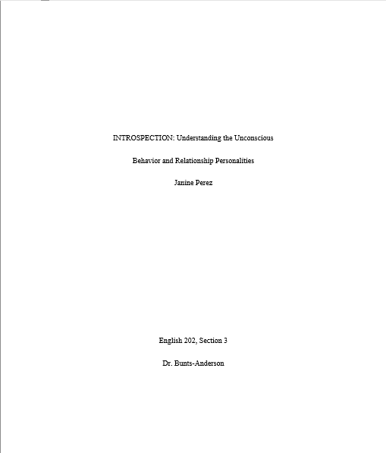
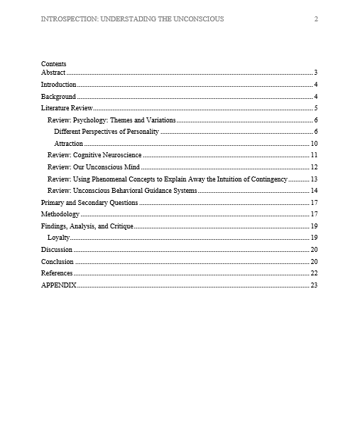
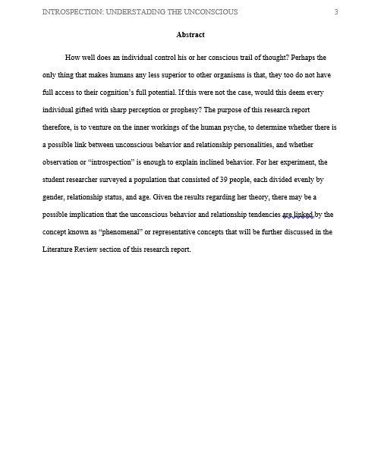
Cover page, Table of Contents, and Abstract

Slide 25
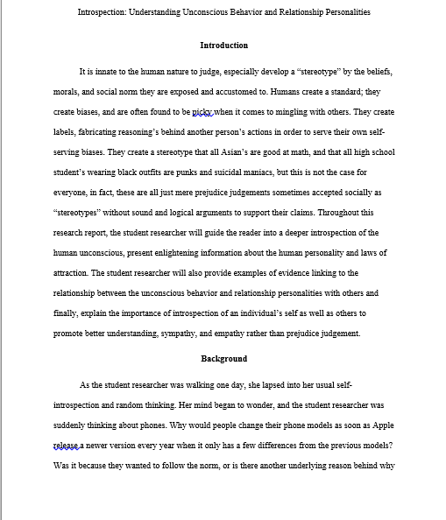
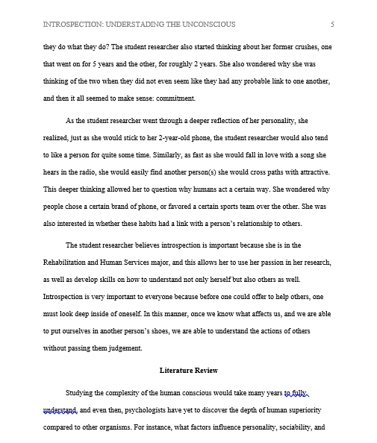
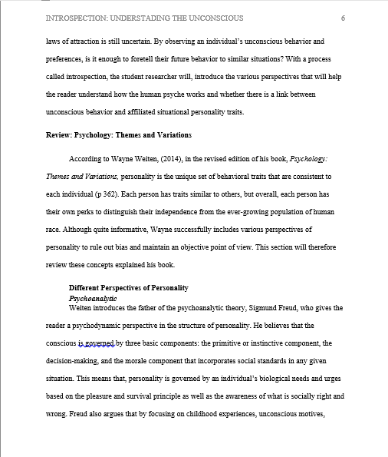
INTRODUCTION, BACKGROUND, LITERATURE REVIEW

Slide 26
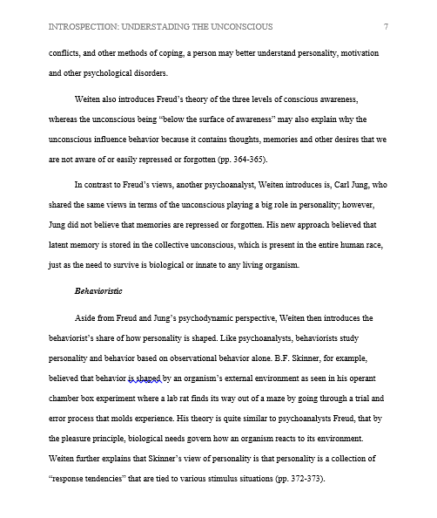
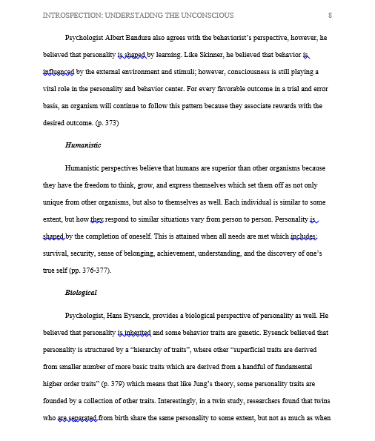
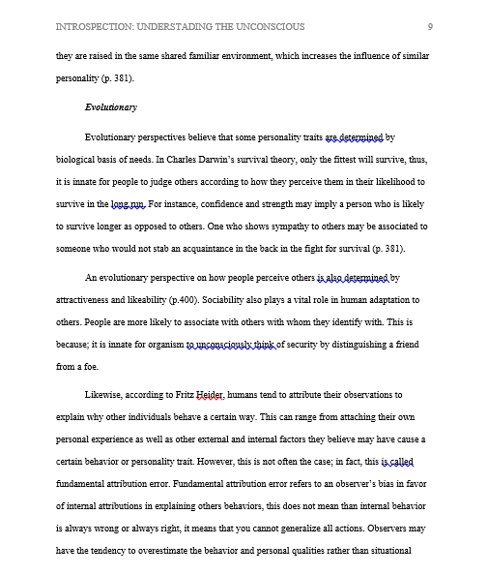
LITERATURE REVIEW CONTINUED

Slide 27
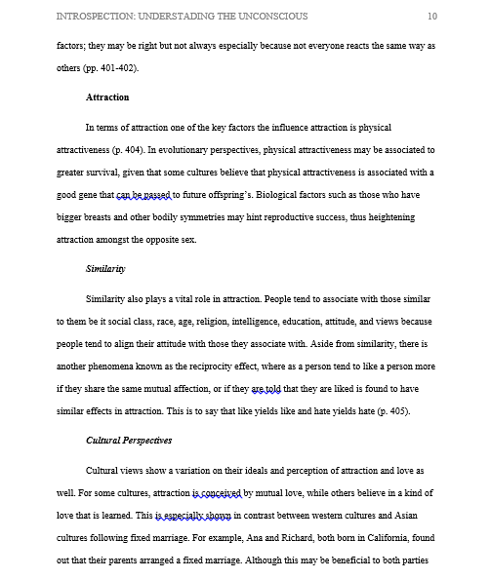
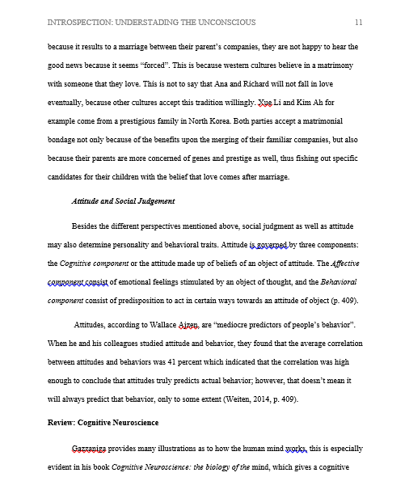
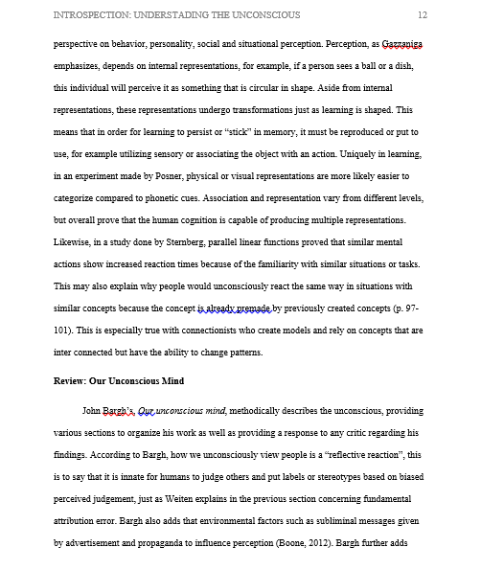

Slide 28
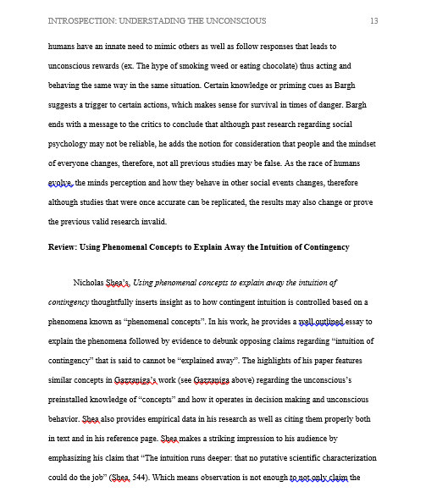
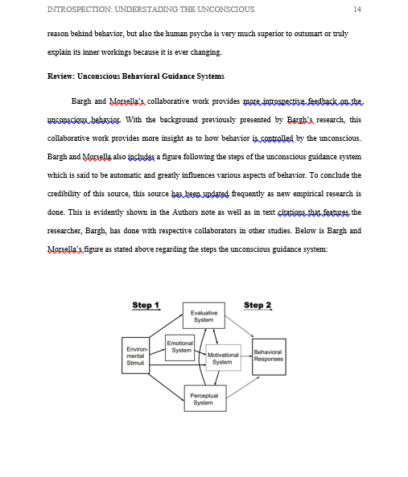
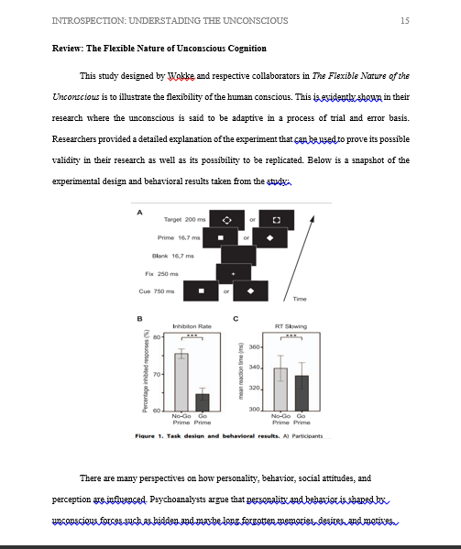
LITERATURE REVIEW CONTINUED

Slide 29
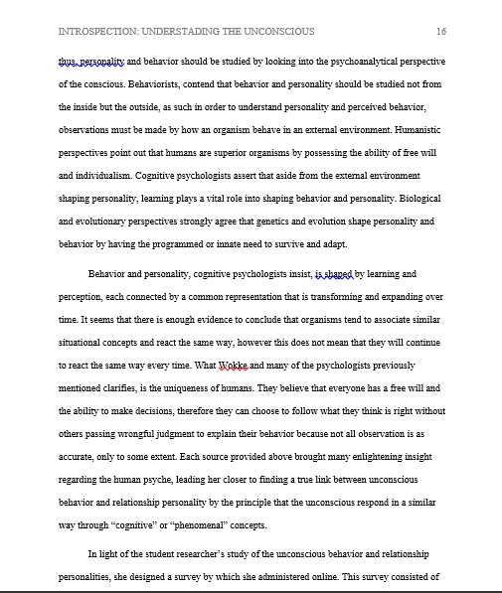
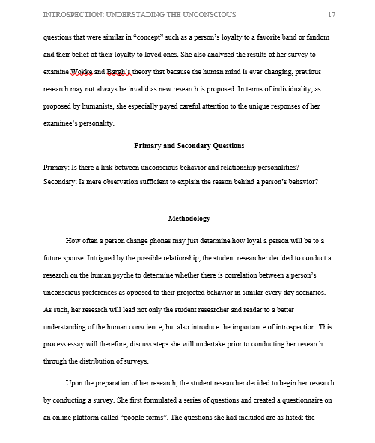
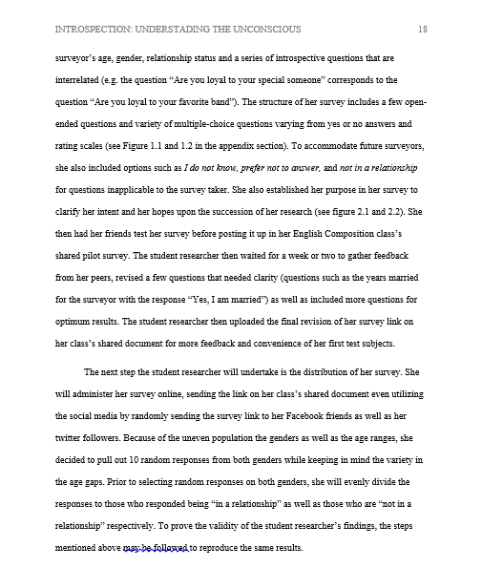
LITERATURE REVIEW CONT, RESEARCH QUESTIONS, METHODOLOGY

Slide 30
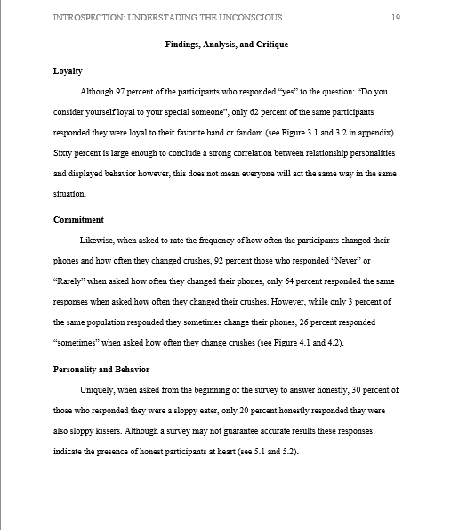
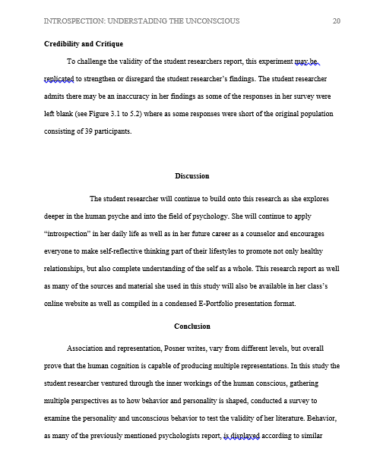
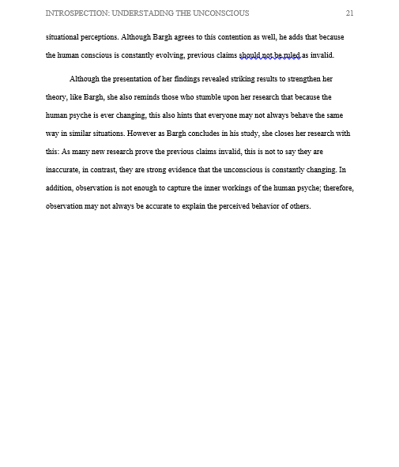
FINDINGS, DISCUSSION, CONCLUSION

Slide 31
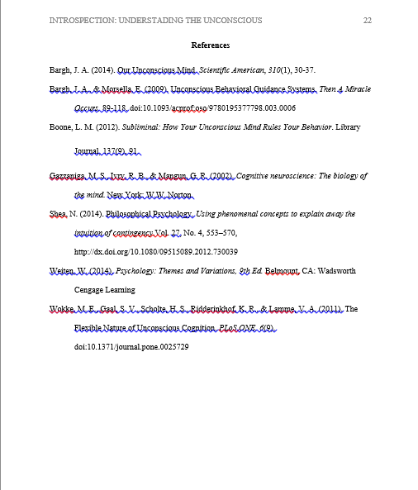
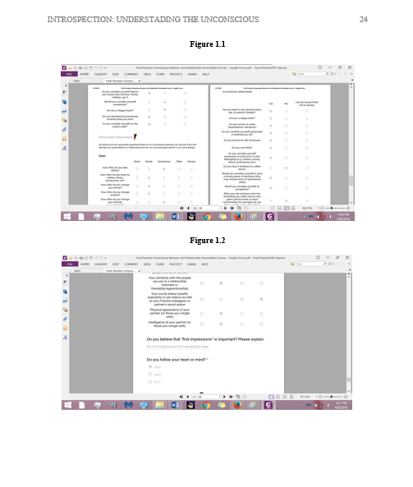
REFERENCES, APPENDIX COVER, APPENDIX

Slide 32
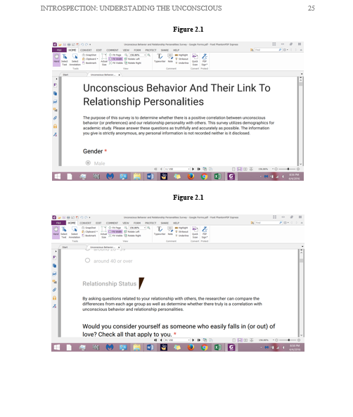
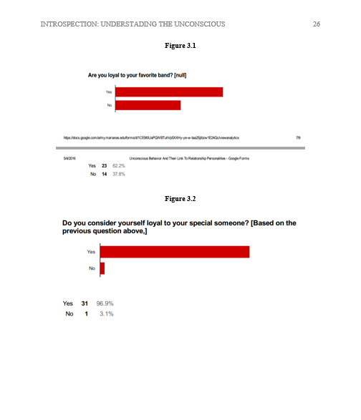
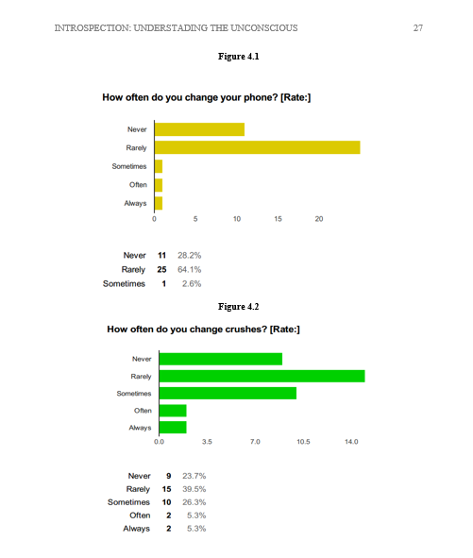
Appendix continued

Slide 33
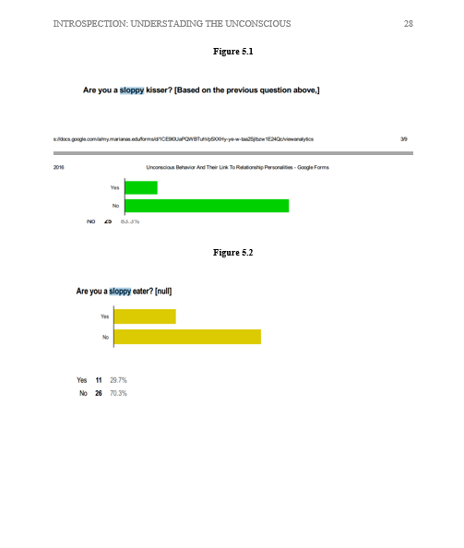
Appendix continued

Slide 34
III. Extended Appendices
The next set of slides compares responses that are inter-related

Slide 35
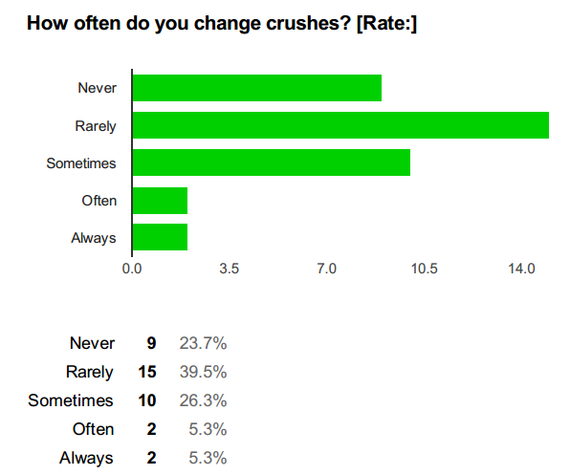
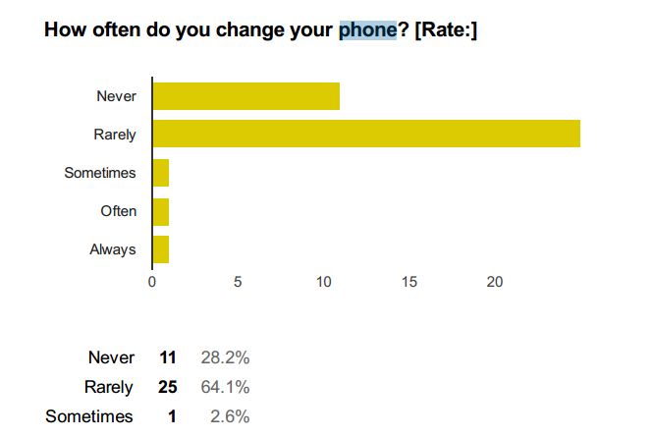
COMMITMENT
* May this indicate how committed we would be to everything in general, or something deeper especially in marriage.

Slide 36
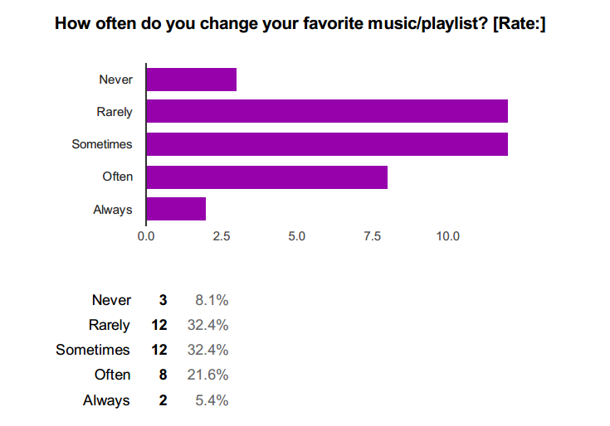
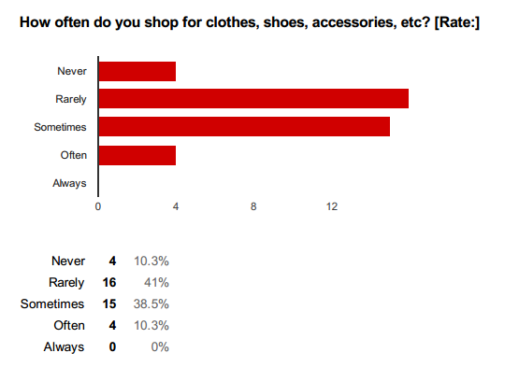
Commitment comparison continued
*Does this indicate an overly sentimental person, committed, or does it just mean the human psyche is constantly changing as they are sublimely exposed propaganda (e.g. magazines, media, celebrity, banners, trends, etc.)?

Slide 37
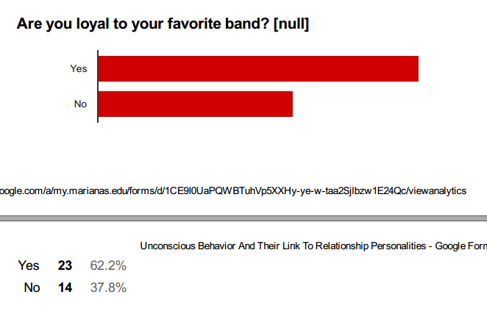
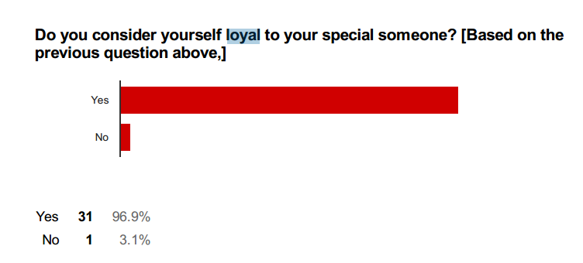
LOYALTY
* May this give us a hint that your loyalty in anyone or anything may indicate your loyalty to future spouses?

Slide 38
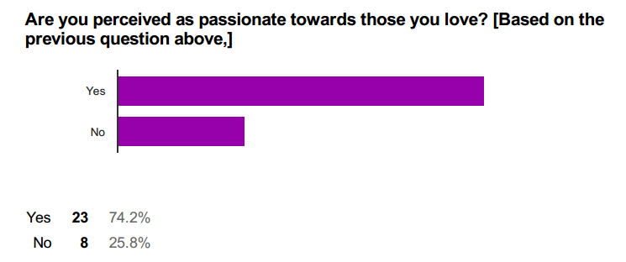
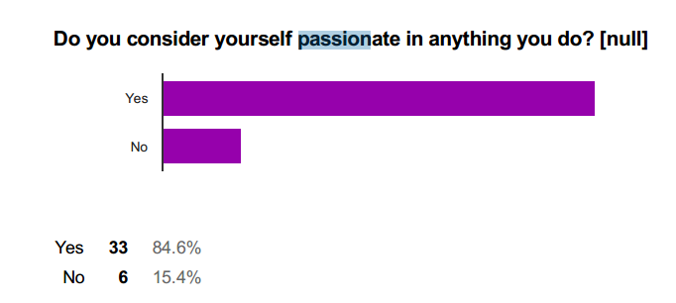
PASSION
* Coincidence or a really passionate person at heart is also passionate in everything they do?

Slide 39
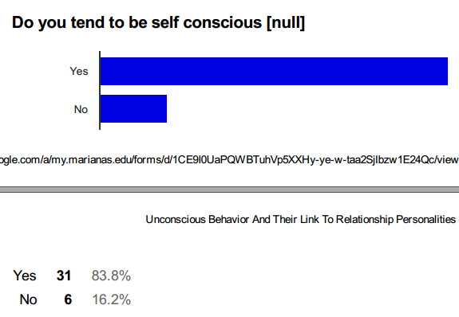
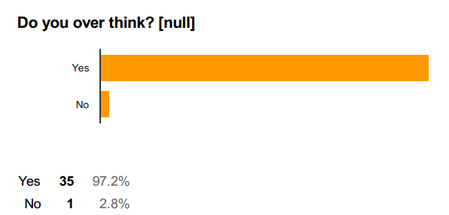
SELF CONSCIOUSNESS
* Does this indicate a person who overthinks is highly self conscious. Does this indicate a personality where as they give more importance to impressions and social reputation?

Slide 40
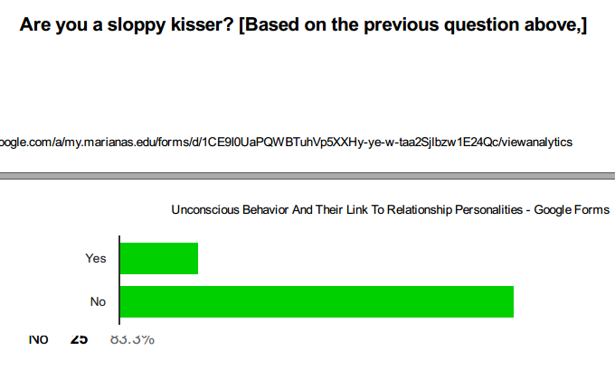
SLOPPY IN NATURE
* Is there really a link between unconscious behavior and expressed behavior in relationships? Surely in the same context.

Slide 41
TRANSITION
*Does this indicate that a person who easily falls in and out of love, easily
Transitions to a new relationship after a breakup?

Slide 42
PREDICTABILITY
* Does the tendency to change mind indicate a spontaneous personality or even short attention span?

Slide 43
NARCISSISM AND PERSONALITY
* Does narcissism indicate the heart is ruled by the mind or the lack of self acceptance?

Slide 44
RELATIONSHIP PERSONALITIES
* As jealousy is to possessiveness, it is also evident that those who are possesses the qualities of being possessive and jealous often takes longer to get over a person.

Slide 45
IV. Reflection
Throughout my research I’ve not only did I proved my hypothesis regarding a link between the unconscious behavior, but I also learned that observation plays a big role in our daily lives. In light of my introspection topic, I’ve learned that we shouldn’t use our observation or simple minded perception to label anyone, or explain behavior simply by how we perceive them alone, but rather use them to better understand not only everyone around us but also ourselves.

