Slide 1
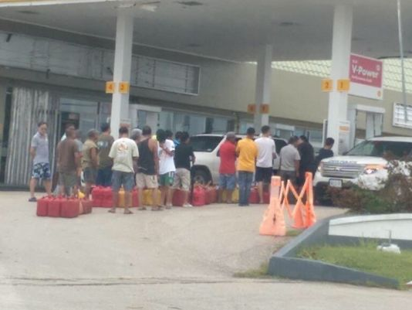
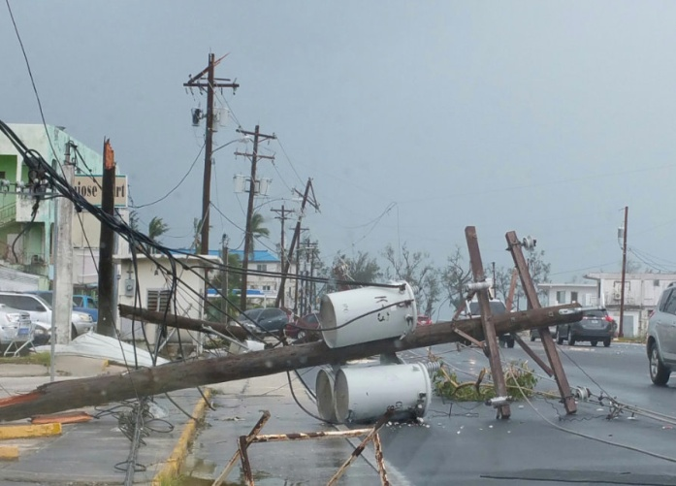
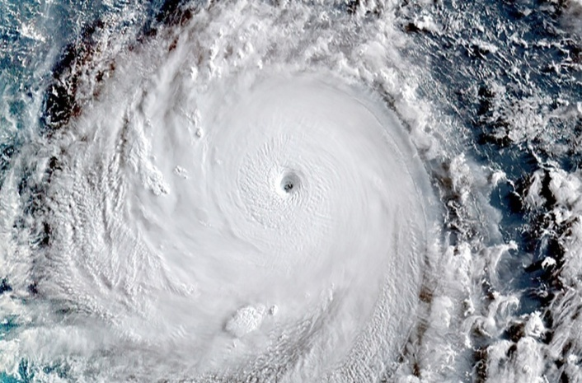
Research Project: E-Portfolio
Government Preparedness
English 202
Kimberly Bunts-Anderson
Elton Castro

Slide 2
Brainstorm

Slide 3
Outline Order
Cover page
Abstract
Introduction
Thesis:
Body
Paragraph 1
Topic Sentence:
Paragraph 2:
Topic Sentence
Paragraph 3:
Topic Sentence
Conclusion
References
Appendix

Slide 4
Research Proposal Essay

Slide 5
Research Proposal Essay

Slide 6
Research Proposal Essay

Slide 7
Research Proposal Essay

Slide 8
S C H E D U L E
Week 1 | Find Research Topic/Research Question
Week 2 | Proposal Prompt
Week 3 | Create a thesis and outline
Week 4 | Make survey and interview questions
Week 5 | Update Schedule, Write Process Essay
Week 6 | Plan, Draft, and Revise Essay, Work on Reference/Bibliography Submit: Process Essay hard copy Work on Descriptive Essay
Week 7 | Review and Revise intro and conclusions in APA Style Interview: Mayor 11/12
Week 8 | Final Descriptive essay hard copy due Create a compare and contrast outline
Week 9 | Compare and contrast rough draft, info-graph Interview: Parks and Rec: 11/25
Week 10 | Interview Governor: 11/30 Infograph, Peer Review and instructor review, Final Research submit
Week 11 | Reflection on Process
Week 12 | Reflection on Process due, E-Portfolio, Final Research Draft
Week 13 | Website upload, E-portfolio, final research draft, reflection

Slide 9
Annotated Bibliography

Slide 10
Annotated Bibliography

Slide 11
Final Research Report

Slide 12
Final Research Report

Slide 13
Final Research Report

Slide 14
Final Research Report

Slide 15
Final Research Report

Slide 16
Final Research Report

Slide 17
Final Research Report

Slide 18
Final Research Report

Slide 19
Final Research Report

Slide 20
Reflection

