Slide 1
Pros and Cons on Chewing Betel Nut
Roshae Manglona
EN202-01
Dr.Kimberly Bunts Anderson
02/08/2018

Slide 2
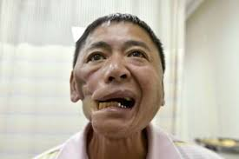
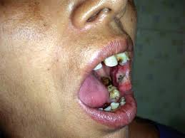
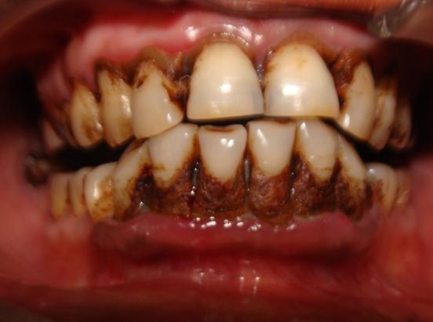
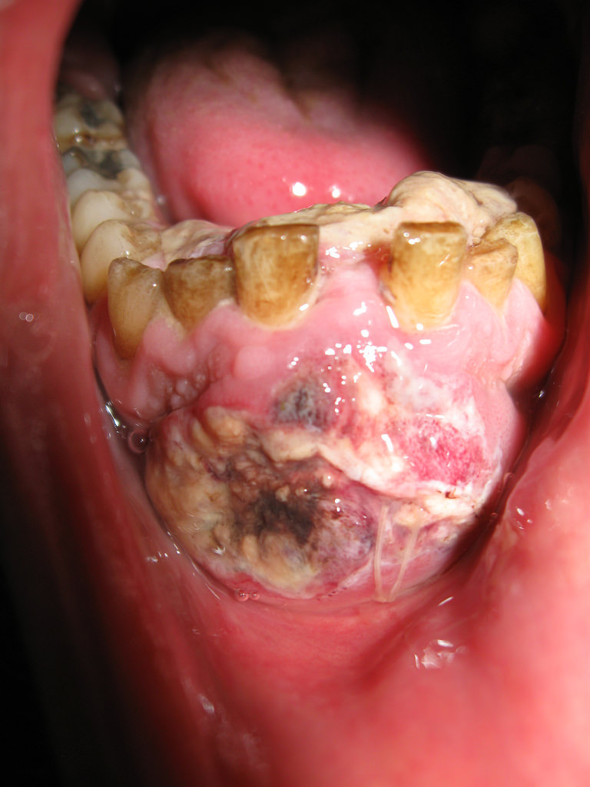
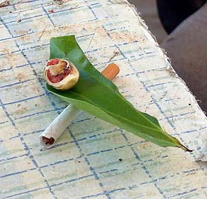
Purpose:
In the CNMI we surrounded with so many people that chew. Betel nut chewing is like drinking coffee, it has a mild boost and it also addicting. People chew betel nut to take a break, share, or relax. Chewing betel nut has been a tradition passed down by generations and generations. The mixture of lime and tobacco have caused lumps on the gum in which oftentimes diagnosed as mouth cancer. This research will be able to educate people and students about how chewing is addicting, cultural, and how it affects the insides of the mouth.

Slide 3
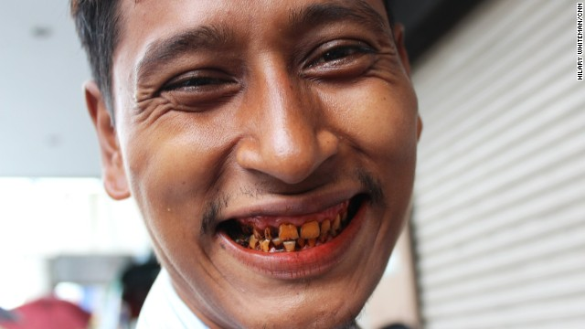
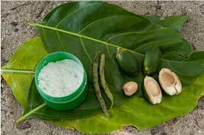
Why is it interesting?
Betel nut chewing is a custom that spread from India to Southeast Asia. From there it spread to the Philippines, Melanesia, Taiwan, and Micronesia. The ancient Chamorros chewed pugua’ (Betel Nut), Sprinkled with afok (quicklime), and wrapped in pupulu (pepper leaf). Till now the locals still chew betel nut. Chewing betel nut is an cultural, and social custom. Chewing causes oral cancer.

Slide 4
Primary Questions
What influenced people to start chewing betel nut?
Is chewing betel nut addictive?
Is chewing betel nut part of their culture?
How does chewing betel nut affect the insides of the mouth?

Slide 5
Secondary Questions
How much does person spend on their chewing habit?
How many people in the CNMI chew including high school students?
How often does a person chew everyday?
At what age did you start chewing betel nut?
Where do you do get your betel nut from?
Do you often see people chew betel nut?
Do you think chewing betel nut is good habit?
Do you know people that chew betel nut?

Slide 6
How am I going to conduct my research?
-I’m going to look for more information online and the library.
-Set up interview with CHC and the dentist.
- Get in contact Yvette Paulino, associate professor at the University of Guam's School of Nursing and Health Sciences and researchers for the Guam Cancer Research Center’s Betel Nut Intervention Trial study, talks about betel nut which causes cancer.
-Set up a survey for some people in the NMC students, high school students, and some people in the community to take.

Slide 7
Schedule
-2 weeks- I will be finding more information online and the library.
- 2 weeks- I will be setting up a survey for NMC students, high school students, and some people in the community to take.
-2-3 weeks- I will be setting up interviews with CHC and the dentist. I will be also getting in contact with Yvette Paulino and ask her more information on my topic.
- 2 weeks- I will be finalizing my research essay.

