Slide 1
Research Project: E-Portfolio
The causes and types of Domestic Violence in the CNMI
Lina Liang | Kimberly Bunts Anderson | EN202-01 ON

Slide 2
Project: Domestic Violence in the CNMI
Section one
Preparation documents
Brainstorm
Proposal
Outline
Readings Notes
Schedule & log
Required draft

Slide 3
Brainstorming
Interviews with officials and others, to make compare and contrasts of the responses between official and citizens.
Includes demographic questions, comment box and multiple choices.
Domestic Violence in the CNMI
Distributing surveys to the NMC students, and analyzes the datas.
Find academics sources from website and gain more valuable and detailed information.

Slide 4
Research Proposal
Introduction
Literature review
Research question
research methodology
References
Tentative schedule

Slide 5
Portfolio Outline
Body paragraph 2
topic sentence
support
paraphrase
transition sentence
Body paragraph 3
topic sentence
concluding sentences
Conclusion
topic sentence
summary statement
concluding statement
Introduction
general thesis
importance
detailed thesis
Body paragraph 1
topic sentence
support
APA Quote
Transition sentence

Slide 6
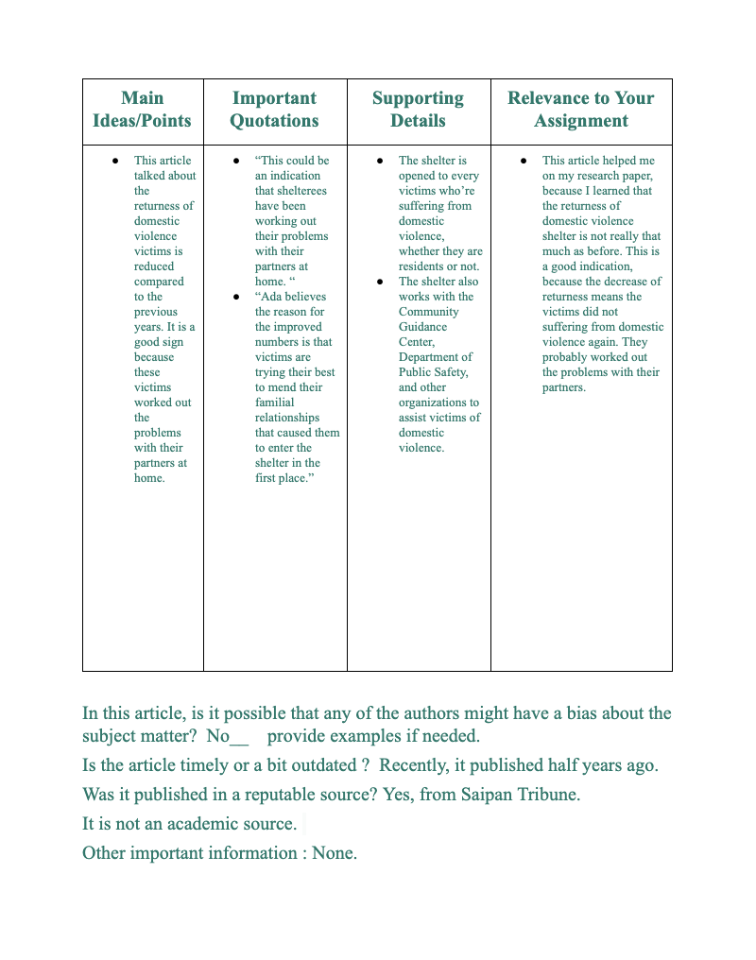
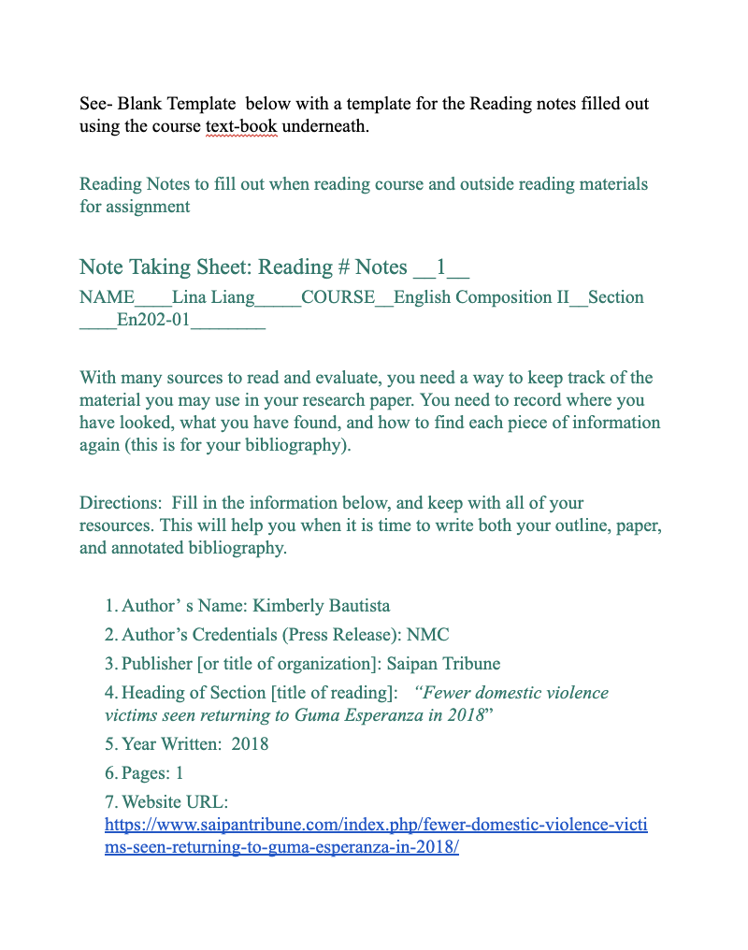
Reading Notes

Slide 7
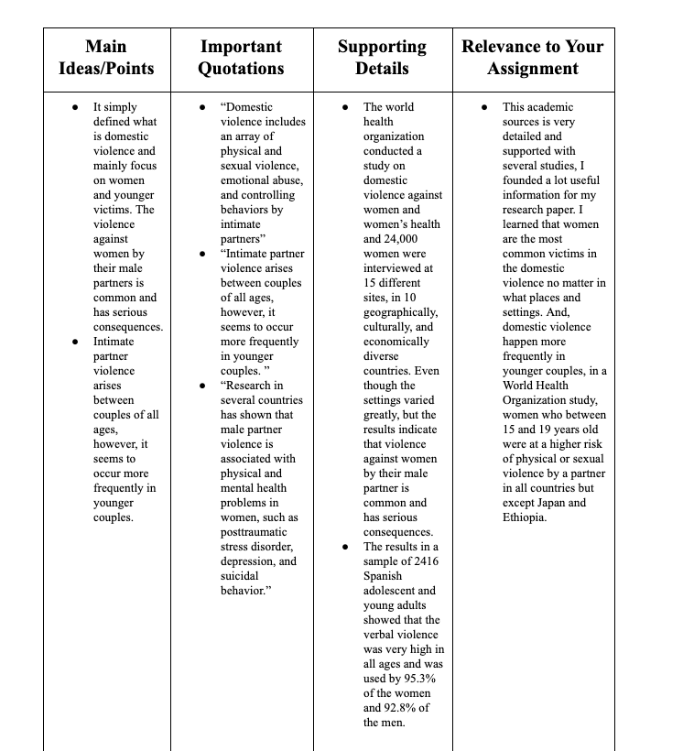
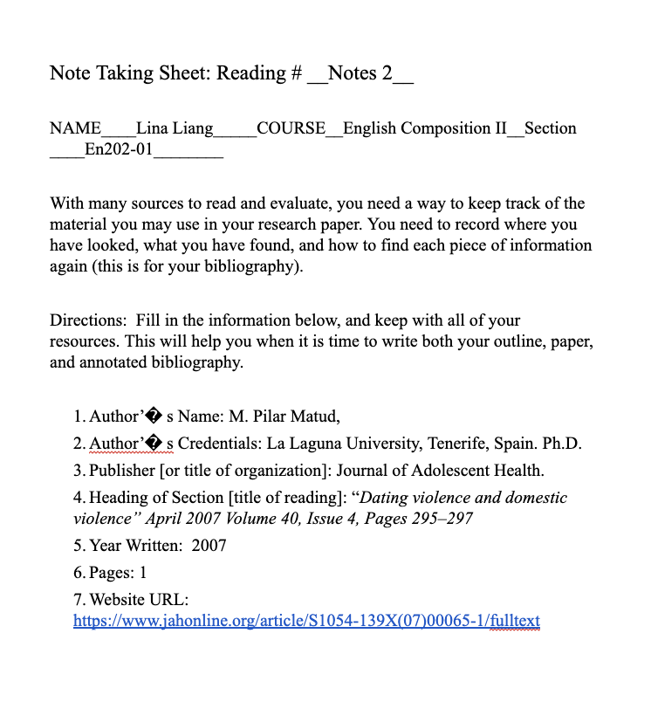
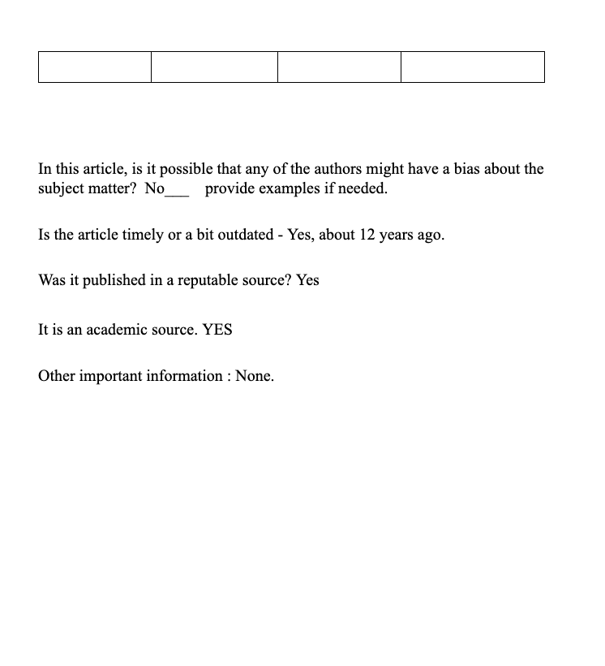
Reading Notes

Slide 8
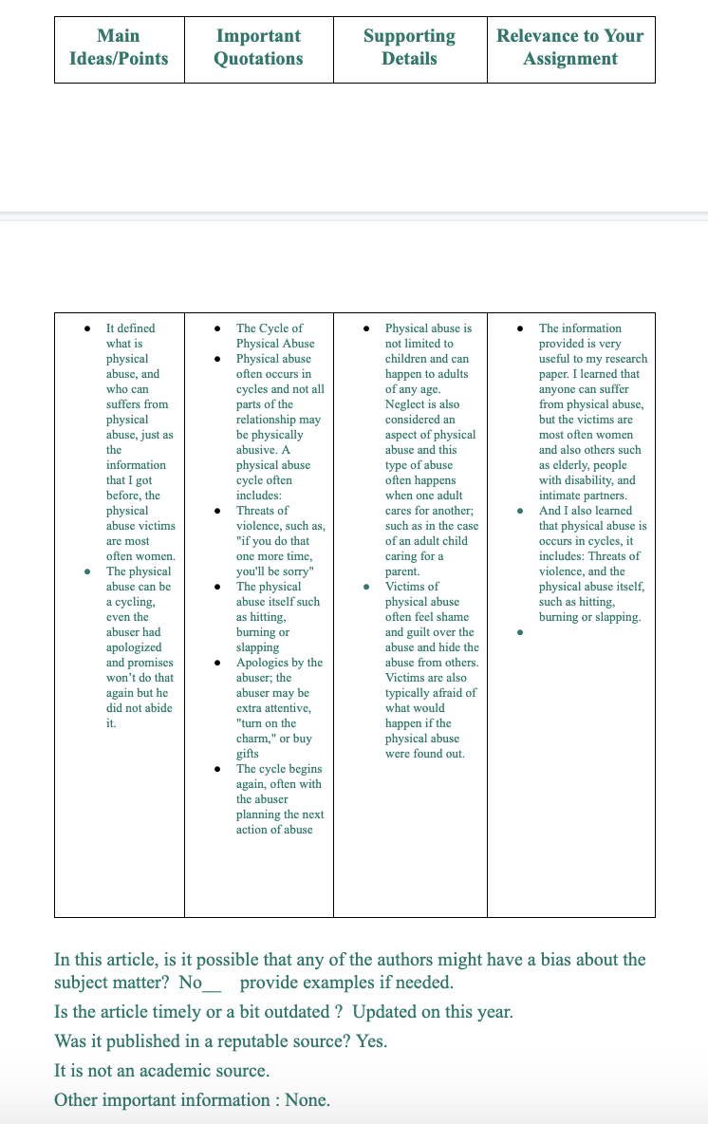
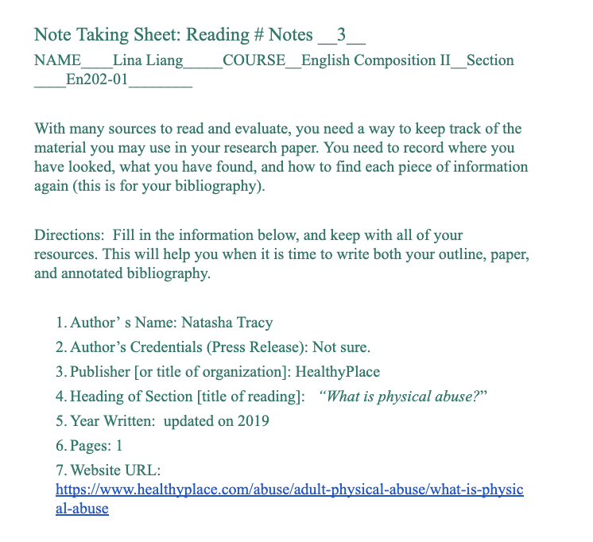
Reading Notes

Slide 9
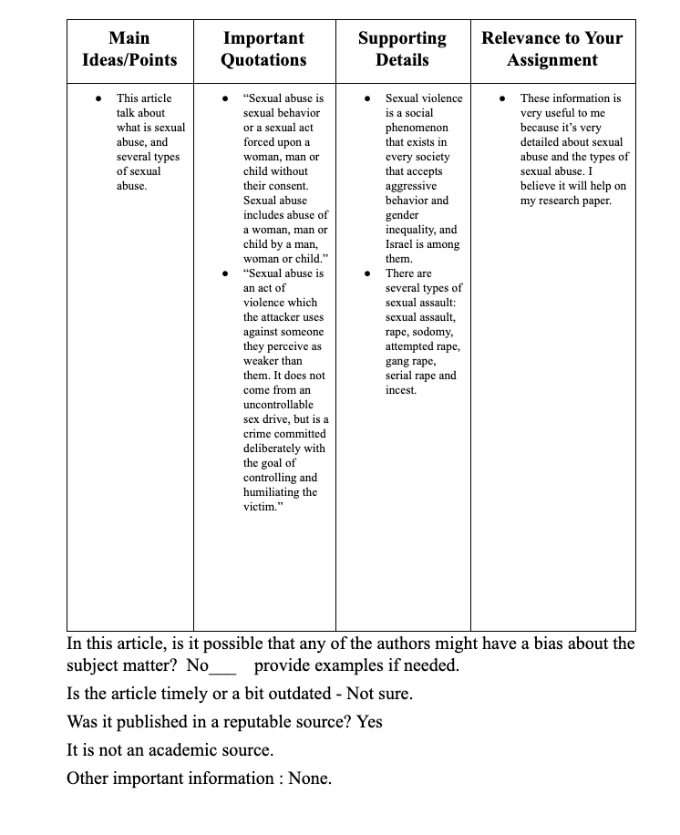
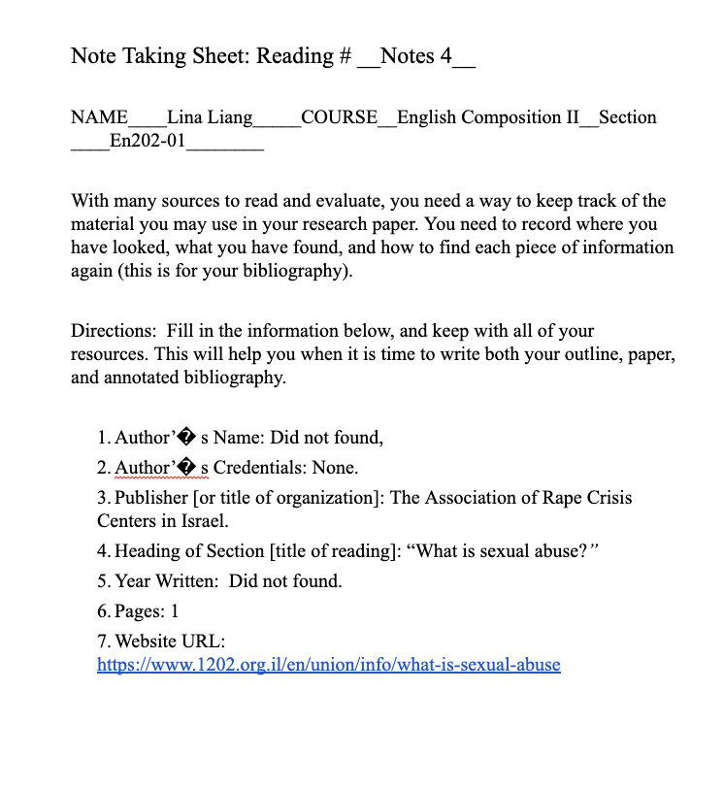
Reading Notes

Slide 10
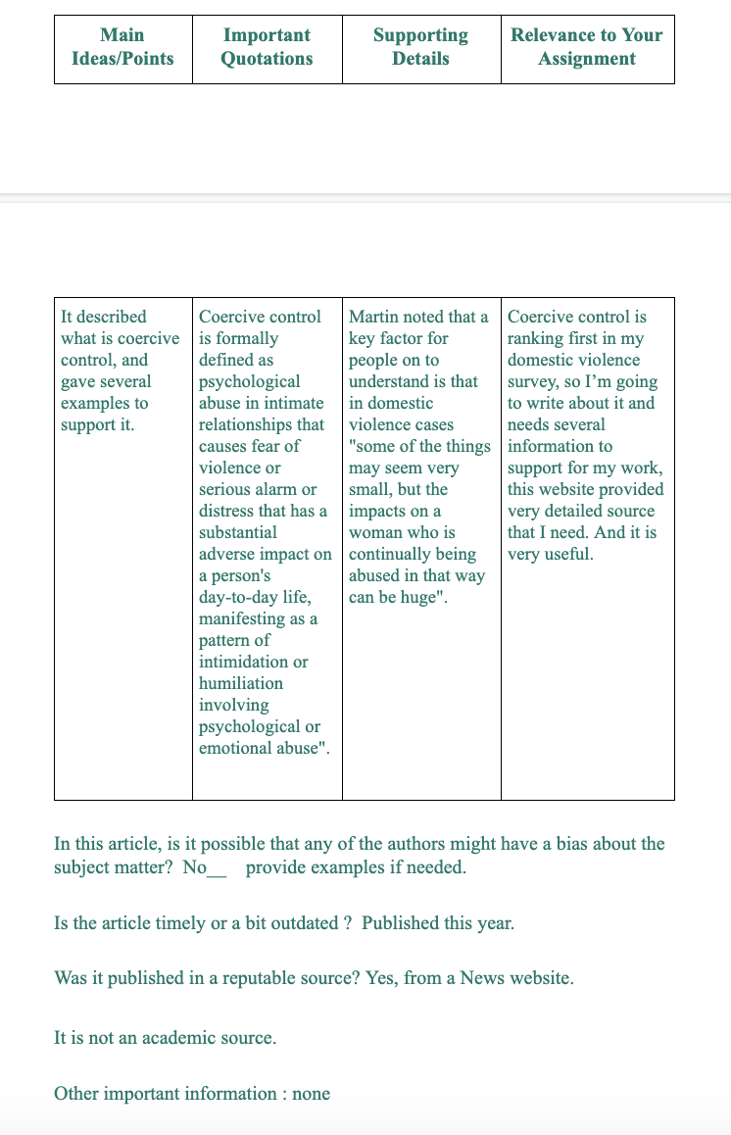
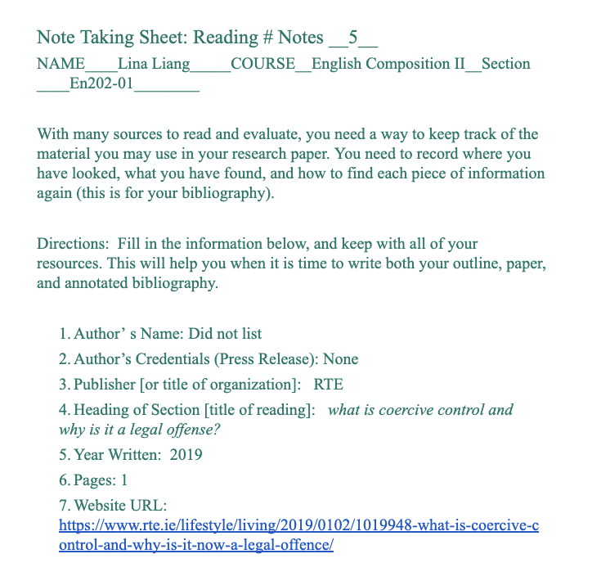
Reading Notes

Slide 11
Schedule & Log
Week 1 (1 April - 7 April) | Developing a research topic and questions.
Week 2 (15 April - 21 April) | To illustrating the ideas by using academic writing format.
Week 3 (22 April - 28 April) | To write good thesis statements, introductory paragraphs, developmental paragraphs, and conclusions for academic essays.
Week 4 (29 April - 5 May) | Use several examples to support with a thesis statement.
Week 5 (6 May - 12 May) | To set up a survey and sharing it with peers.
Week 6 (13 May - 19 May) | Planning to write a process essay and able to use citation correctly.
Week 7 (20 May - 26 May) | Write letters to 10 experts, provided feedback to the other students, create reading notes 1 and 2, 3 and 4.
Week 8 (27 May - 2 June) | Write literature review, create reading notes 5 and 6, 7 and 8, and analyzing datas.
Week 9 (3 June - 9 June) | To categorize, organize, describe and illustrate literature collected on their research topic. Write research report draft and reflection of the project.
Week 10 (10 June - 16 June) | Prepare E-Portfolio, presentation, reflection, and research paper.

Slide 12
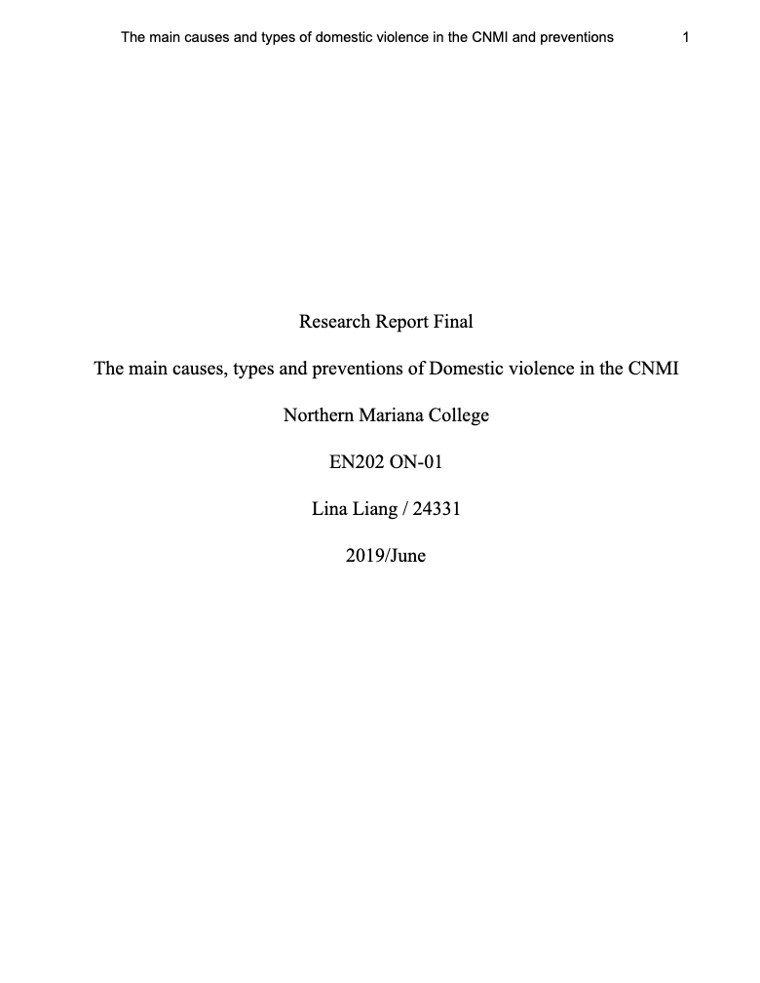
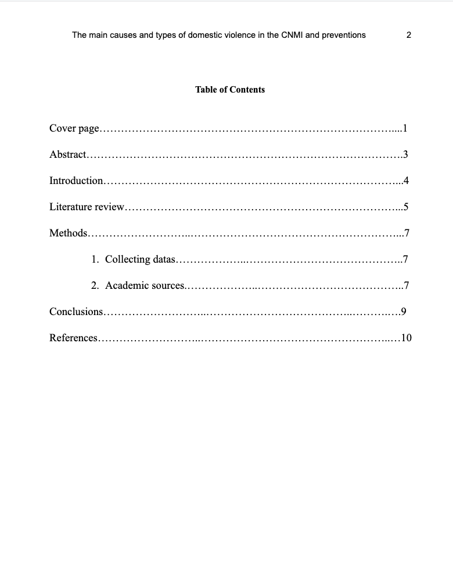
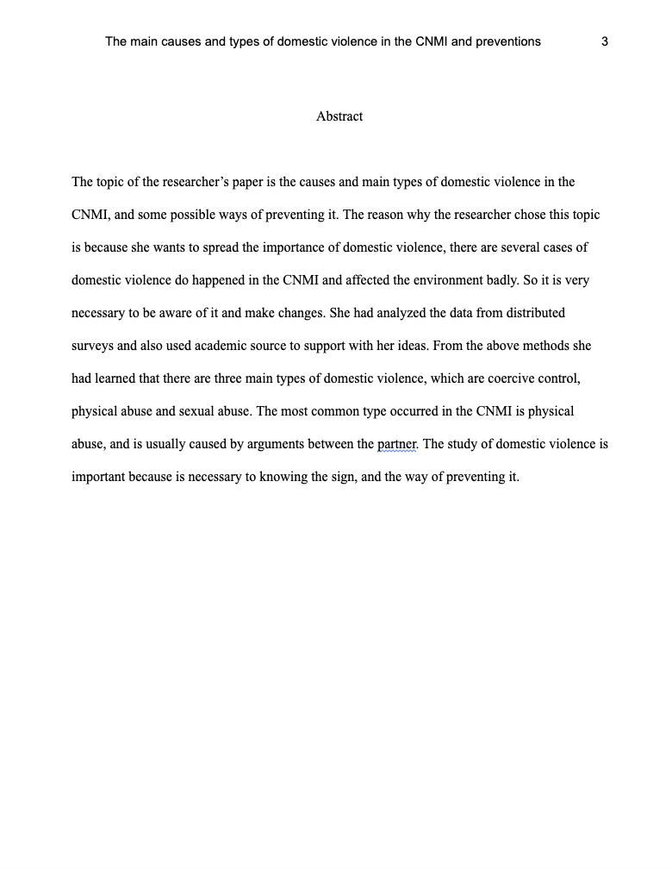
Final Research Report

Slide 13
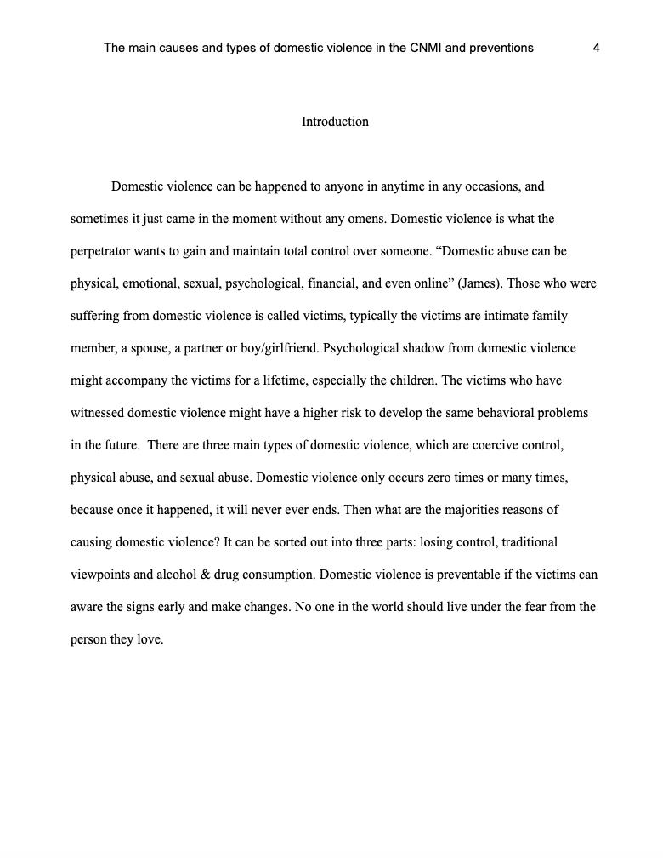
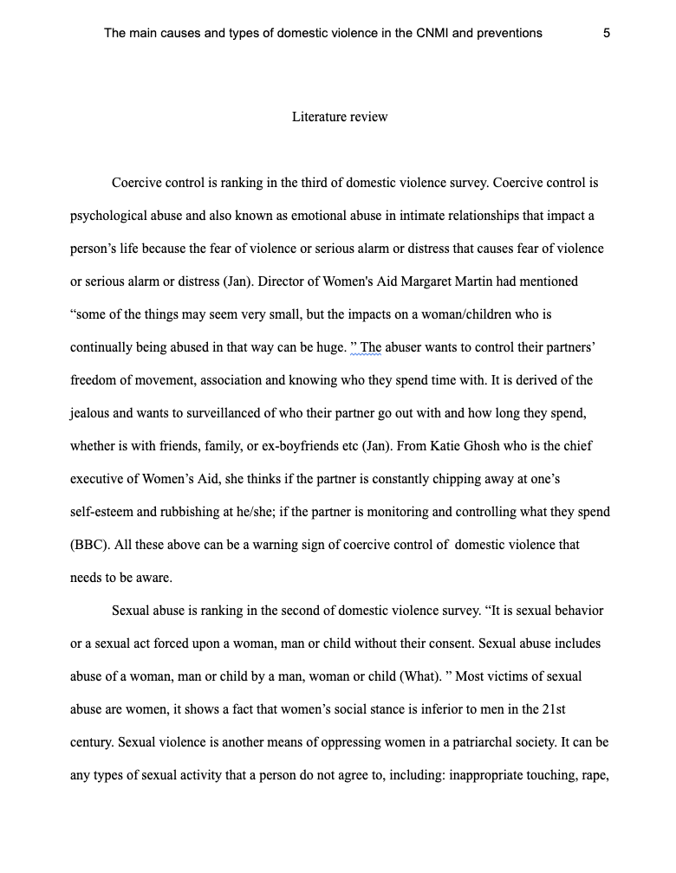
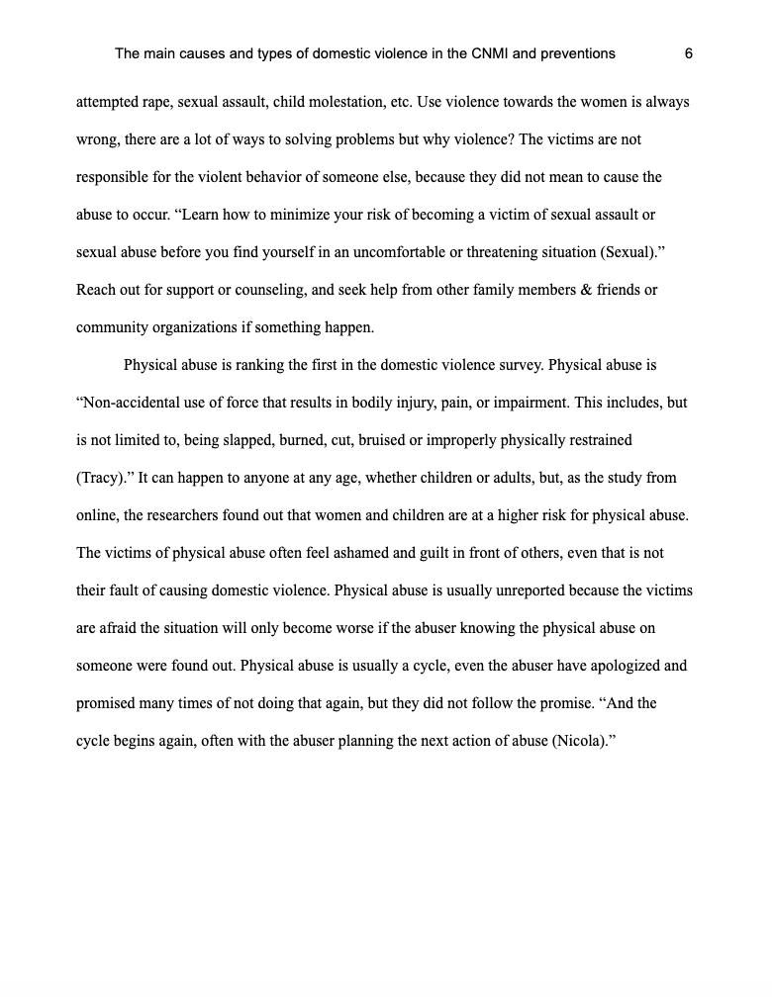
Final Research Report

Slide 14
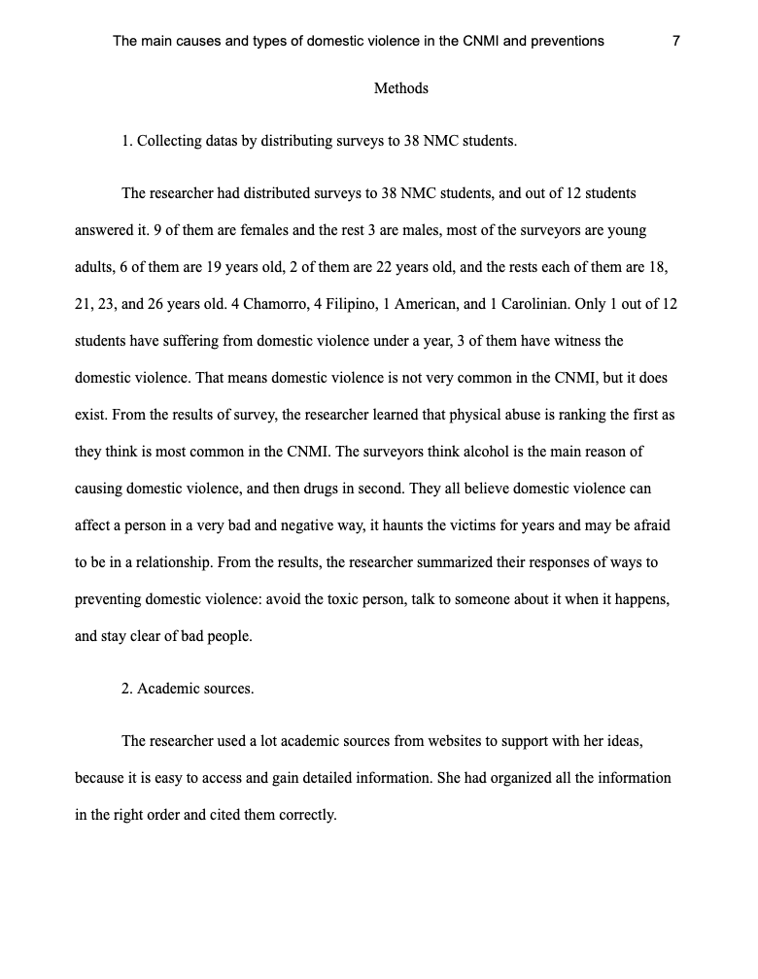
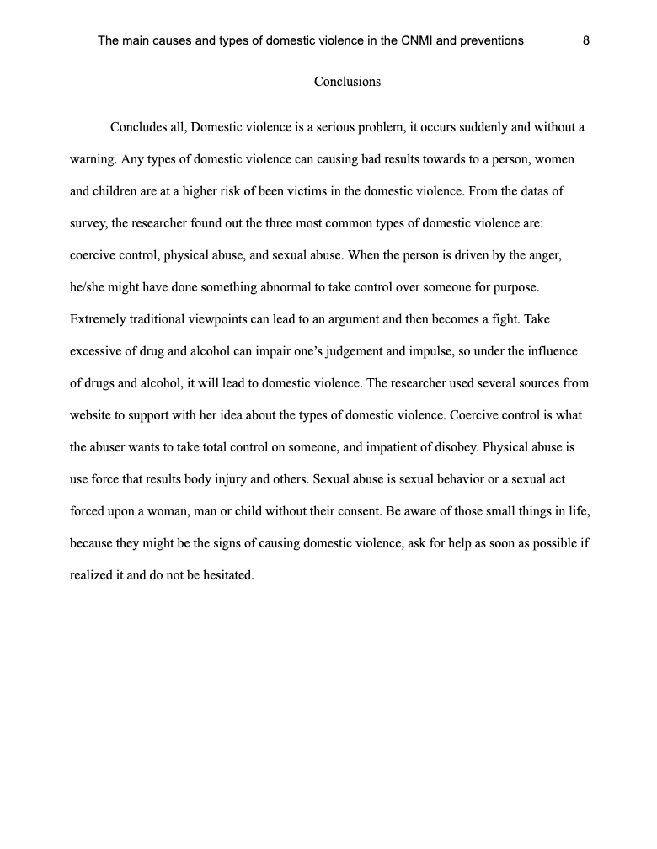
Final Research Report

Slide 15
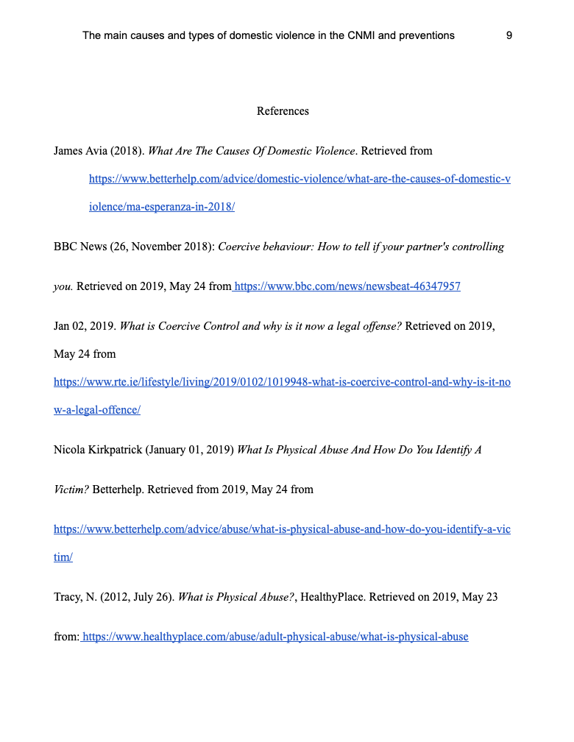
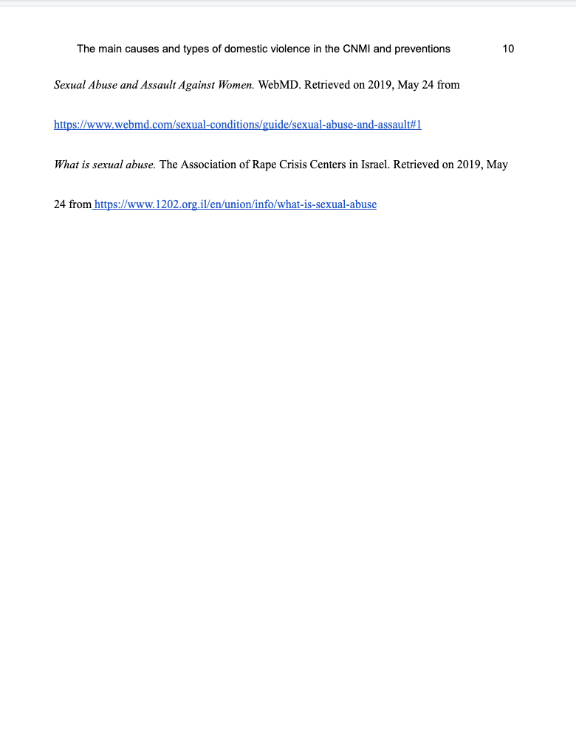
Final Research Report

Slide 16
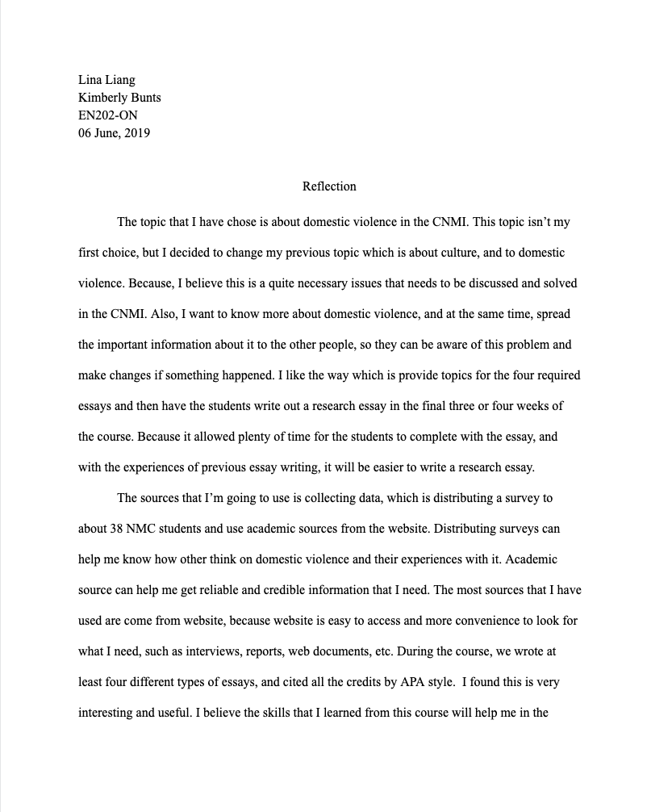
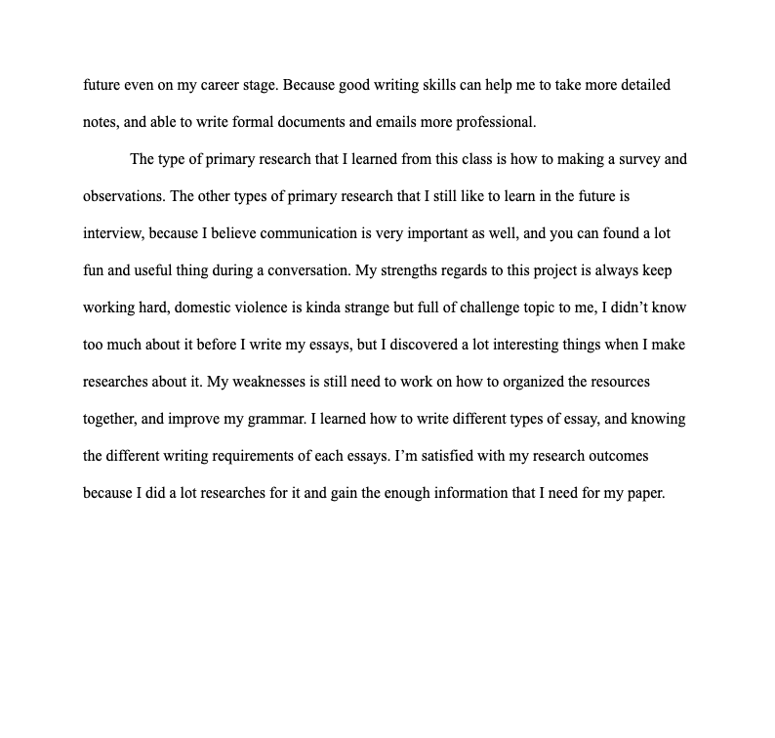
R
E
F
L
E
C
T
I
O
N

Slide 17
The End.

