Slide 1
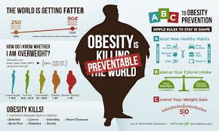
Research Results Presentation
Obesity in the CNMI
EN202 – 03
SPRING 2016
MRS. K. ANDERSON
Vaeotootoo N. Failauga, Jr.

Slide 2
Primary Research Question:
Secondary Research Question:
What are the factors, causes and consequences that reside in obesity among adults and children in the CNMI?
What are the ways to prevent or overcome obesity among adults and children?

Slide 3
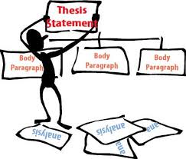
Production:
Research Topic: Obesity in the CNMI
Thesis Statement: Obesity in the CNMI needs to be addressed and prioritized for the overall quality of life for future generations to come.

Slide 4
Goal of Research:
To not only determine the number of cases of obesity in the CNMI and the influences, but also to collect suggestions & ideas on how to address the pandemic.

Slide 5
Planning:
Research & Investigation
Affiliate with group to find out about CNMI Health Background & Data Statistics
Find a Variety of Literature Review (Articles, Journals & Other Texts to include both Academic & Professional Resources

Slide 6
Methods:
Research & Investigation
Retrieved BMI Data from CNMI Public School System - William S. Reyes Elementary School
Acquired related and relevant information to answer research questions through online sources and other texts
Created and Sent Out Pilot Survey for Feedback and Recommendations

Slide 7
Methods:
Research & Investigation
Finalized Survey and Sent Out to Begin Data Collection
Survey Questions
Comprised of a Total of 12 Questions
Participants were presented with a variety of questionnaires in which some were required to be answered and a few were optional.
Survey included a series of multiple-choice options, check-all that apply types, a linear scale as well as open and closed answer responses.
Participants were required to indicate their gender as well as age group.
A Body Mass Index (BMI) Chart was also provided for participants to assess the amount of body fat they had and indicate their measurement on the list provided.

Slide 8
Methods:
Sent out randomly through e-mail and manually to start collecting data
Goal of Responses to be Collected: 100
Total Responses Collected: 70
Analyzed & Consolidated BMI Data from WSR

Slide 9
Survey Administration:
A total of 70 random participants responded on a volunteer basis.
Volunteers Consisted of Various Ethnic Backgrounds & Gender
Involved different Age Ranges between 16 years of age through 40 years and older
23 survey responses were collected through e-mail
47 surveys were given out and collected at the Saipan Marianas Fitness (Gold’s Gym).
Place of survey administration was chosen because of affiliation.
Manual Survey responses were then inputted into the online survey for overall data consolidation

Slide 10
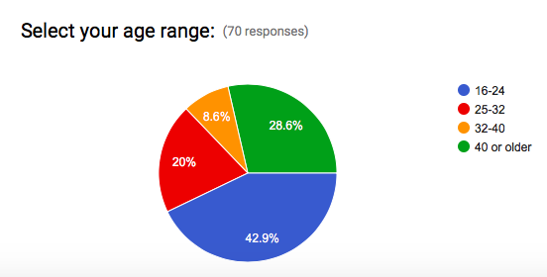
Survey Questionnaires & Results:

Slide 11
BMI Chart Presented

Slide 12
Survey Questionnaires & Results:

Slide 13
Survey Questionnaires & Results:

Slide 14
Survey Questionnaires & Results:

Slide 15
Survey Questionnaires & Results:

Slide 16
Survey Questionnaires & Results:

Slide 17
Survey Questionnaires & Results:

Slide 18
Survey Questionnaires & Results:

Slide 19
Survey Questionnaires & Results:

Slide 20
Survey Questionnaires & Results:

Slide 21
Survey Questionnaires & Results:

Slide 22
Survey Questionnaires & Results:

Slide 23
Survey Questionnaires & Results:

Slide 24
Survey Success:
Many of the questions presented were relevant and successful towards reaching the research goals and answering the research questions as many of the survey responses as well as the literature reviews could be used to justify both the primary and secondary research questions.
There were many patterns and evidence that pointed out that the primary influences of obesity due to lifestyle choices occurs not only in the CNMI, but also globally.

Slide 25
Survey Improvements:
However, if time persisted, a more in-depth study and research could be conducted to find out the precise numbers of cases and causes of obesity for the overall CNMI and possibly the Pacific Islands in general.
More affiliations should be established as to conduct further studies and more updated data and statistics.

Slide 26
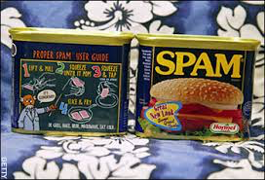
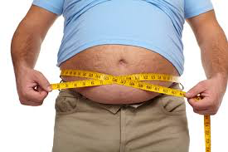
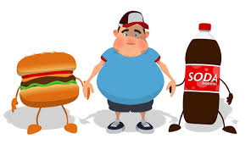
OVERALL:
REFLECTION:
Because of this learning experience, I have since realized that my vocabulary has expanded, my typing of words per minute has increased and although, I find the APA formatting quite interesting, it is still quite confusing to master. Also, I have yet to finally conquer obesity in my life as well. Let’s MOVE CNMI!

