Slide 1
Presentation 2 “My results” “To what extent does the media and society affect our perception on body image?”
Evangeline Challberg Babauta
EN101//Bunts

Slide 2
Main Research Question
“To what extent does the media and society affect our perception on body image?”
I feel that my topic discussion question is sufficient because it still covers the overall general debate on media affecting body imagine, but also isn't too broad.
Secondary research questions:
Does media influence girls more than boys on body image?
How has society affected society’s opinion on body image gradually throughout the years?

Slide 3
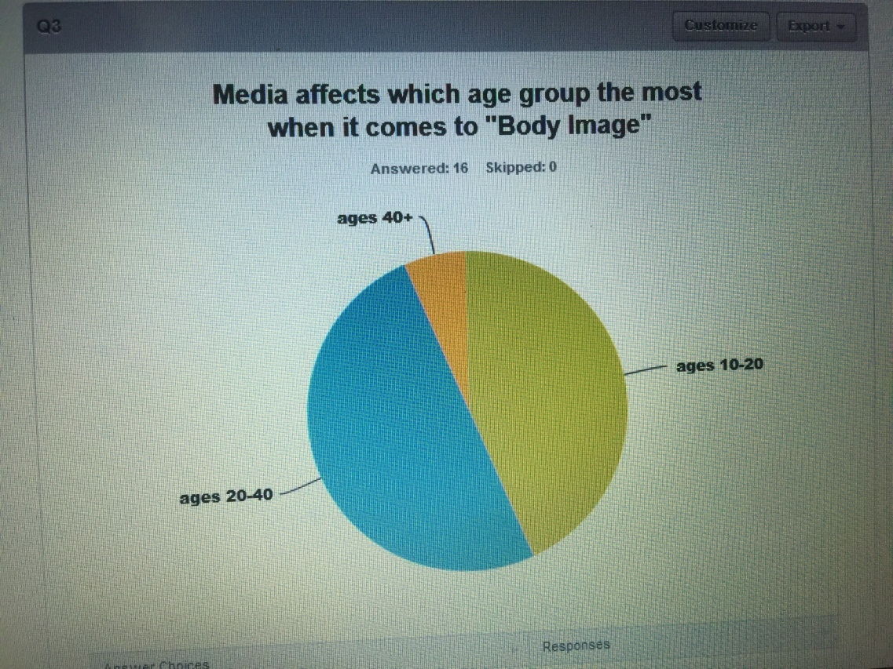
My results
Through survey monkey- I had 18 respondents.
My predictions of opinions came out to be very similar

Slide 4
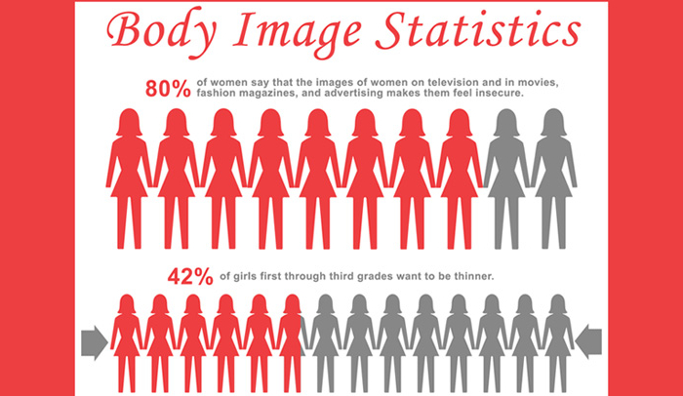
Your statistics ARe your research credibility!
I interviewed 2 students and 2 parents. Its good to make sure your audience is an even 50% for best and accurate results. (2 males, 2 females, I of each older and younger etc.)

Slide 5
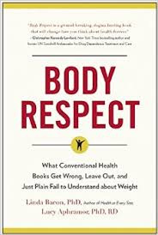
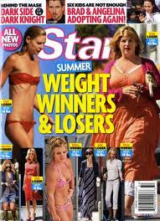
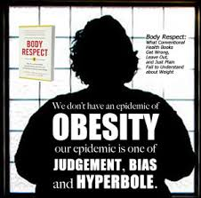
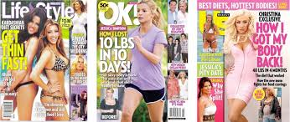
My sources
My resources are endless
Online references, I emailed 2 experts and checked out the book (on the left)

Slide 6
Things I considered when I conducted research…
Staying neutral to the topic, and not exposing bias opinions
Finding credible sources
Using a variety of sources including literature, statistics, and online resources
WHY THIS TOPIC?
I believe that in today’s culture, we are quick to point fingers at the media for influencing what is, and is not considered beautiful. I do have personal ties to this topic, however, I am genuinely seeking answers to see if the media and magazines were filtered- would there be a significant decrease in linking eating disorders, and body confidence.

Slide 7
Most helpful sources
I’ve found valuable information from online PDF’s submitted by other researcher students from universities.
I’ve read “Body Respect” the novel to gain more statistical numbers on percentages and growth. (non fiction book)
I located several online articles of magazines and websites discussing this topic

Slide 8
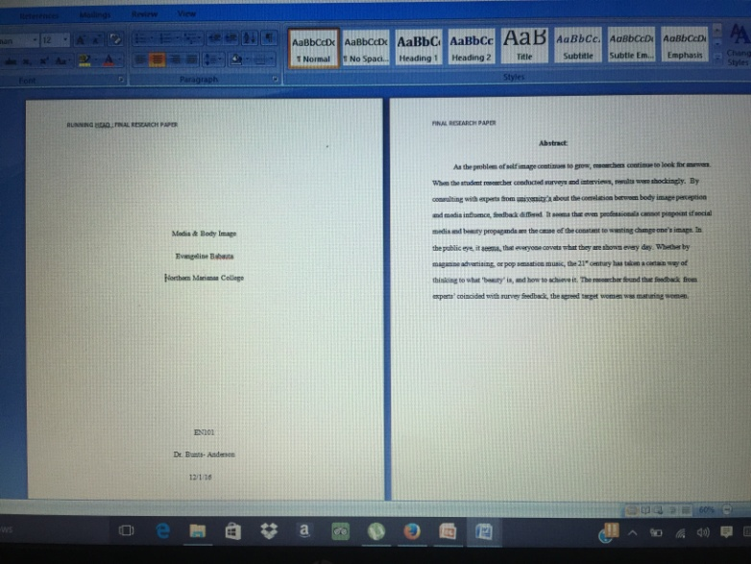
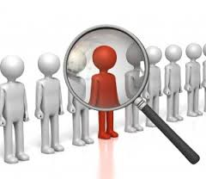
Concluding results
My primary and secondary questions were answered.
My hypothesis was proven accurate
After gathering all of my results I could piece together my analysis by the process of “Likely grouping” and created my research paper!

Slide 9
Bibliography:
http://scholarship.claremont.edu/cgi/viewcontent.cgi?article=1749&context=cmc_theses
http://pocketcultures.com/2013/08/20/the-influence-of-body-image-in-our-society/
“Body Respect” By Linda Bacon
http://livelifegetactive.com/blog/body-image-self-esteem/

