Slide 1
Results
Tyra Santos

Slide 2
Questions
Can social media alter the cultural identity of Saipan people?
In what ways can social media change the mentality of people?
Can social media change a person’s lifestyle?

Slide 3
Methods
Online survey (sent by email)
Purpose: to collect general data
40 people
Interviews
Purpose: to ask open-ended questions about social media experience and perspective
10 people
Experiment
Purpose: to observe any changes in mindset from being on social media to off social media

Slide 4
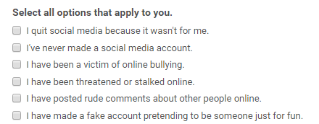
Successful data methods
Poll: setting up the questions in a way that they can check off the box if they relate
Poll: setting up a scale for people to rate themselves
Experiment: writing down the differences in mindset from when on social media and when off social media

Slide 5
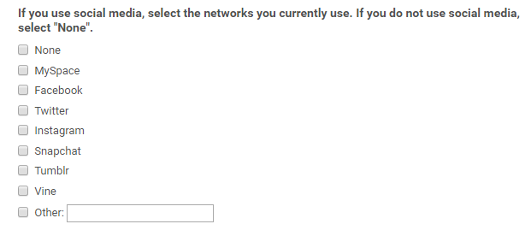
Unsuccessful data methods
Poll: asking what networks people are on
Useless question
Doesn’t help provide further info

Slide 6
Results

Slide 7
Results

Slide 9
Analysis
Social media users:
More likely to judge others and get into people’s business based on their online environment
More concerned with their image online
More susceptible to change their mindset due to trends, slang, popular opinions
Non-social media users:
More focused on self, but still tend to be judgmental toward others
Less likely to compare themselves to others
More in tact with who they really are as opposed to social media users

Slide 10
Answers
Can social media alter the cultural identity of Saipan people? Yes.
In what ways can social media change the mentality of people? A social media user’s mindset can easily be influenced by the lives of others, people’s opinions, slang, and trends.
Can social media change a person’s lifestyle? Yes. Social media can change the way a person dresses, talks, acts, and thinks.

Slide 11
Suggestions
To anyone interested in conducting social media research, it is best to ask people through a poll and use the checkbox method I used.
It is also a good idea to hold interviews to get further information and varied answers.

Slide 12
What I learned
Regarding the topic:
I should have picked an easier topic
There is not a lot of literature published on social media’s effects
Regarding the research:
The report relied heavily on primary research
The social networks people use do not matter

Slide 13
What I would do differently
I would conduct more data from interviews rather than polls because of the open-ended answers I would receive.

Slide 14
What I would like to learn more about
If there was a way for social media to not change a person
Removing the like button
Removing the number of followers

Slide 15
Skills to work on:
Coming up with stronger questions
Arranging a realistic schedule to follow
Skills I improved on:
Analyzing data to come up with a conclusion
Breaking up a big project into little sections to get work done easily

