Slide 1
Saipan’s Water quality
People’s opinion
Jua Son
Northern Marianas Islands
En 202 Sec 01
Dr. Kimberly Bunts-Anderson

Slide 2
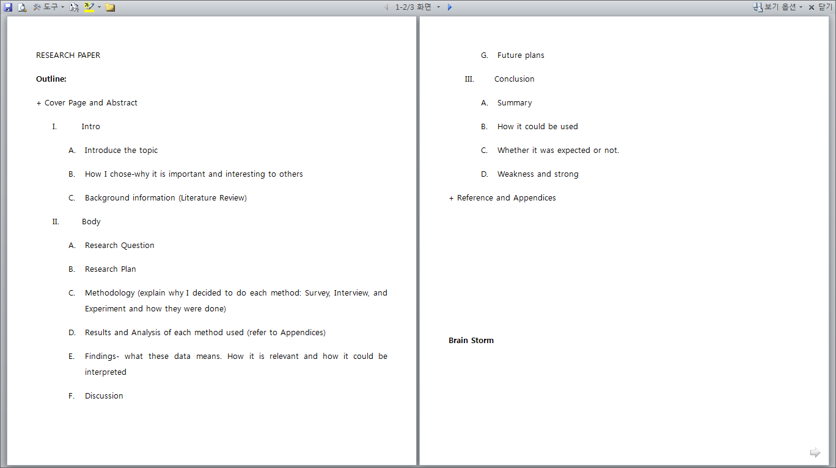
Brainstorm
Outline

Slide 3
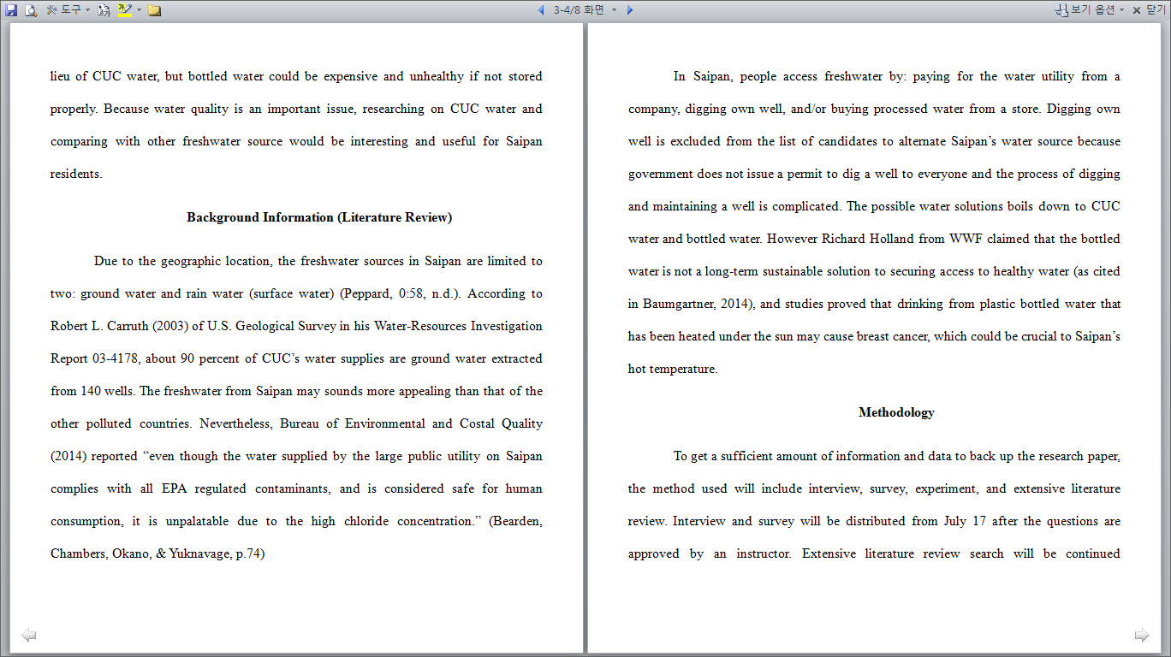
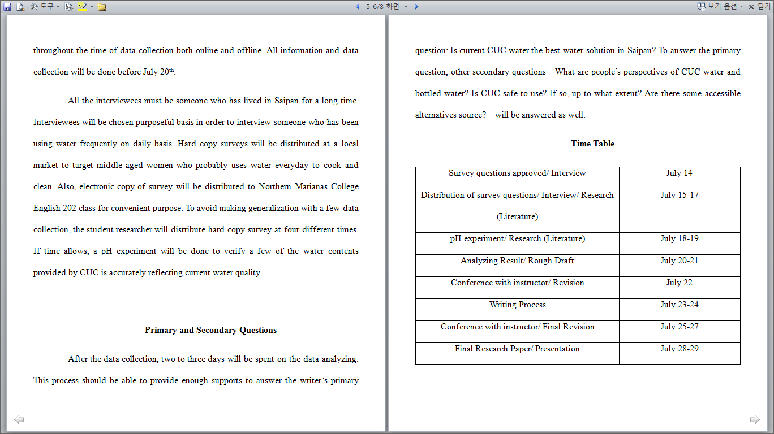
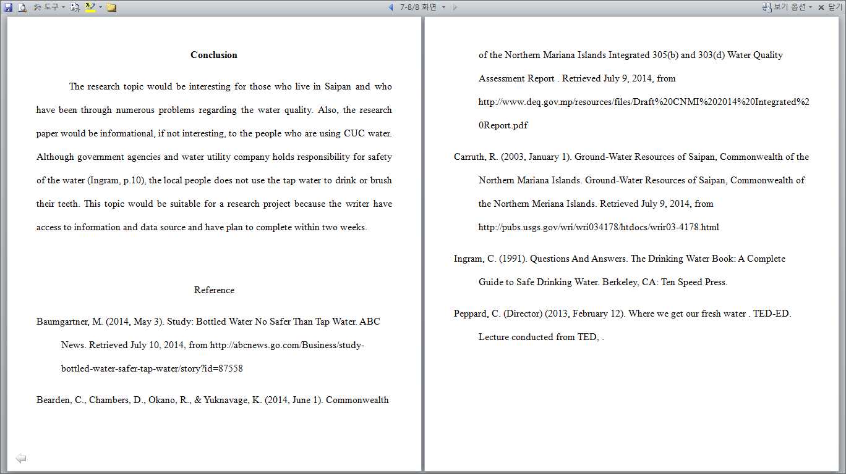
Research Proposal

Slide 4
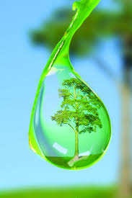
Why I chose this topic:
Water is an important matter
I have been using it everyday (experience)
Thought it would be informative and beneficial to everyone

Slide 5
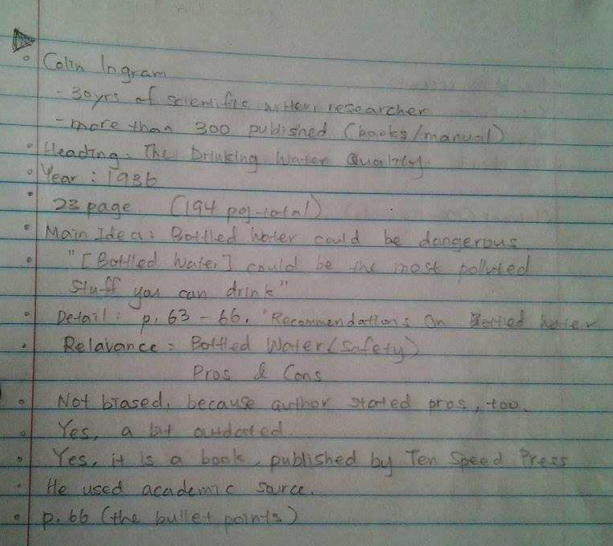
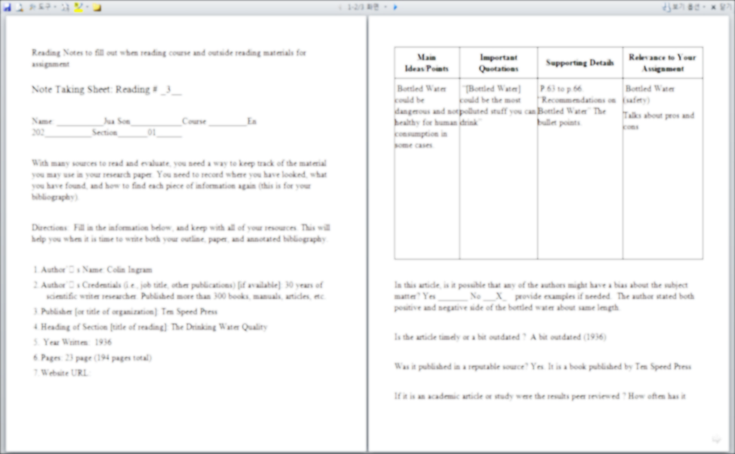
Reading Notes
The Drinking Water Quality by Colin Ingram
Water Quality 2014 by Bureau of Environmental and Coastal Quality
2013 Water Report by Commonwealth Utility Corporation

Slide 6
References
Article
Study
Article
Book
Video
Study
Baumgartner, M. (2014, May 3). Study: Bottled Water No Safer Than Tap Water. ABC News. Retrieved July 10, 2014, from http://abcnews.go.com/Business/study-bottled-water-safer-tap-water/story?id=87558
Bearden, C., Chambers, D., Okano, R., & Yuknavage, K. (2014, June 1). Commonwealth of the Northern Mariana Islands Integrated 305(b) and 303(d) Water Quality Assessment Report . Retrieved July 9, 2014, from http://www.deq.gov.mp/resources/files/Draft%20CNMI%202014%20Integrated%20Report.pdf
Carruth, R. (2003, January 1). Ground-Water Resources of Saipan, Commonwealth of the Northern Mariana Islands. Ground-Water Resources of Saipan, Commonwealth of the Northern Meriana Islands. Retrieved July 9, 2014, from http://pubs.usgs.gov/wri/wri034178/htdocs/wrir03-4178.html
Ingram, C. (1991). Questions And Answers. The Drinking Water Book: A Complete Guide to Safe Drinking Water. Berkeley, CA: Ten Speed Press.
Peppard, C. (Director) (2013, February 12). Where we get our fresh water . TED-ED. Lecture conducted from TED.
Commonwealth Utility Coporation. (2014, July). Commonwelath Utility News (2013 Water Quality Report). Retrieved from http://www.cucgov.org/wp-content/uploads/2014/06/CCR-2013.pdf

Slide 7
Primary and secondary Questions
Should CUC improve their water quality?
Are the residents of Saipan satisfied with the quality of CUC water?
What do people mostly use the CUC water for and is it safe?
How does the resident feel about the quality of other alternative sources?

Slide 8
Methodology
Survey
Made using Surveymonkey
Distributed manually at: Blue Sky Market and Joeten Kiyu Library
Distributed electronically to: Northern Marianas College Summer English 202 Class
Interview
Formally for the first 15 minutes and informally for the last 25 minutes.
Experiment
Tested pH, Chlorine, Alkaline, and Stabilizer level using AquaChek.
Followed the procedure written on AquaChek.

Slide 9
Schedule
few changes
To-do list | Initial Plan | 1st Revision | Final Plan
Survey questions approved/ Interview | July 14 | July 16 | July 16
Distribution of survey questions/ Interview/ Research (Literature) | July 15-17 | July 17-21 | July 17-21, July 23 (in class)
pH experiment/ Research (Literature) | July 18-19 | - | July 24-25
Analyzing Result/ Rough Draft | July 20-21 | July 21-23 | July 21-25
Conference with instructor/ Revision | July 22 | - | -
Writing Process | July 23-24 | July 24 | July 25-27
Conference with instructor/ Final Revision | July 25-27 | July 25-27 | July 28
Final Research Paper/ Presentation | July 28-29 | July 28-29 | July 29

Slide 10
Survey Questions
1. [Demographics] Age, Gender, Nationality, Village
2. Do you use CUC water? If not, what alternative water source do you use?
3. Are you satisfied with CUC water quality? (1-unsatisfied, 5-very satisfied):
4. Have you been to another place other than Saipan? If so, where?
5. What do you think about Saipan's water quality compared to that of the other places? (1-worse, 5-better):
6. Do you purchase any type of water bottles? (Size/brand/country)
7. If so, name three activities you use the bottled water:
8. Do you use CUC water on the following activities? (circle)
laundry cook wash dishes shower drink brush teeth
9. How safe do you feel about bottled water in Saipan? Why?
How safe do you feel about tap water in Saipan? Why?
10. Any comments?

Slide 11
Results-Survey
Village:
A | Aslito
F | Finasisu
SA | San Antonio
K | Koblerville
CK | Chalan Kanoa
T | Tanapag
KT | Kannat Tabla
S | Susupe
D | Dandan
SR | San Roque
SV | San Vicente
KG | Kagman III
G | Garapan
Location | Blue Sky Market (9) |  |  |  |  |  |  |  |  | Avg
age | 29 | 32 | 43 | 18 | 31 | 47 | 14 | 33 | 37 | 31.6
gender | F | F | M | F | F | F | F | F | M | 7;2
nationality | F | F | K | US | C | K | F-Ch | Ch | F
village | K | A | SA | ST | CK | SA | SA | T | T
water source | C | C | C | C | C/R | C | C | C | C
satisfaction | 2 | 3 | 1 | 3 | 2 | 1 | 4 | 3 | 2 | 2.33
other place | N | P | K | Gu/PI | C | K | Y | N | F
comparison |  | 4 | 1 | 3 | 2 | 1 | 4 |  | 2 | 1.89
bottled water | Sp | Sp |  | Y | Seo | Seo | Sp | Sp | Sp
size | 5gal |  |  |  | 1L |  | 5gal
country | S | S |  | S | K | K | S | S | S
use of bottled water |  |  | recycle | drink | Brush teeth |  | drink
use of bottled water |  |  |  | shower | drink |  | cook
use of bottled water |  |  |  |  | wash vegetables |  | laundry
use of CUC water:
laundry | Y | Y |  | Y | Y | Y | Y | Y | Y | 8
cook |  |  |  | Y |  |  | Y | Y | Y | 4
wash dishes | Y | Y | Y | Y | Y | Y | Y | Y | Y | 9
shower | Y | Y | Y | Y | Y | Y | Y | Y | Y | 9
drink |  |  |  |  |  |  |  |  |  | 0
brush teeth |  | Y |  | Y |  |  | Y | Y | Y | 5
Country/Nationality
Ca | Caucasian
C | Chinese
Ch | Chamorro
K | Korean
F | Fillipino
S | Saipan
Gu | Guam
J | Japan
Au | Austrailia

Slide 12
Location | Joeten Kiyu Library (5) |  |  |  |  | Avg
age | 18 | 64 | 15 | 15 | 16 | 25.6
gender | F | F | M | M | F | 3;2
nationality | C | Ch | F | K | F
village | A | A | F | SA | K
water source | C | C | C | C/R | C
satisfaction | 1 | 1 | 4 | 3 | 3 | 2.4
other place | Gu | Tu/Or | Gu/PI | K | Gu
comparison | 2 | 2 | 3 | 1 | 3 | 2.2
bottled water | Icis | Sp | Star | Sp | Sp
size | 500ml |  | 5gal |  | 5gal
country | K | S | S | S | S
use of bottled water | drink | Rice | Sports | Sports | drink
use of bottled water | cook | coffee | eat | Recycle | laundry
use of bottled water |  | soup | cook | art | cook
use of CUC water:
laundry | Y | Y | Y |  | Y | 4
cook |  |  |  |  | Y | 1
wash dishes | Y | Y | Y |  | Y | 4
shower | Y | Y | Y | Y | Y | 5
drink |  |  |  |  |  | 0
brush teeth |  |  | Y |  | Y | 2

Slide 13
Location | Online- Summer English 202 Sec 1 (7) |  |  |  |  |  |  | avg.
age | 21 | 20 | 20 | 19 | 20 | 40 | 26 | 23.71
gender | M | F | F | F | F | F | F | 6:1
nationality | F | US | US | Ch | F/Ch | Ca | US
village | KT | S | D | SR | SV | KG | G
water source | C | C | C | C | C | bottled water | C
satisfaction | unsatisfied-1 average-6 |  |  |  |  |  |  | 2.857
other place |  | F, Au, J, Gu | US |  |  |  | Gu
comparison | worse-4 similar-2 better-1 |  |  |  |  |  |  | 2.143
bottled water | Saipan Ice | Seoksu, etc | Star Water |  |  | Star Marianas | Saipan Water
size | 5 gal | 500ml/5gal | 5 gal | 5 gal | 1 gal | 5 gal | 5 gal
country | S | S/K | S | S | S | S | S
use of bottled water | drink | drinking | drink | drinking | drinking | drinking | drinking
use of bottled water | cook | cooking | cook | cooking | cooking | cooking | cooking
use of bottled water | wash |  | brush teeth | turtle water |  |  | baking
use of CUC water:
laundry | Y |  |  | Y |  | Y | Y | 4
cook |  |  |  |  |  |  |  | 0
wash dishes |  |  |  |  |  | Y | Y | 2
shower | Y |  |  |  | Y | Y | Y | 4
drink |  |  | Y |  |  |  |  | 1
brush teeth |  |  |  |  |  | Y | Y | 2

Slide 14
Comments:
Survey comments on CUC water quality:
sucks for my hair
not safe
Not safe. friend of mom got sent to hospital for drinking the CUC water.
Not safe, so dirty
not so good, taste okay
It is not safe
No it's not safe
Safe enough to brush teeth with, but not to drink from.
not very safe to drink/cook
not so safe, specially for sensitive people
Not safe enough to consume
Average
It is safe enough to use for shower but not for dinking
I don't feel it is very safe
It really does not taste fresh and I think it is a health hazard if we do drink from it.
there are some chemicals in the water
even if they say its clean i still think that there is probably too much chlorine in it
Not sanitary
Not that dirty
Too much chlorine.
Because of the color and the taste.
Survey comments on bottled water quality:
safe-everybody drink it no negative side effect!!!!
good. safe enough
Safe, safer than CUC's water quality.
safe
I think it’s pretty safe
I think it’s safe enough to consume
Clean
Safe enough.
Very Safe.
For instance, Saipan Ice Water is Fluoridated water that is, not only fresh and safe enough, it is good for our teeth.
it is better filtered and processed
if it wasn’t then it should not be allowed to be distributed as drinking water
It tastes pure
drinkable
I haven't heard of anyone getting sick or dying from the bottled water. lol
I feel confident the businesses sterilize the bottles properly

Slide 15
Result-Interview
Interviewee A
Chamorro
64 years old
Live in Tanapag
Interviewee B
Korean
47 years old
Live in San Antonio

Slide 16
Interviews
“Tell me how you think about the CUC water and Bottled water.
"I think CUC water is only good for washing, because [I] experience strong smell of chlorine. The bottle water is good, because being sterilized and have fluoride in it." "My brother's cousin is working at CUC and I think he told me about the chemicals."
"I never used CUC water when I cook certain things like soup and rice.” Why? “Because it's for my family."
"CUC water quality is okay when it is not used for cooking"
But some surveyees said the water is safe and they also use it for cooking and to brush their teeth:
"Even if the CUC officials says it is safe, it is hard to believe because of strong odor. "
"It's their choice. But if I were they, I wouldn't be doing that"
Do you think CUC should improve water quality?
"I would definitely love if they improve the water quality"
[Survey question number 8] You did not check for cooking, drinking, and brushing teeth. Why?
"Because CUC water is unsafe-so many people have kidney problems.”
How did you know that?
"When I came to Saipan, one local told me to not drink the CUC water because many people who have been constantly drinking the CUC water were having vital organ problems-especially kidney. Since then, I don't use CUC water to cook."
You’ll be using a lot of bottled water then.
"When I have to use a lot of water, for example wash vegetables, I always rinse them with bottled water after washing it with the CUC water."
“[CUC] need to invest for pure water and civil safety."
"It's never wrong to be over safe about these kinds of things"

Slide 17
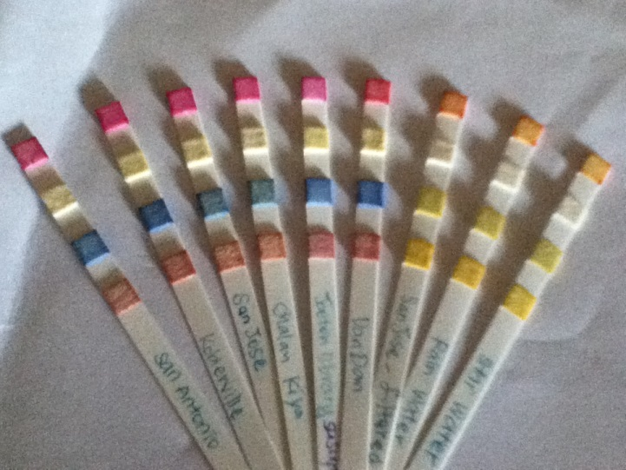
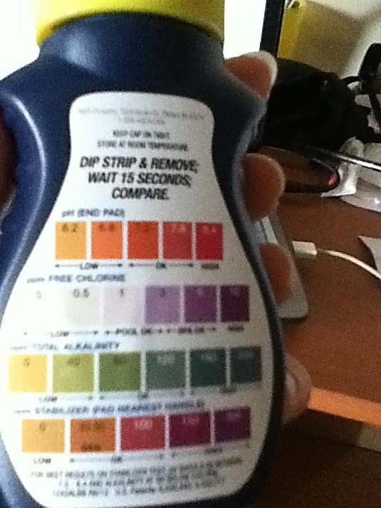
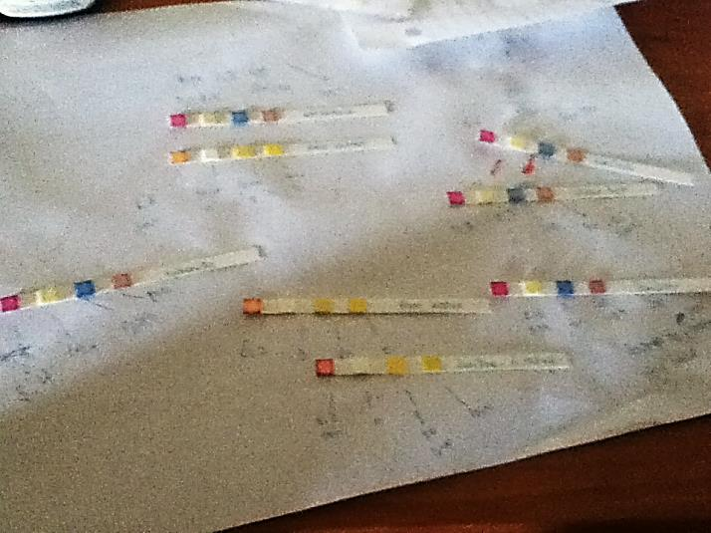
Result-Experiment
pH
Chlorine
Alkaline
AquaCheck
Hach Company, USA
Stabilizer

Slide 18
Result-Experiment
*Rain water result did not differ much from Star water’s and San Jose’s Filtered water’s result.
*CUC waters’ pH and Alkalinity levels were direct opposite/showed huge gap with Star water’s and Filtered water’s.

Slide 19
Summary/Conclusion
Overall, majority of people were not satisfied with the quality of CUC water because of high Chlorine level, white substances remaining after washing dishes, and unknown health risk. However, most of their Chlorine argument was not well-supported when asked to provide its source. Because of these concerns and inconveniences, bottled waters are used for certain daily tasks which varied from surveyees to surveyees. Surveyees reported that bottled water is “good” and “safe,” but these claims were too vague and not supported as well. Although the 2013 report on municipal water quality provided by CUC stated that their water met all primary EPA standards, but people who consider tap water “unsafe” argues that people who have been drinking water got kidney problems and other health issues.

Slide 20
Reflection
Strength: Used more than one (required) methodology, so I was able to examine in many perspective
Weakness: lack of time-couldn’t go in depth with analysis for experiment

Slide 21
Improvement
Reflection (cont.)
The survey had technical difficulties and some questions were hard to understand
More data collection
More research on how pH, Alkaline, Chlorine, and Stabilizer level affects the quality of water.
Future Research:
How pH, chlorine, alkaline, and stabilizer levels affect water in relation to human

Slide 22
THANK YOU

