Slide 1
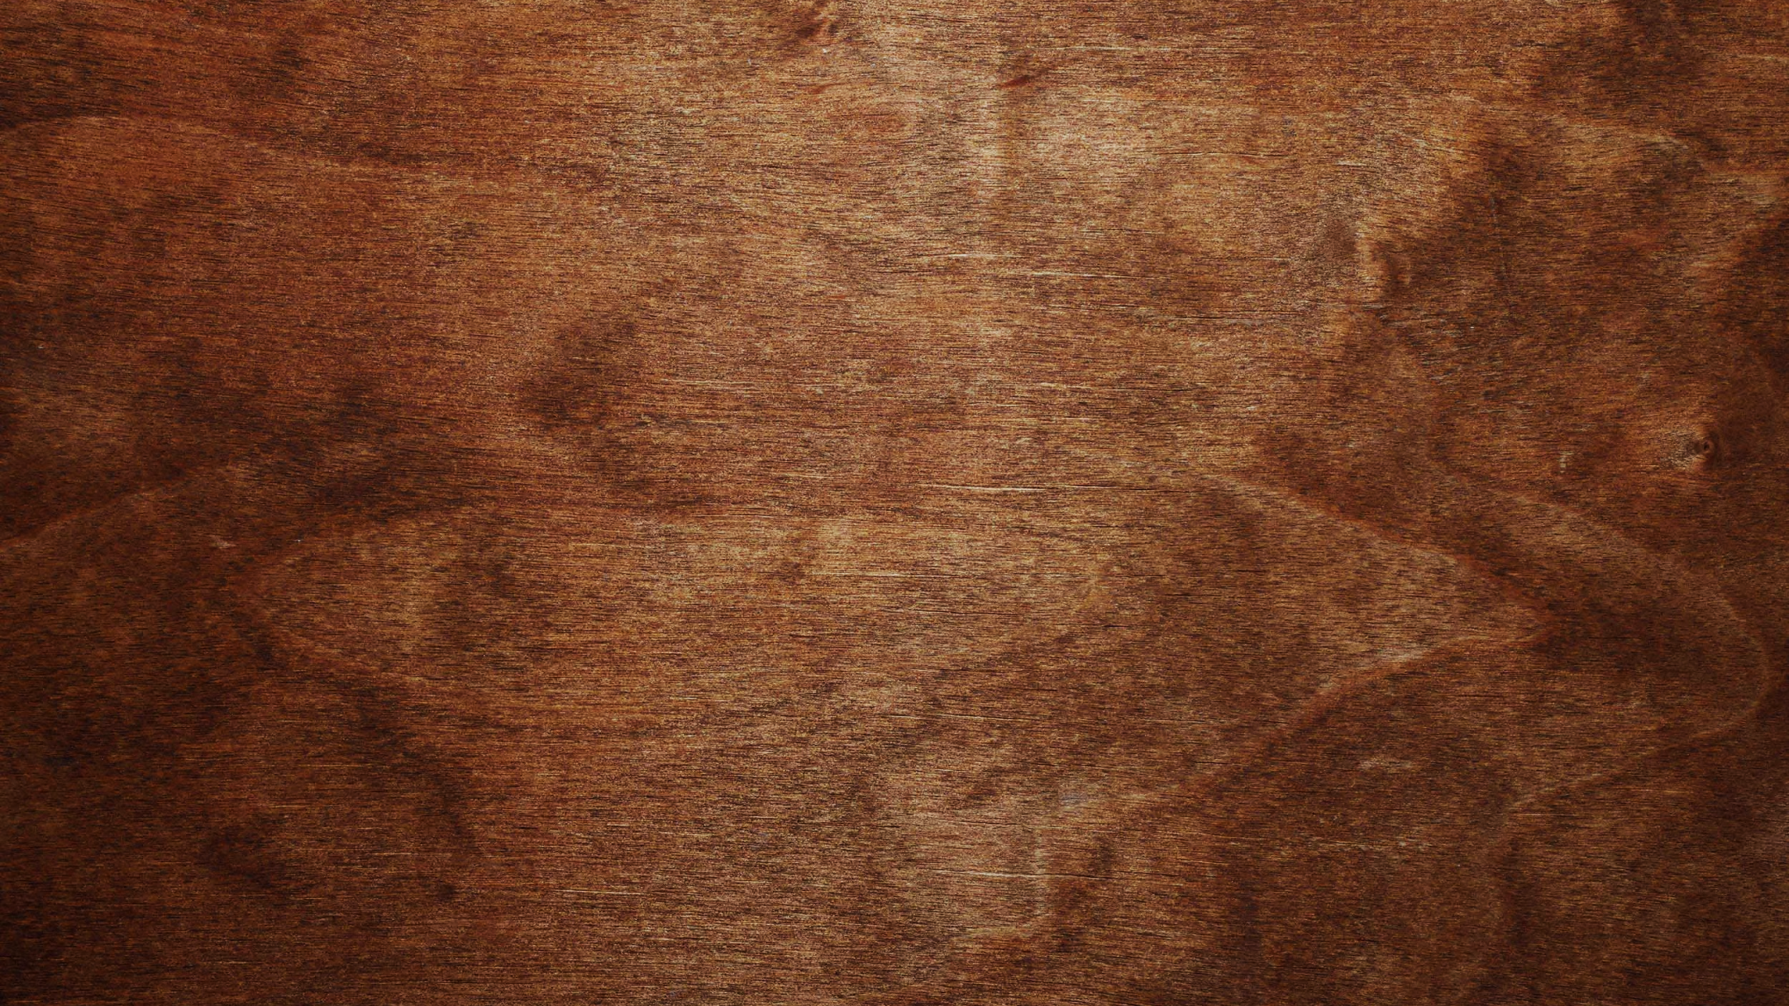
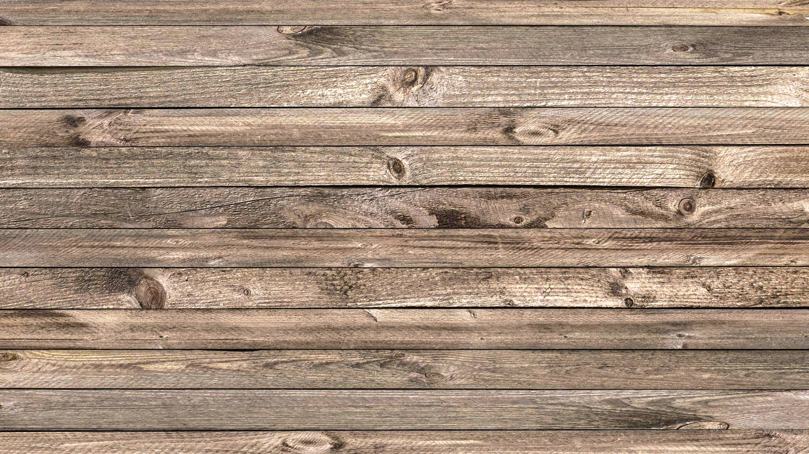
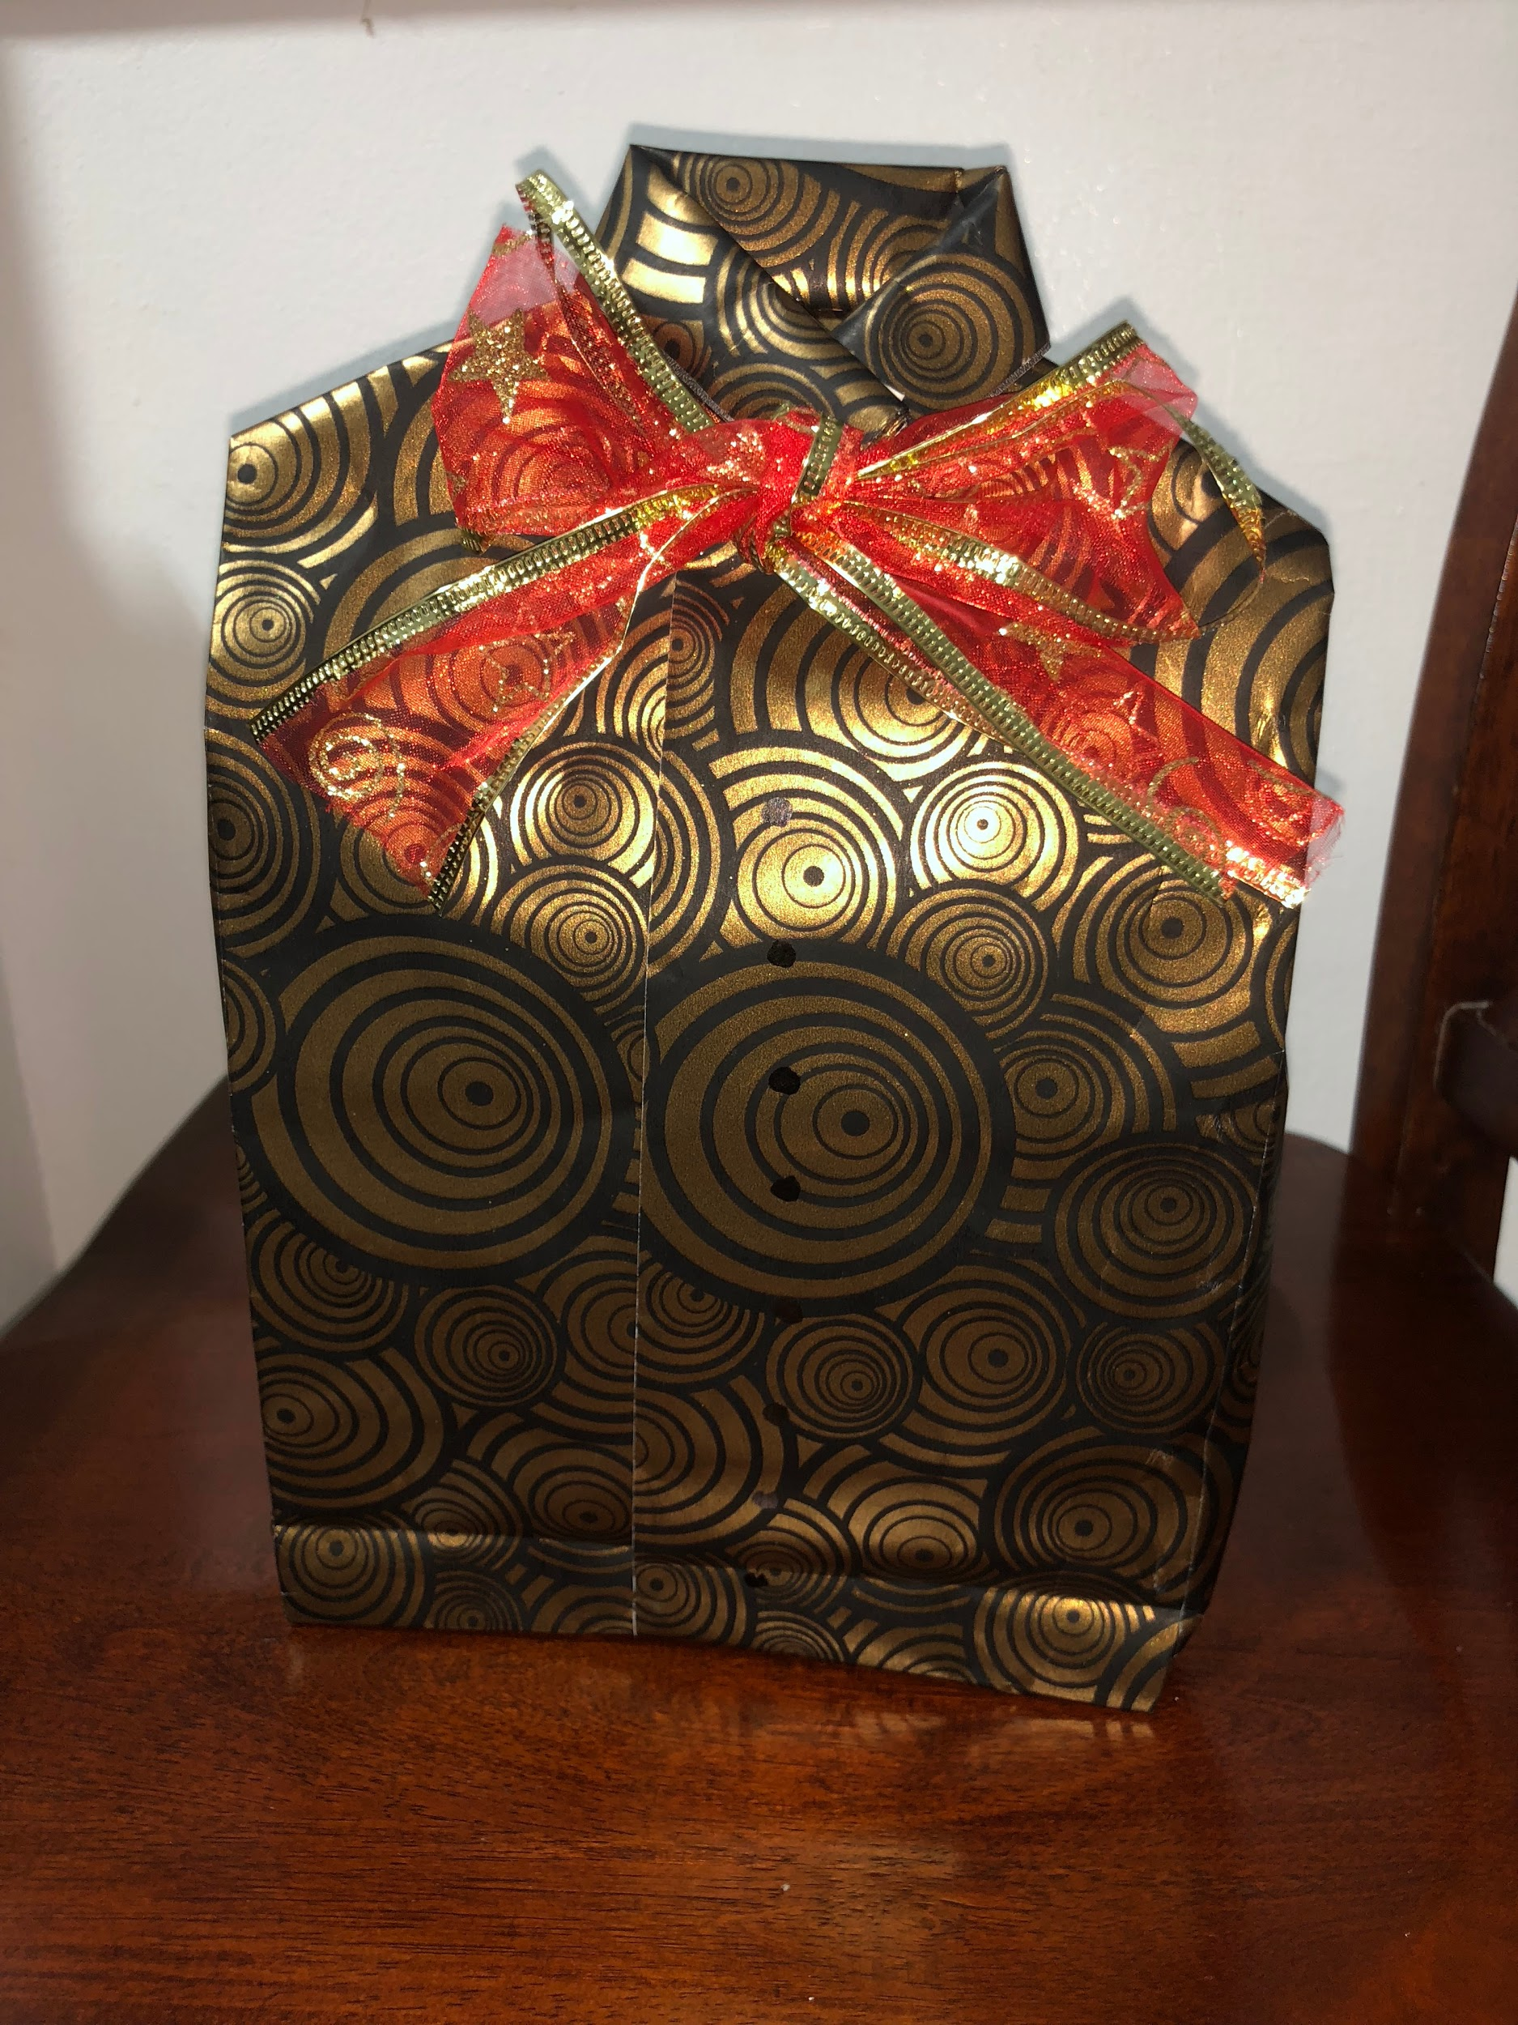
Shirt Style
Gift Wrapping

Slide 2
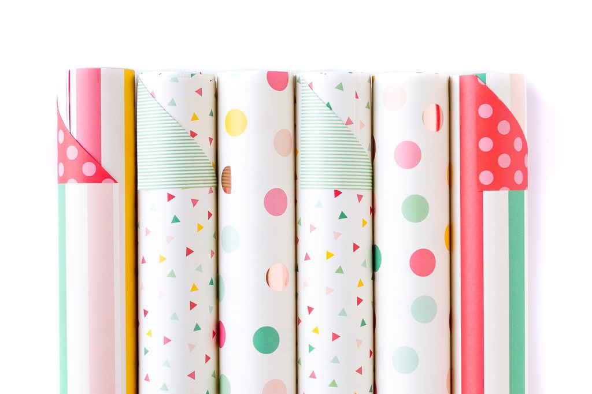
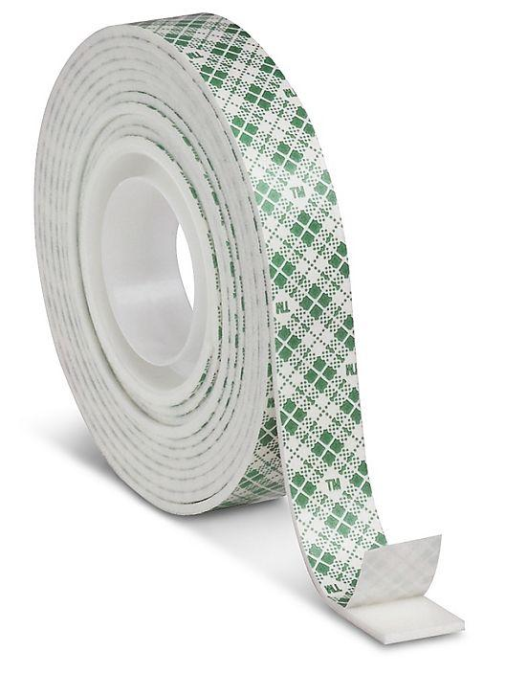
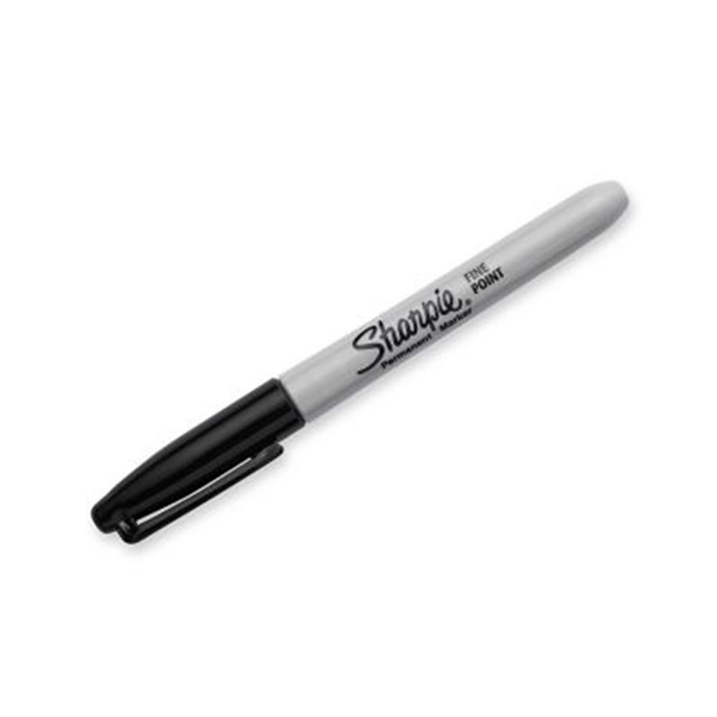
Materials

Slide 3
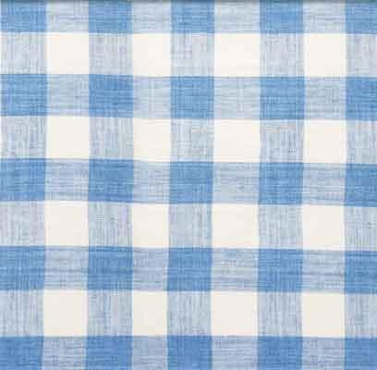
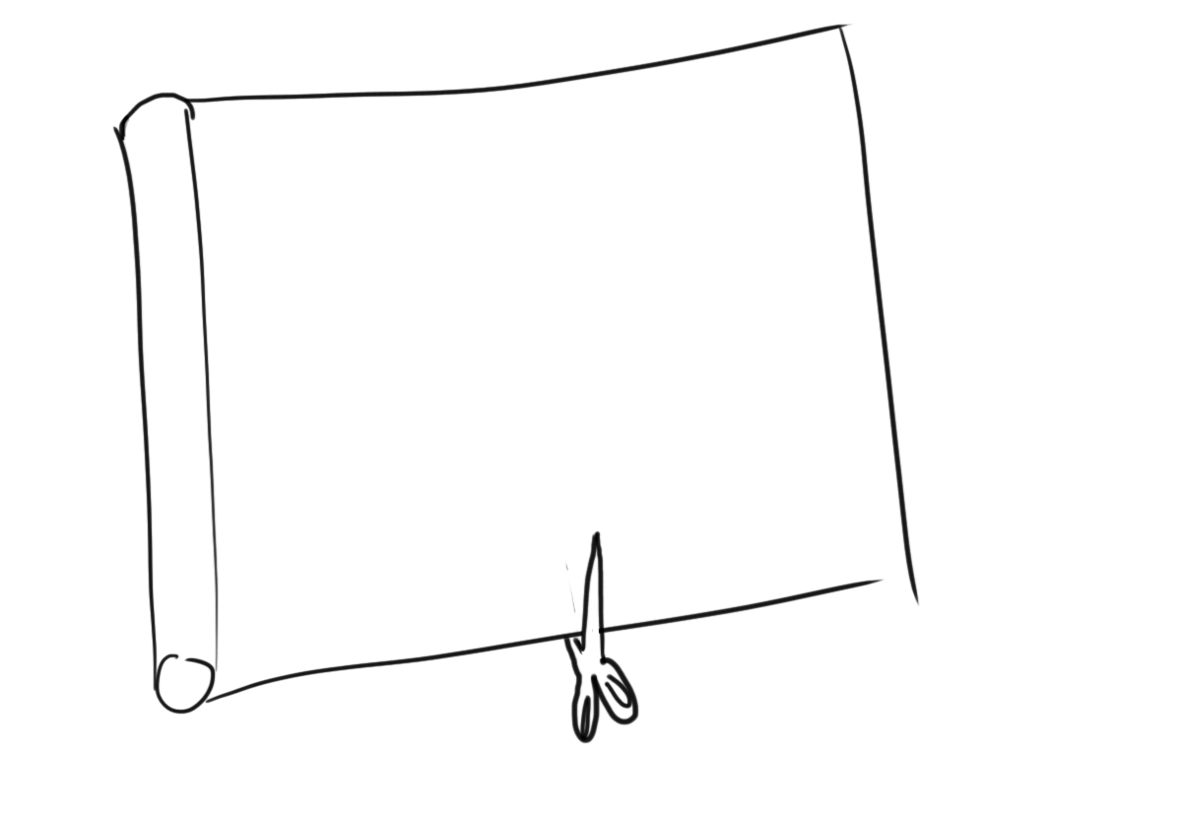
Steps
Step 1:
Get your wrapping paper and cut it to the size of your gift. Make sure you have enough at the top to create collars and shoulders.

Slide 4
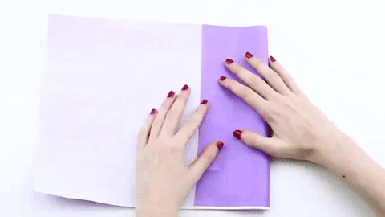
Steps
Step 2:
Fold the sides of the bag into place. Be sure to maintain the landscape orientation as you work to fold the sides.

Slide 5
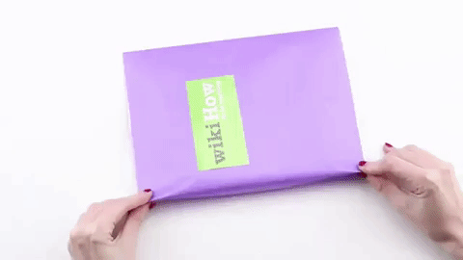
Steps
Step 3:
Fold the side-creases to create a slight accordion effect. You will make the sides of the bag so that it opens up as a rectangle.

Slide 6
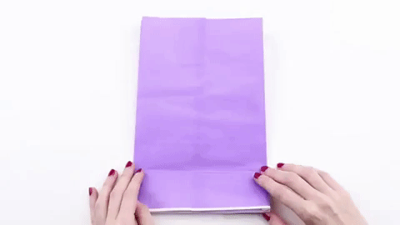
Steps
(Prepare The
Bottom of the Bag)
Step 4:
Keep the bag flattened for now and prepare the bottom:
Fold and tape the bottom of the bag into place. Once you've determined where the bottom of your bag is, piece together the bottom

Slide 7
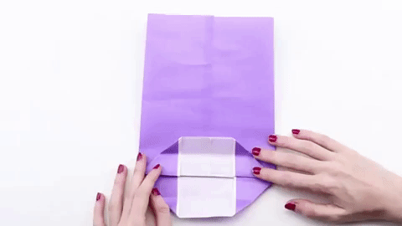
Steps
(Prepare The
Bottom of the Bag)
Step 5:
Piece together the bottom of the bag. You will be folding a few sides to the center, using their triangular shape to ensure the bottom of the bag is evenly put together.

Slide 8
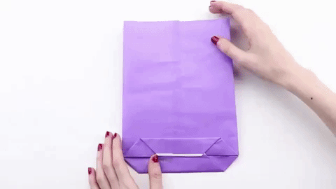
Steps
(Now the top)
Step 6 & 7:
Put the gift inside the bag, then fold twice to the front.
Insert the ribbon, and fold twice again to the front then tape the last fold.

Slide 9
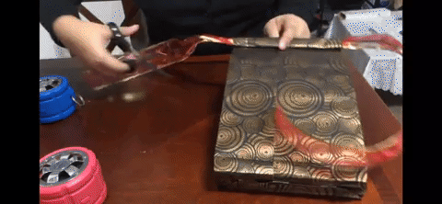
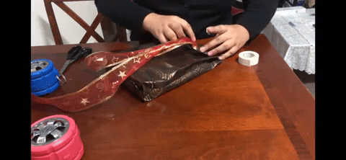
Steps
(Now the top)
Step 8 & 9:
Cut each side (just right under the folded section).
Fold both side’s cut section to the center and fold the open section to form a shoulder.

Slide 10
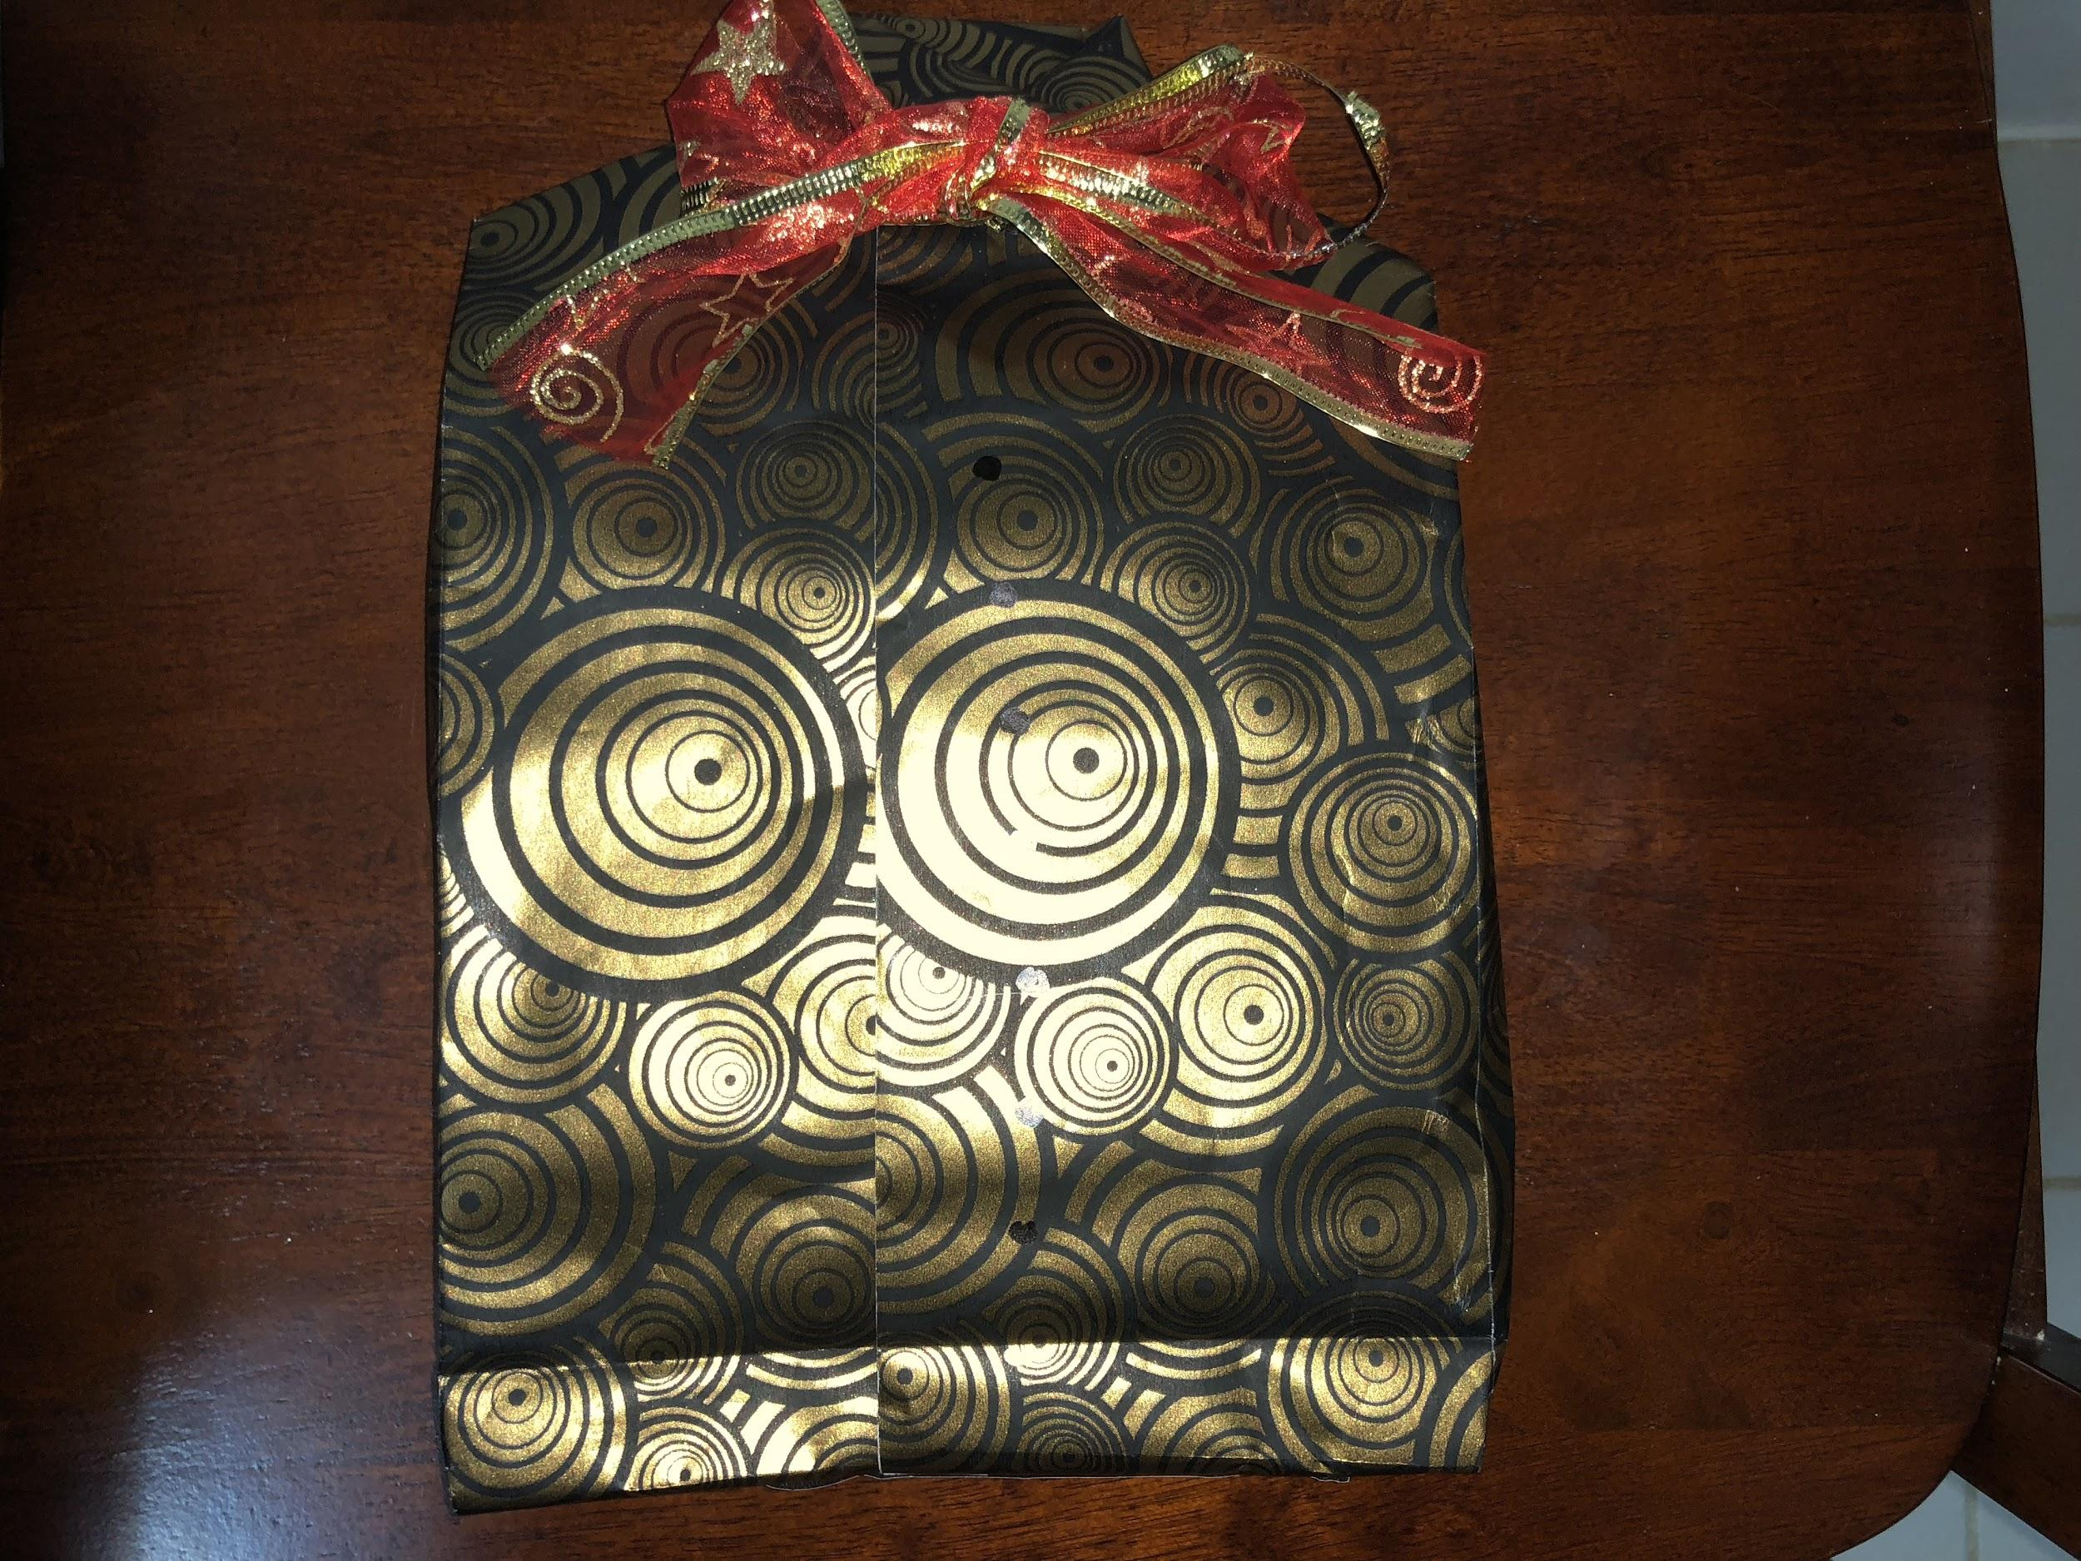
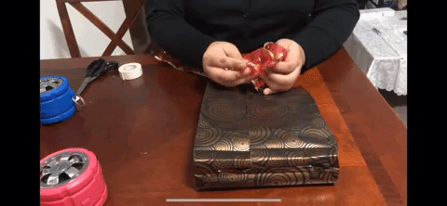
Steps
(Now the top)
Step 10:
Create a tie or a bowtie using the ribbon. Voila! Good to go now!

Slide 11
Precious Gifts, Precious Memories

Slide 12
Questions
How many materials are there?
There are 5 materials
Name the 5 materials.
Gift wrapping paper
Scissors
Ribbon
Double sided tape
Marker
What is my tagline?
Precious Gifts, Precious Memories

Slide 13
Reference:
https://www.youtube.com/watch?v=e68OBUlSNhY
https://www.wikihow.com/Make-a-Paper-Bag

