Slide 1
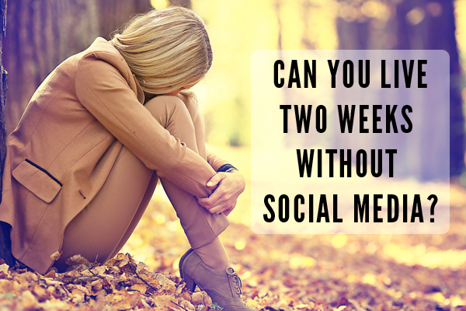
Social Networking Addiction
Joanna Bea
Northern Marianas College
EN 202-02

Slide 2
Research Question
“When social networking becomes an addiction?”

Slide 3
Secondary Research Questions
What are the reasons or motivations for Social Networking Sites usage?
Does Saipan have a lower or higher risk of social networking addiction?

Slide 4
Methodology
Survey
Pilot Study 1
Pilot Study 2

Slide 5
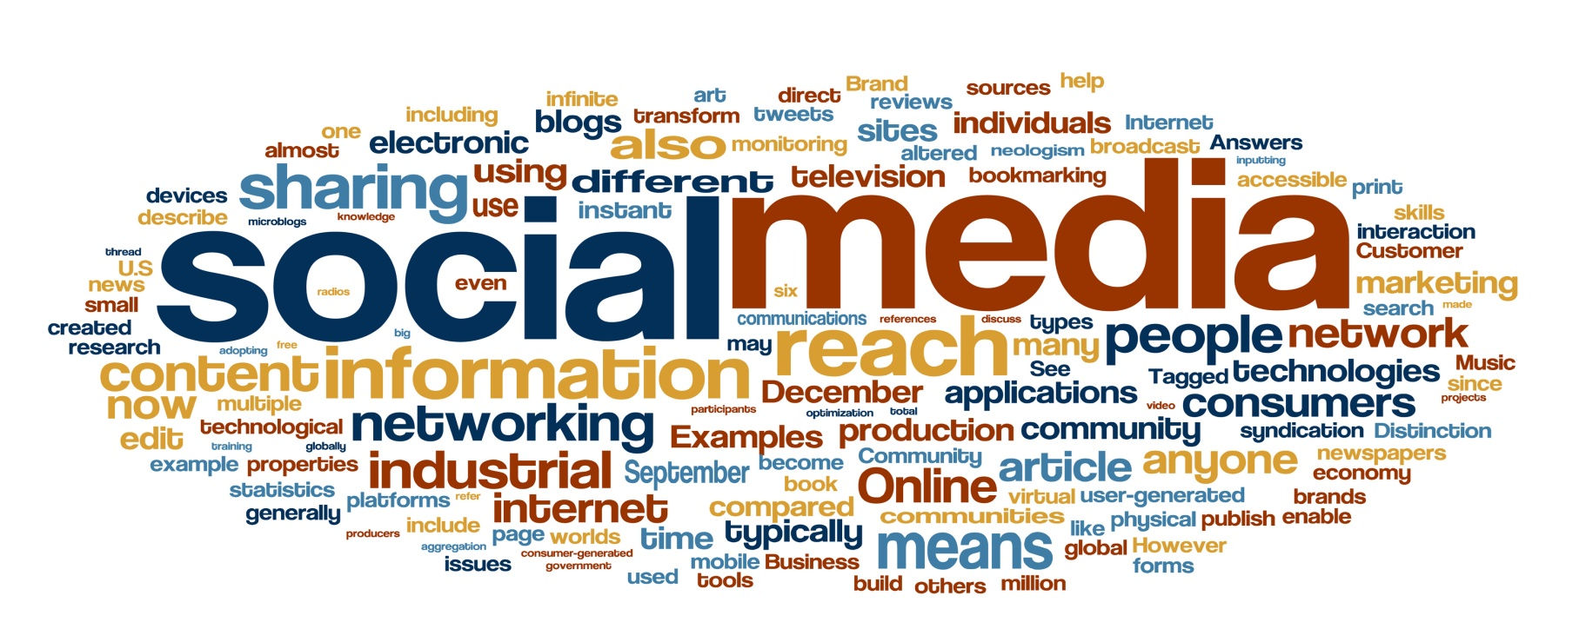
Methodology
Interview & Questionnaire
Mr. Christopher Jones
Myra Grageda

Slide 6
Findings
Social networking addiction
Negative
Positive

Slide 7
Strengths
Weaknesses
Interview
Survey questions
Literature
Less survey/method

