Slide 1
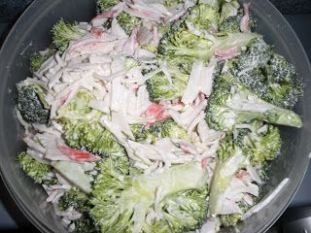
How to make Crab Salad

Slide 2
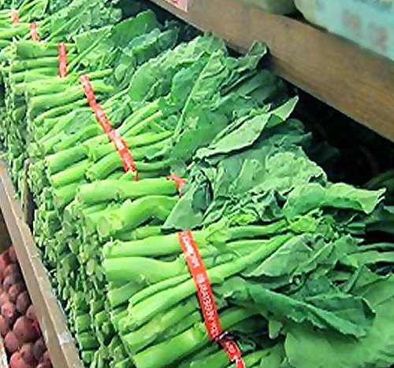
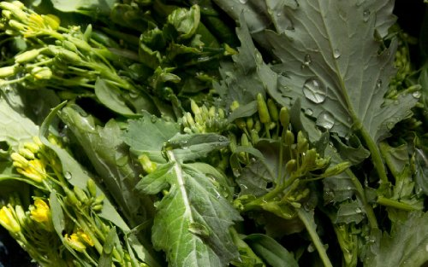
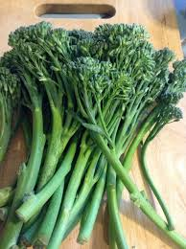
How many types of Broccoli are there?
10
Belstar
Calabrese
Destiny
DiCicco
Green Goliath
Green Magic
Purple Sprouting
Romanesco
Sun King
Waltham 29
https://gardenerspath.com/plants/vegetables/best-broccoli-varieties/

Slide 3
Ingredients:
3 lbs. Broccoli
1 pkg. Imitation Crab Meat (Ocean Best)
4 Cups. Mayonnaise
½ Tsp. Salt
1 Tsp. Black Pepper

Slide 4
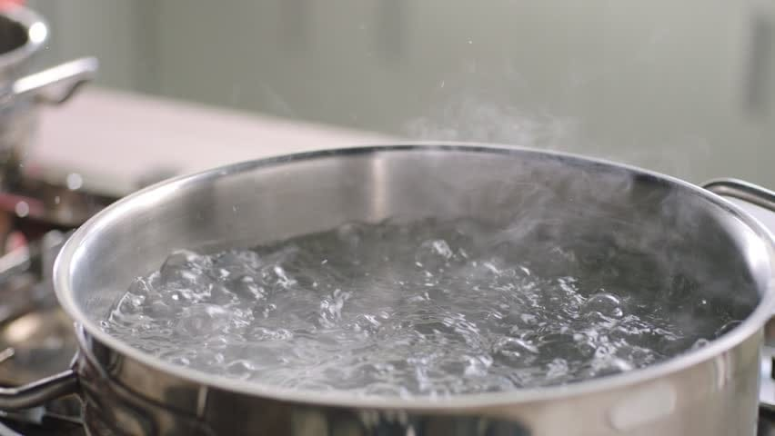
Step 1:
Before you prepare your ingredients, the first step will be to bring 6-8 cups of Water to a Boil.

Slide 5
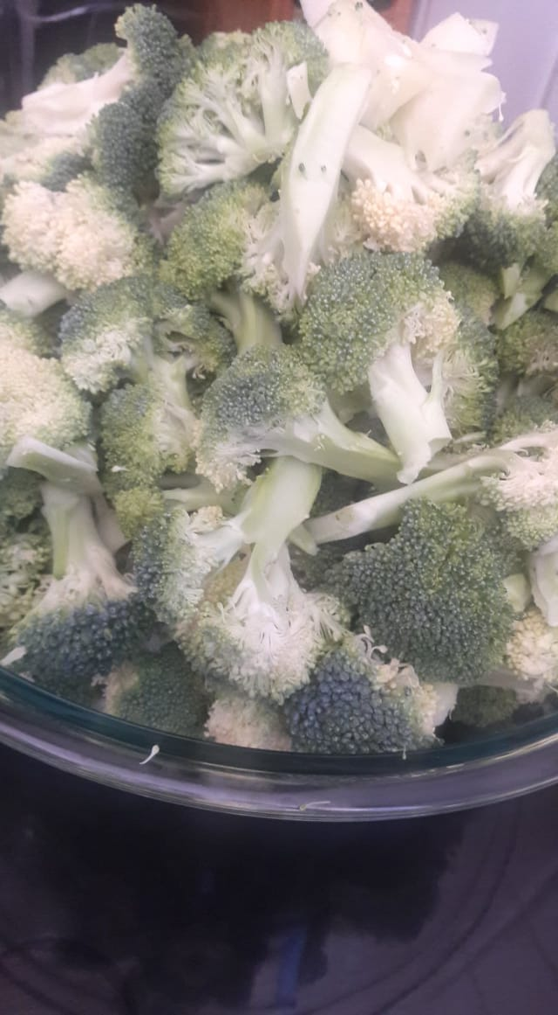
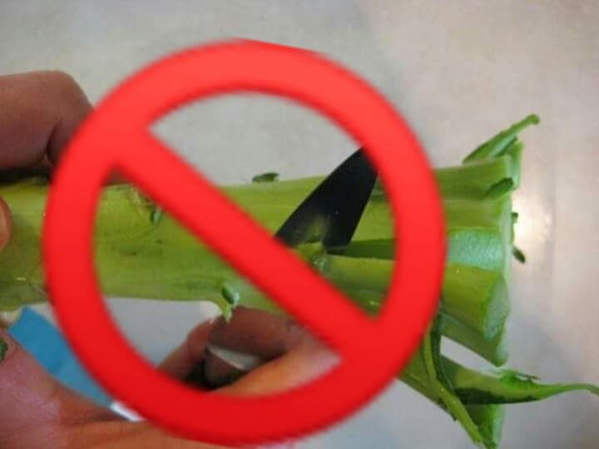
Step 2:
Cut up your Broccoli into bite size pieces

Slide 6
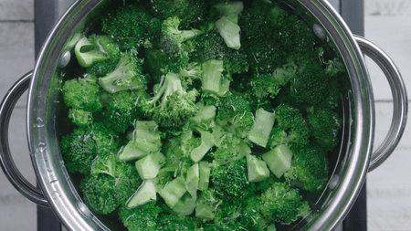
Step 3:
Blanch Broccoli for 2-3 minutes and drain.

Slide 7
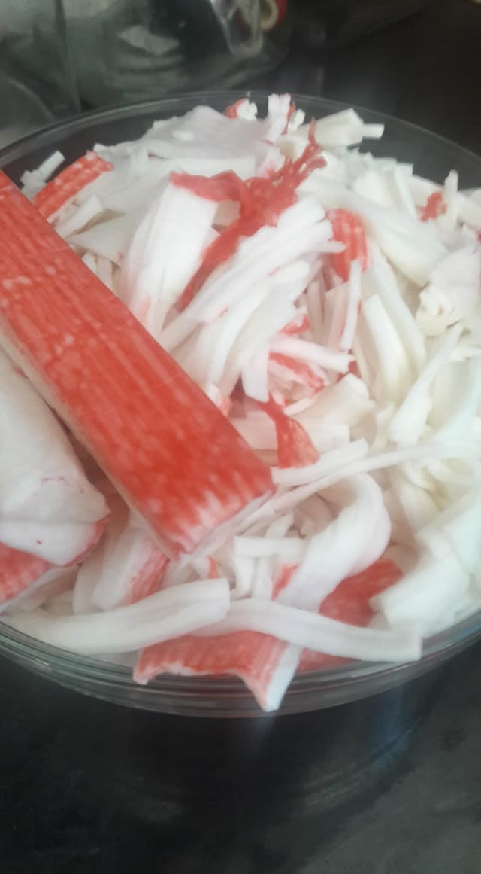
Step 3:
Cut Crab Meat into
thirds and shred

Slide 8
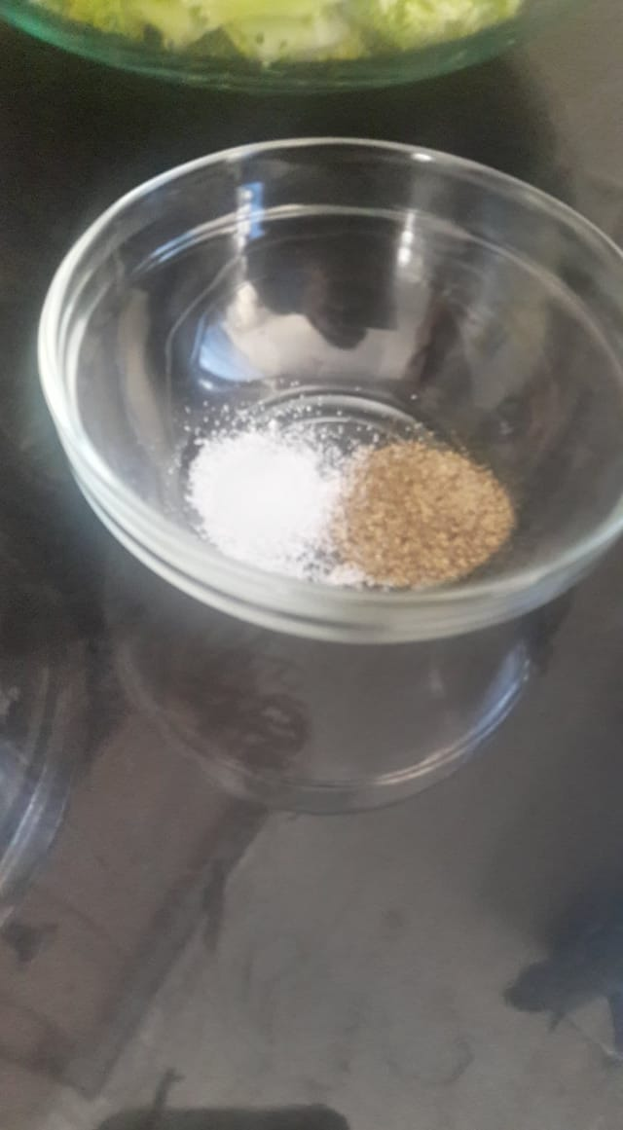
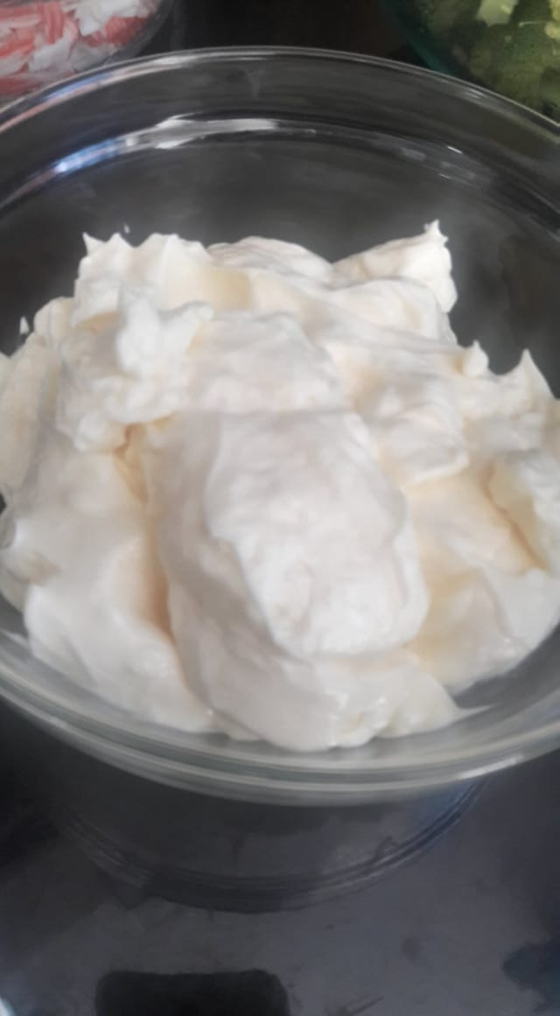
Step 4:
Combine the 3 ingredients
together and then add
in the broccoli.

Slide 9
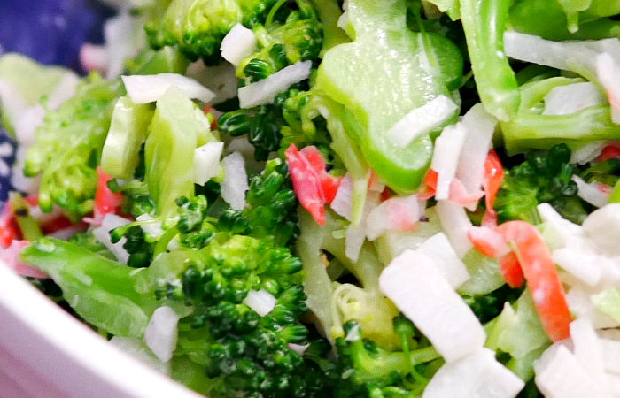
Step 5:
Place salad in a serving dish and its ready to eat.

