Slide 1
The Abuse of Crystal Methamphetamine & the Smuggling and Distribution of it in the CNMI
By: Venetia Atalig and Mariol Joy Lopez

Slide 2
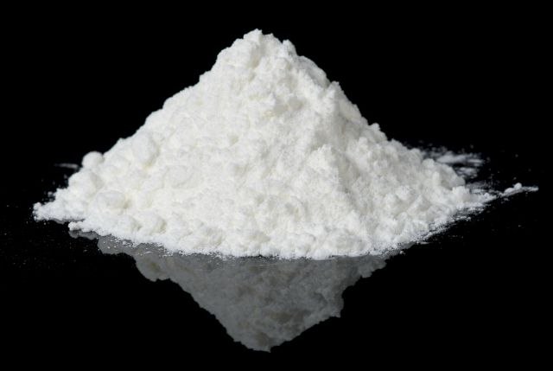
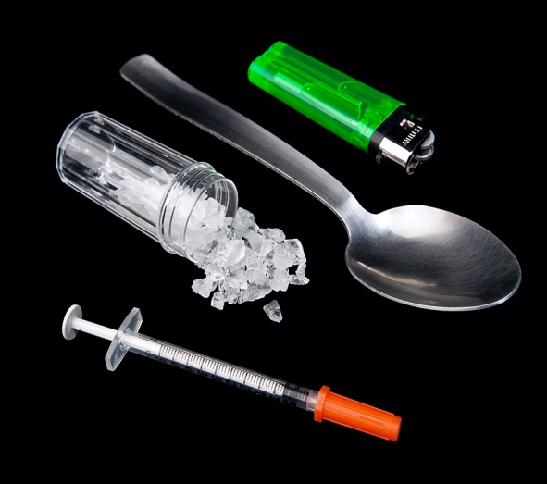
Abuse of Crystal Methamphetamine
Crystal Methamphetamine has drawn obstructions not only on individuals, but families, neighborhoods, and the entire community as well.
It is an illegal drug that many individuals of varied ages take to experience euphoria. (by inhaling or snorting, eating, smoking, injections, and anal.)

Slide 3
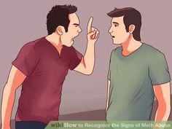
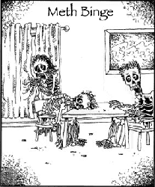
Abuse of Crystal Methamphetamine
1
1.) Rush: Abuser consumes the drug which leads to rapid vital signs.
2.) High: Consumer feels aggressively smarter and becomes argumentative.
3.) Binge: Abuser has an urge to keep on consuming the drug to maintain the feeling of euphoria or high.
2
3

Slide 4
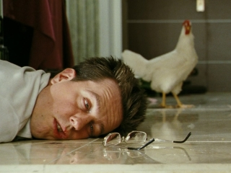
Abuse of Crystal Methamphetamine
4
4.) Tweaking: Abusers are labeled to be in a dangerous phase. “Psychotic phase”
5.) Crash: The consumer’s body can no longer cope with the overwhelming that the drug causes so it shuts down leaving the abuser in a long period of sleep.
6.) Meth Hangover: Abuser wakes up feeling nauseated, starved, extremely tired physically, mentally, and emotionally.
5
6

Slide 5
Abuse of Crystal Methamphetamine
7
7.) Majority of abuser feels depressed and is need of more “rush” or “high”. Some result to suicidal attempts.

Slide 6
Smuggling and Distribution of Crystal Meth
According to National Drug Intelligence Center and conducted interviews, there has been no reported productions of crystal meth in the CNMI.

Slide 7
Smuggling and Distribution of Crystal Meth
Crystal Methamphetamine is illegally smuggled into the CNMI through various means of transportation .

Slide 8
Smuggling and Distribution of Crystal Meth
Crystal methamphetamine is most commonly smuggled into Saipan from Asian countries.

Slide 9
Smuggling and Distribution of Crystal Meth
Once crystal methamphetamine reaches Saipan, it eventually spreads through its neighboring islands of Tinian and Rota.

Slide 10
Smuggling and Destruction of Crystal Meth
According to interviews, there are Chinese dealers who are known to be the primary distributors of crystal methamphetamine .
They arrive on Saipan and retrieve the drug from couriers they have employed and also recruit retail distributors in Saipan.

Slide 11
Crime Cases
Illegal use of crystal methamphetamine.
→ Majority of the crime cases in the CNMI.
* Domestic Violence
*Theft
*Burglary

Slide 12
Call to Action
The rules and regulation must be implemented no matter the circumstances. The residents of the CNMI does not need a destroyer, what it needs is a healthy lifestyle free from any drug as dangerous as crystal methamphetamine.

Slide 13
Be smart and DON’T meth around!

