Slide 1
Ocean Acidification in the CNMI
EN202 Section 3 – Dr. Kimberly Bunts-Anderson
Created by: Jenevieve Cruz

Slide 2
Objectives
To analyze the effects of ocean acidification on marine life and other related factors
Increase the awareness of individuals to promote sustainability in the ecosystem(s)

Slide 3
Problem Statement
Carbon dioxide emissions are increasing rapidly, and are greatly affecting the coral reefs today. The issue should not be ignored because coral reefs provide us with many advantages including food supply, economic development, and shoreline protection. If the issue is ignored, the threats would prolong both to the community and marine ecosystem functions and interactions.

Slide 4
Research Questions
From your observation, has the warming temperature impacted the amount of fishes in the ocean (i.e. reproduction rate)? Has it declined? If so, how?
How often do you go fishing?
How long (months or years) have you been fishing? How would you describe the oceanographic changes?
Do you think the fishing industry will be affected in terms of the issue of global warming?
What type(s) of fish(es) can you say has/have degraded or is slowly degrading?
What characteristics are affected (i.e. size of fish, appearance, taste, etc.) among the various fishes?
Do you think we are at the stage of global warming?
What do you think about the issue of global warming?
How soon should officials start working on the issue?
Do you think it will impact the economy?
From a scale of 1 to 10, how would you rate the United States’ government effort in trying to reduce global warming?
What factors in the CNMI contribute to global warming?
What factor do you think has the greatest impact in the CNMI?
What effective strategies can be conducted to reduce gas emissions in the atmosphere?
Have you attended any of the climate change seminars, such as the Brown Bag Seminar, on the island?
Do you think it is too late to save the planet?

Slide 5
Methodology
Interviews
Online desk research
Surveys
Observations

Slide 6
Literature Review
The Great Barrier Reef has been surveyed for 93% of mass coral bleaching, leaving the 7% unaffected. 50% is either dead or dying.
For Saipan, the ocean acidity rose to 30%.
The alert level for coral bleaching in the CNMI is between Alert Level 1 and Alert Level 2.
Experiments have been conducted by scientists using a satellite bleaching system to measure the thermal stress among the corals.

Slide 7
Findings & Results
According to both results collected from studies of the Great Barrier Reef and the Mariana Archipelago concludes that both are caused by thermal stress from the warming temperature in the ocean.
Based on the findings I have gathered, ocean acidification is caused by vehicle combustion, imports, burning trash, and polluted run-offs.

Slide 8
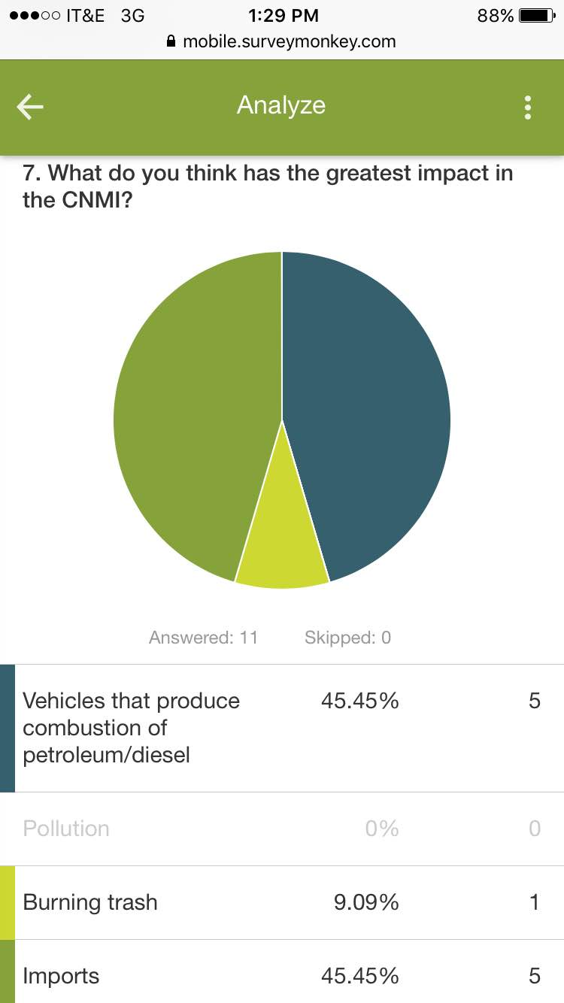
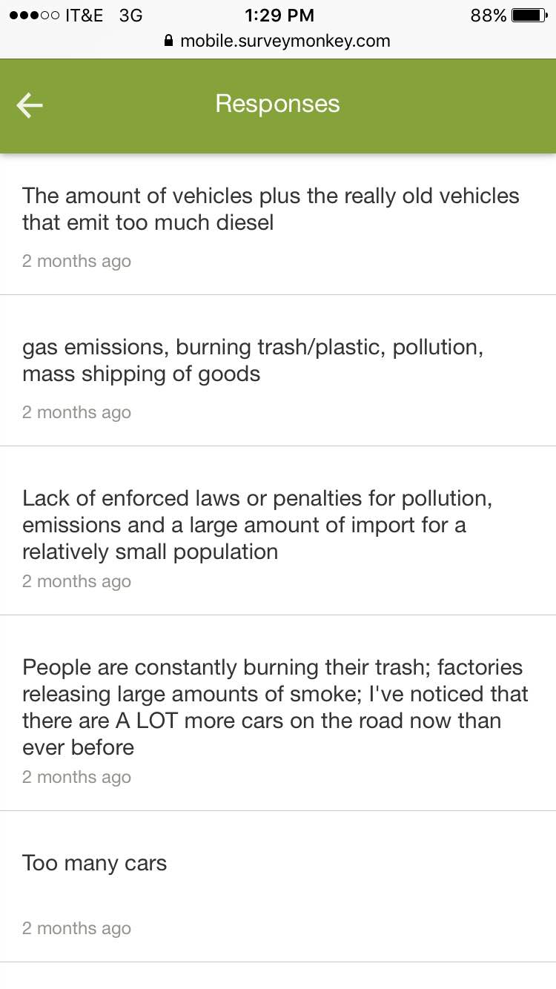
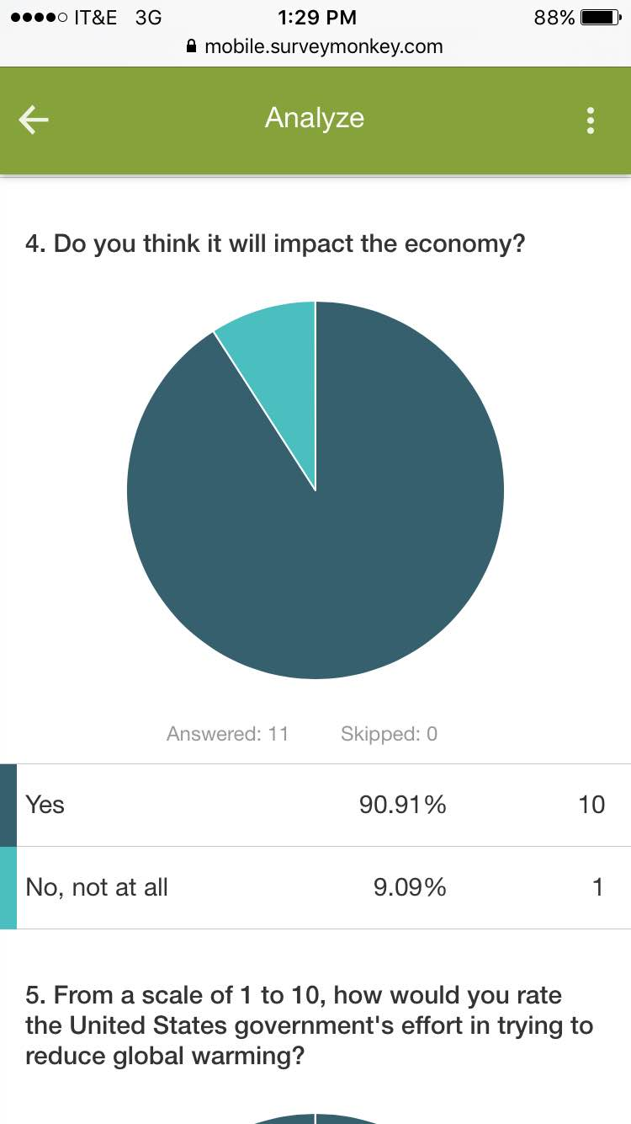

Slide 9
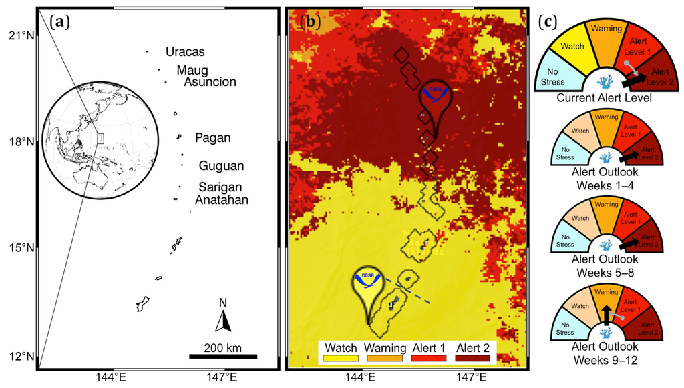

Slide 10
Discussion
Coral bleaching/ocean acidification has impacted a major part of the ocean. Marine organisms may be closer to being affected. Endangerment of marine species may be possible due to the diminishing food web interactions. We can conclude from the studies and reports that the pollution accumulation has reached or is closely reaching its absorptive capacity in the ocean.
Contacted experts on an earlier basis
Alternatives helped (interviews with individuals, observations, etc.)
Obstacles

Slide 11
References
Camacho, J. (2014, May 14). Saipan Tribune. Retrieved from Saipan Tribune Website: http://www.saipantribune.com/index.php/report-climate-change-now-impacting-nmi/
Camacho, J. (2015, January 28). Saipan Tribune. Retrieved from Saipan Tribune Website: http://www.saipantribune.com/index.php/acidic-ocean-will-challenge-cnmis-marine-environment/
Hoegh-Guldberg, O., Mumby, P., Hooten, A., Steneck, R., Greenfield, P., Gomez, E., . . . Hatziolos, M. (2007, December 14). Coral reefs under rapid climate change and ocean acidification. New York Avenue NW, Washington, DC, United States of America.
(2008). Report: climate change key for NMI coral reefs. Northern Mariana Islands.
Shi, D., Xu, Y., Hopkinson, B. M., & Morel, F. M. (2010, February 5). Effect of ocean acidification on iron availability to marine phytoplankton. New York Avenue NW, Washington, DC, United States of America.

