Slide 1
The Painting Progress

Slide 2
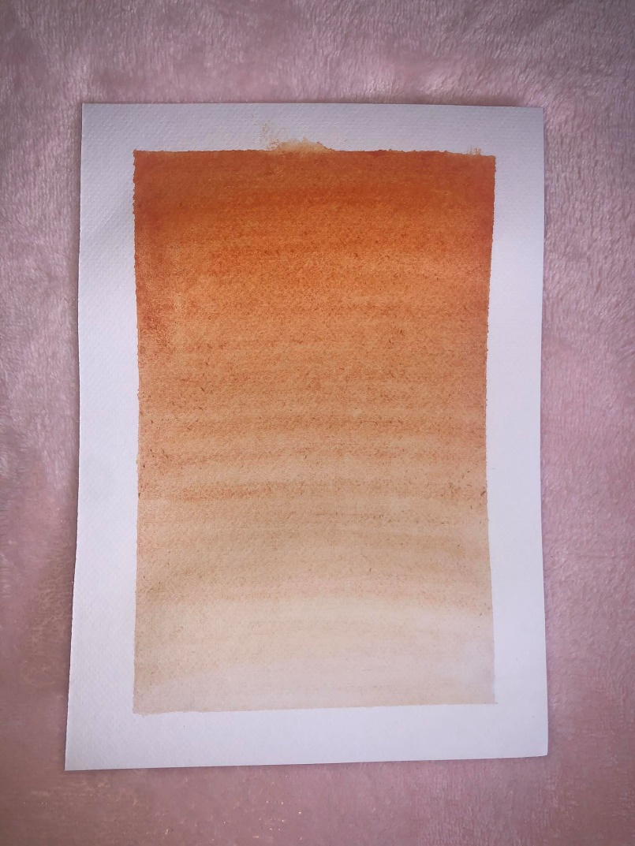
For the first few days, I decided to work on gradients. Water color is very flowing which makes it easier to create simple errors with just the wrong stroke. Today I worked on the color orange. It took me 3 times until I got the result I wanted.

Slide 3
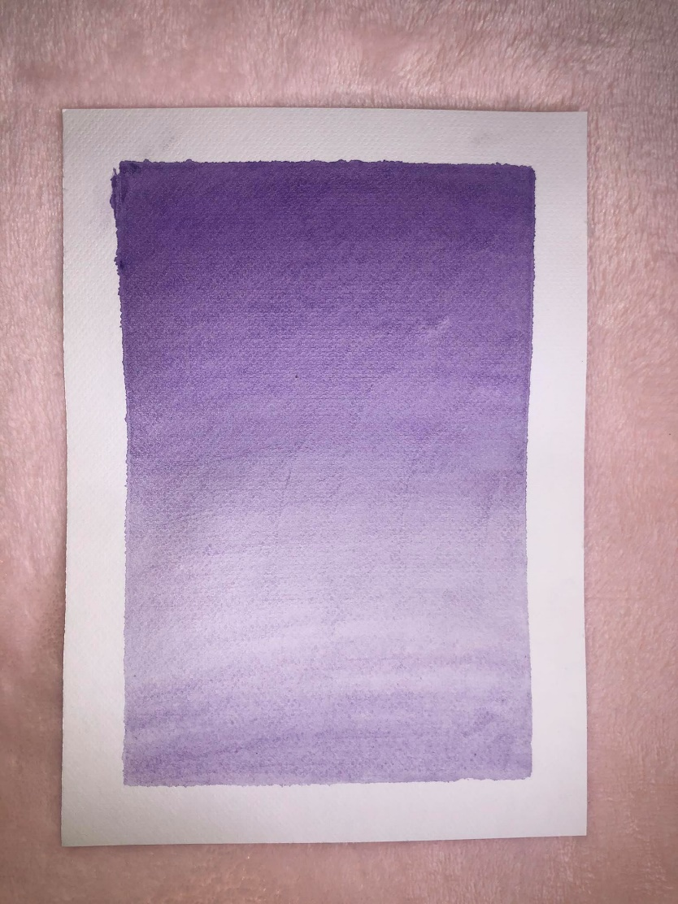
Another day, I tried the color purple. I tried to create more depth into this gradient and build it up slowly through different strokes. I also settled on one brush that seemed to work best for creating shades and depth into these water color paintings.

Slide 4
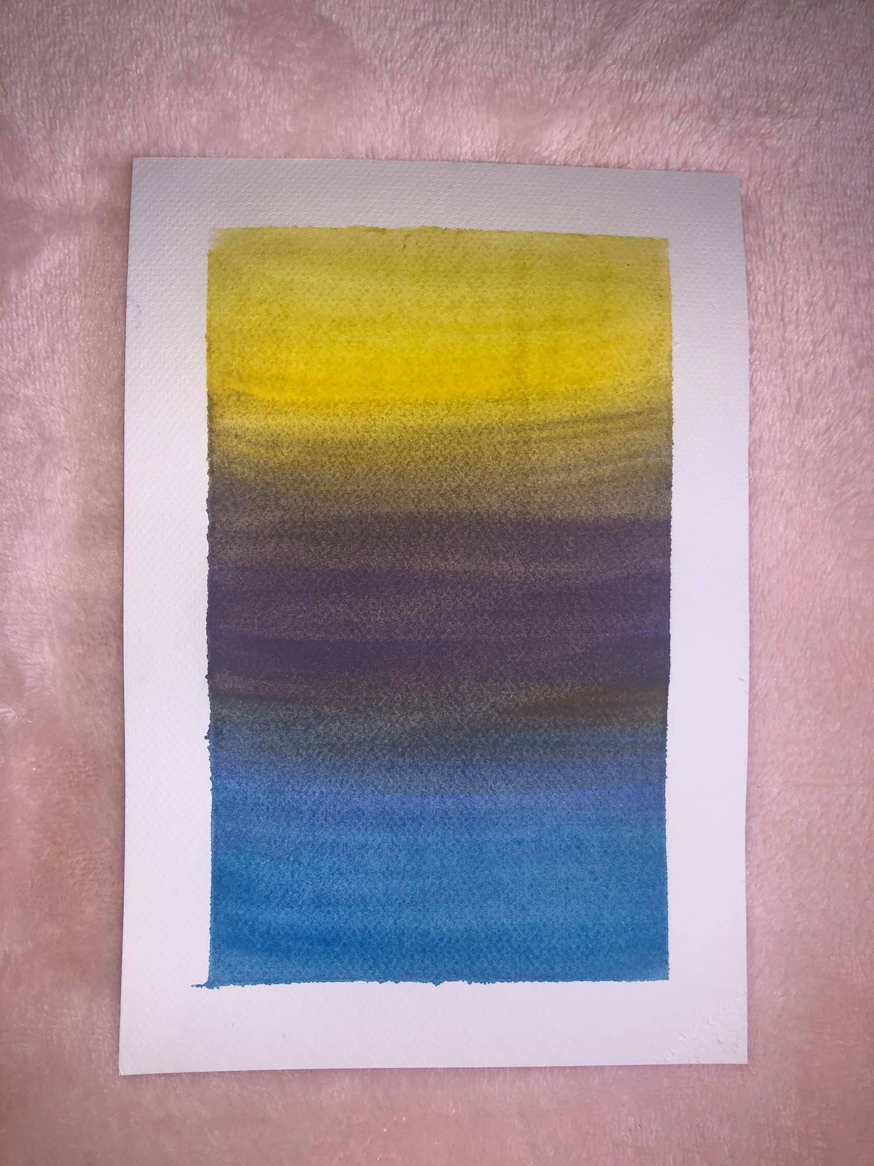
I took any random colors on this day and tried to create a gradient despite how contrasting these colors were. It was very difficult at first. The colors kept mixing and repeatedly turned into a brownish-blue. It took me about 3 times until I was satisfied with this result.

Slide 5
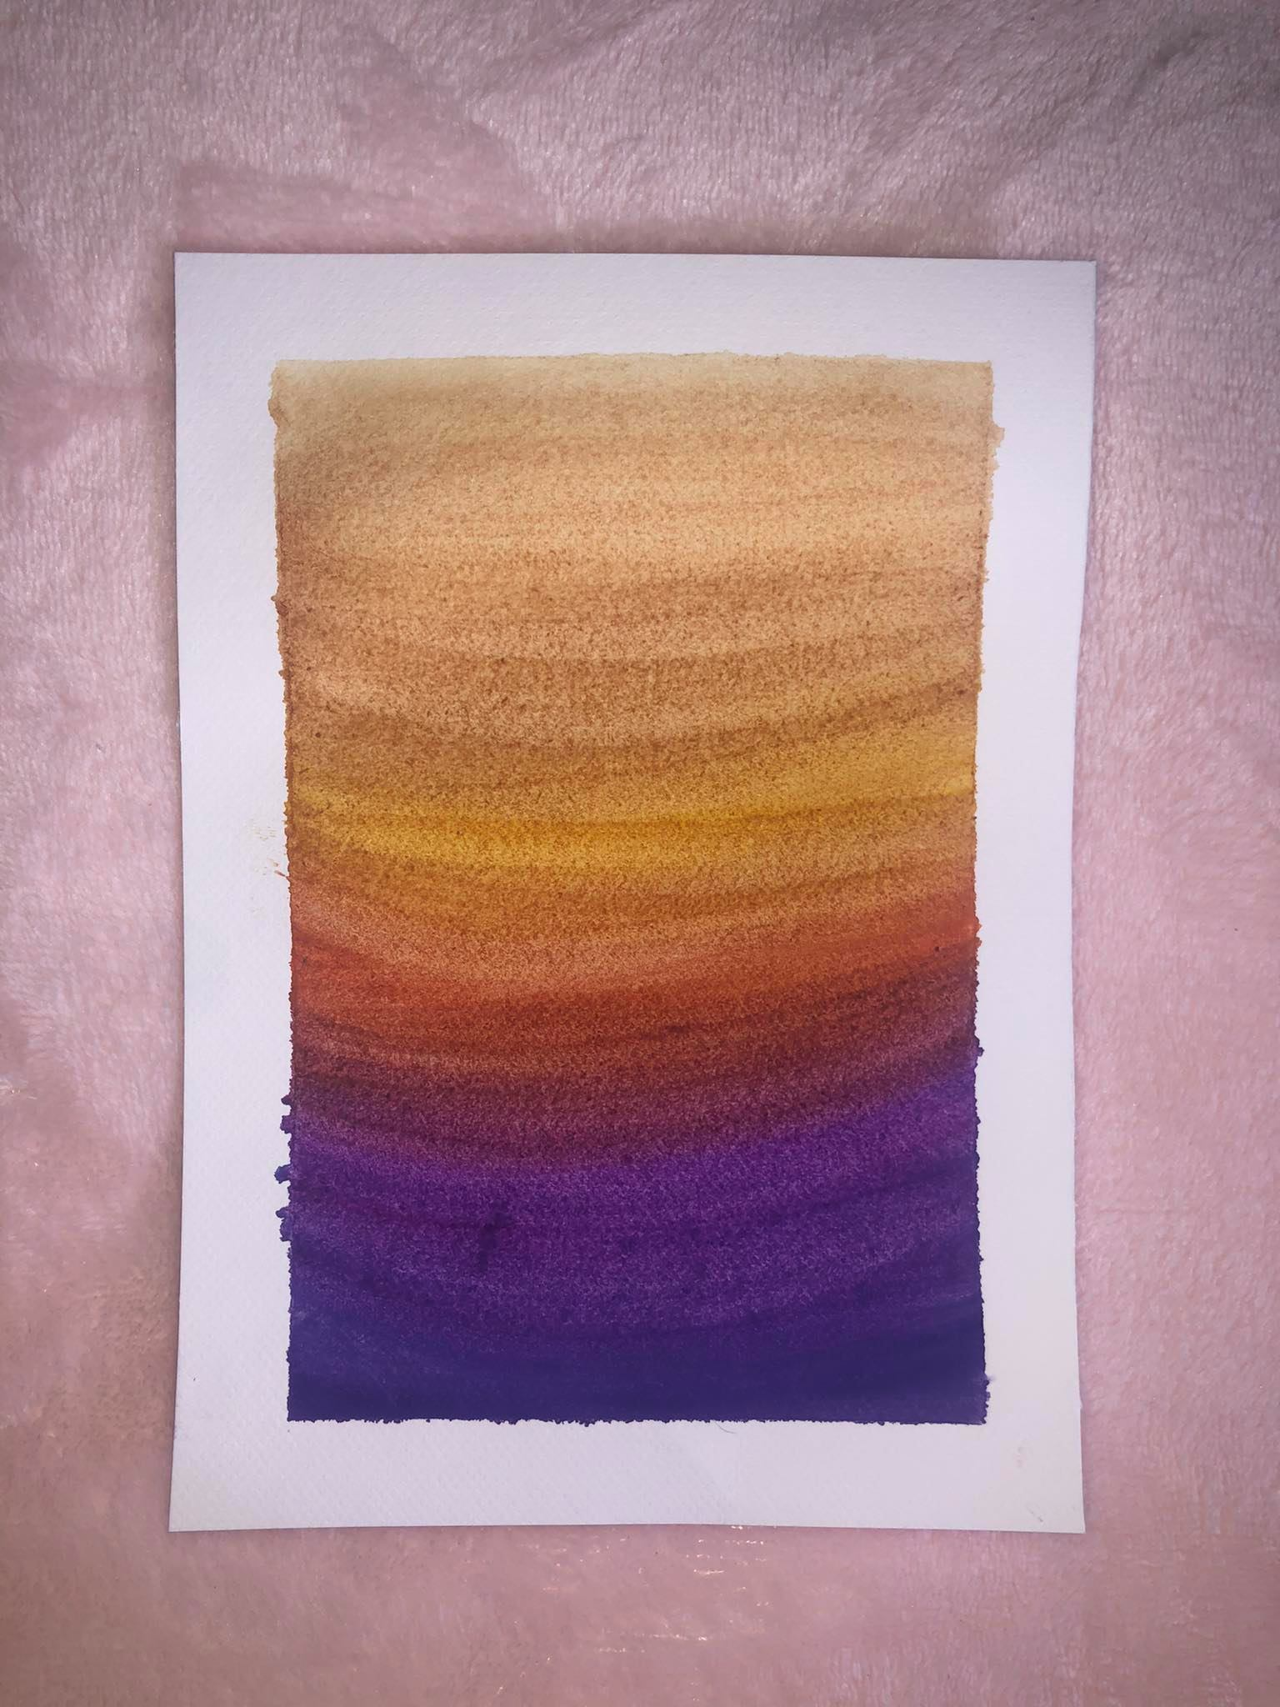
For this painting, I decided to go for more than three colors. I used a deep purple, deep red, a deep orange, and then yellow. Blending these colors were a hassle. I noticed that the more water I placed on the paper at first, created a better blending effect on the colors over time.

Slide 6
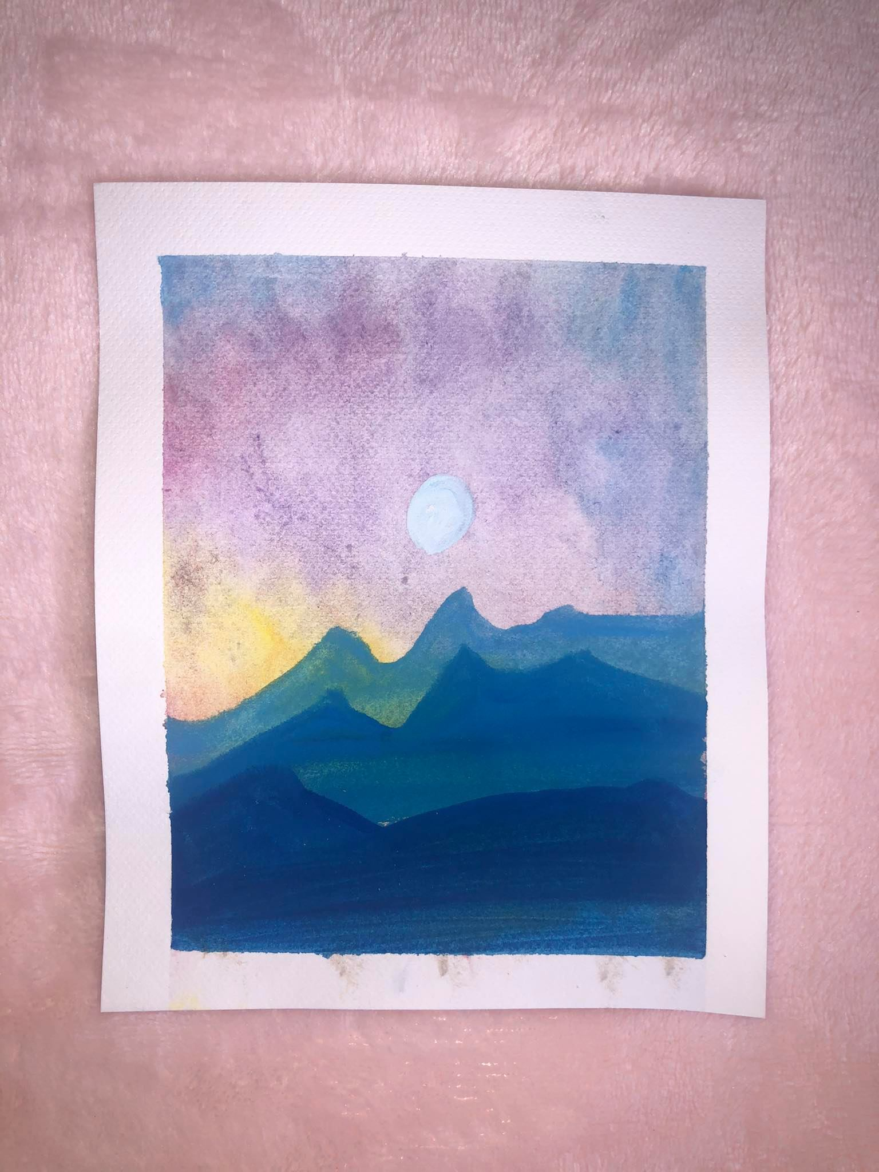
Definitely harder than it looks. It was easy blending colors, but to blend within the shapes of the mountains was a whole different story. This was the first time I attempted to paint a scene.

Slide 7
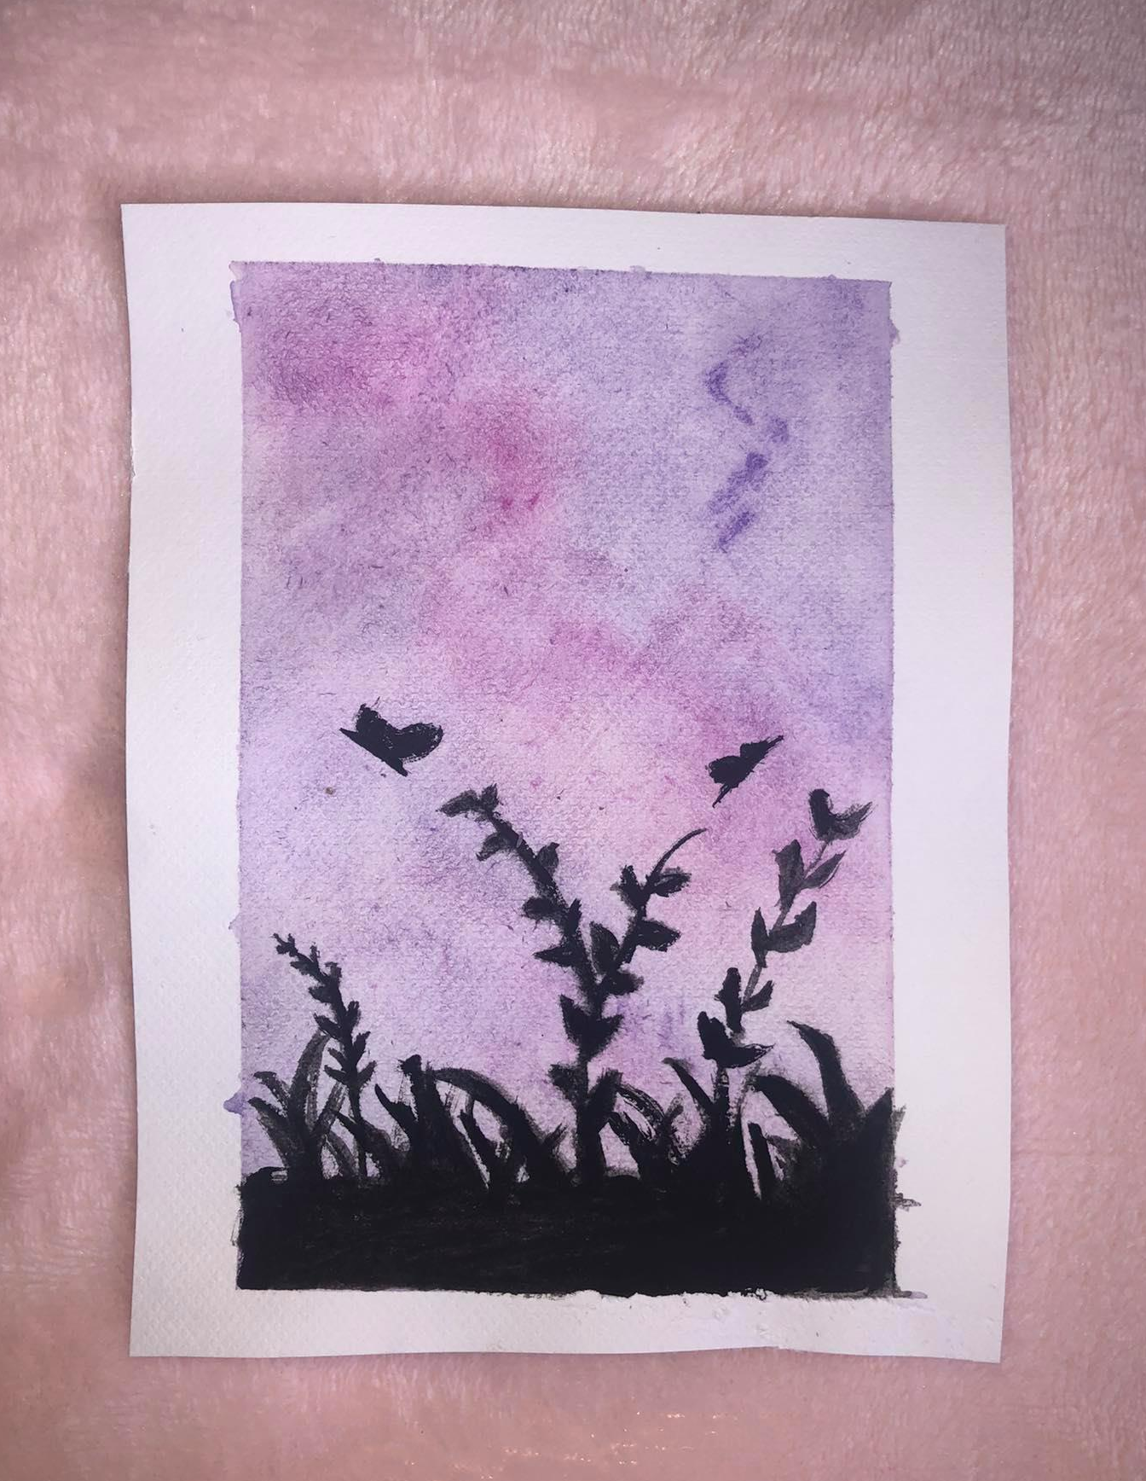
So instead of mountains, I tried to paint the silhouette of grass and small butterflies. One thing I took out of this is that you should definitely use a fine tip brush for small, intricate details.

Slide 8
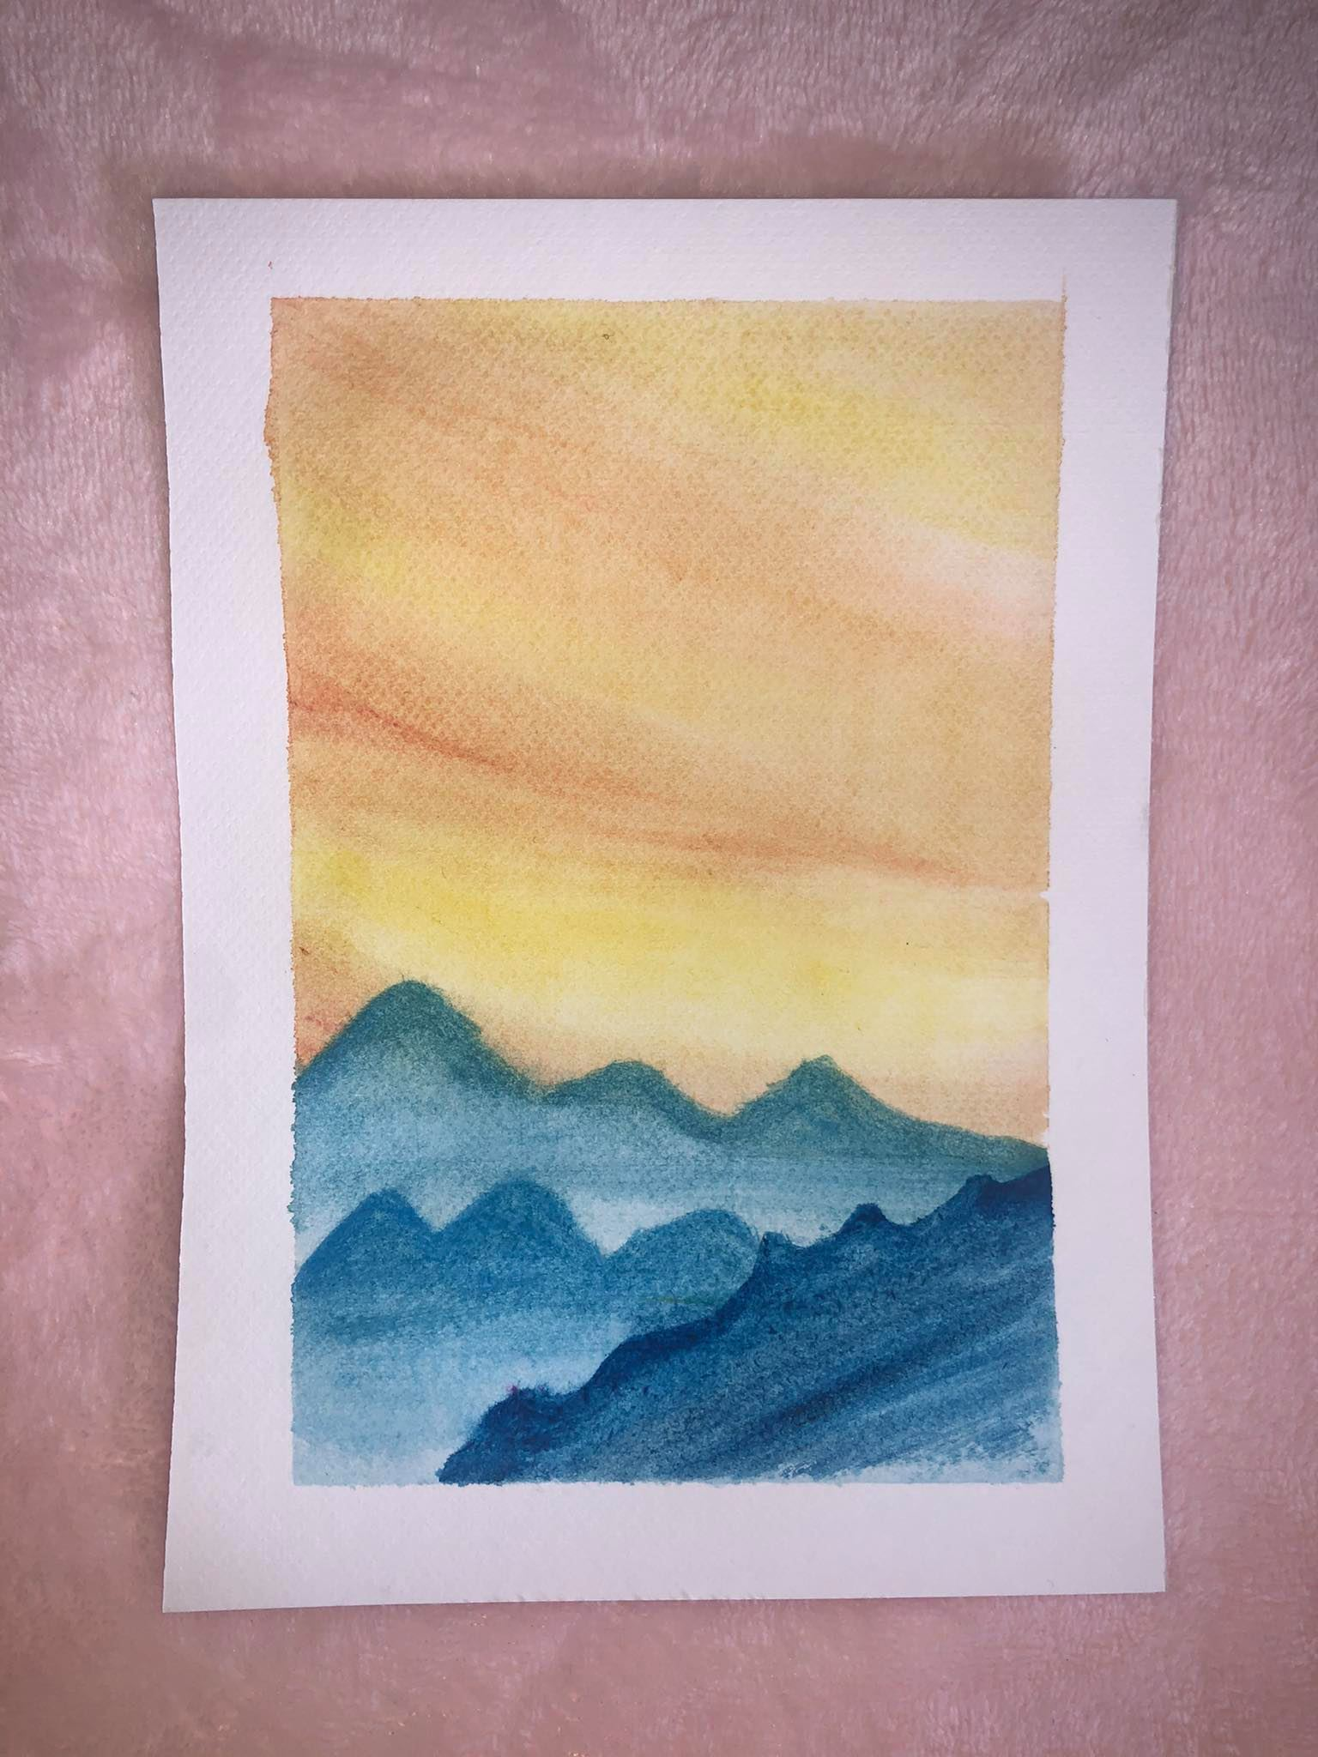
Not really different from the painting before this, I was having a hard time blending the colors and creating depth within the mountains.

Slide 9
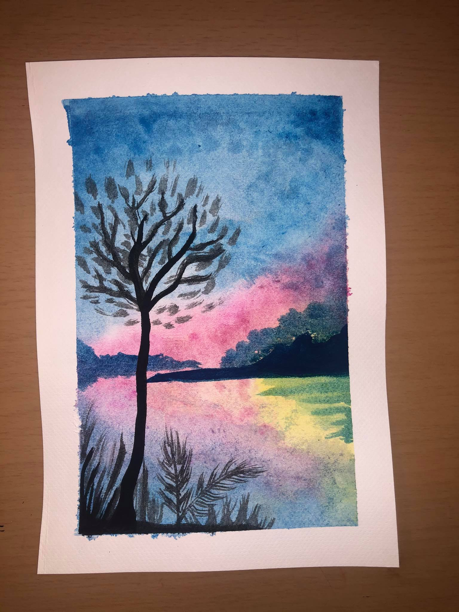
My blending got better. I also tried to go softer on the black. I'm definitely seeing improvement, even if it's the slightest. I love how I actually used different colors in the background with irregular forms. It gives the painting a better feel. Trying to make the colors look as if they're reflecting was definitely a challenge, but it came along just fine.

Slide 10
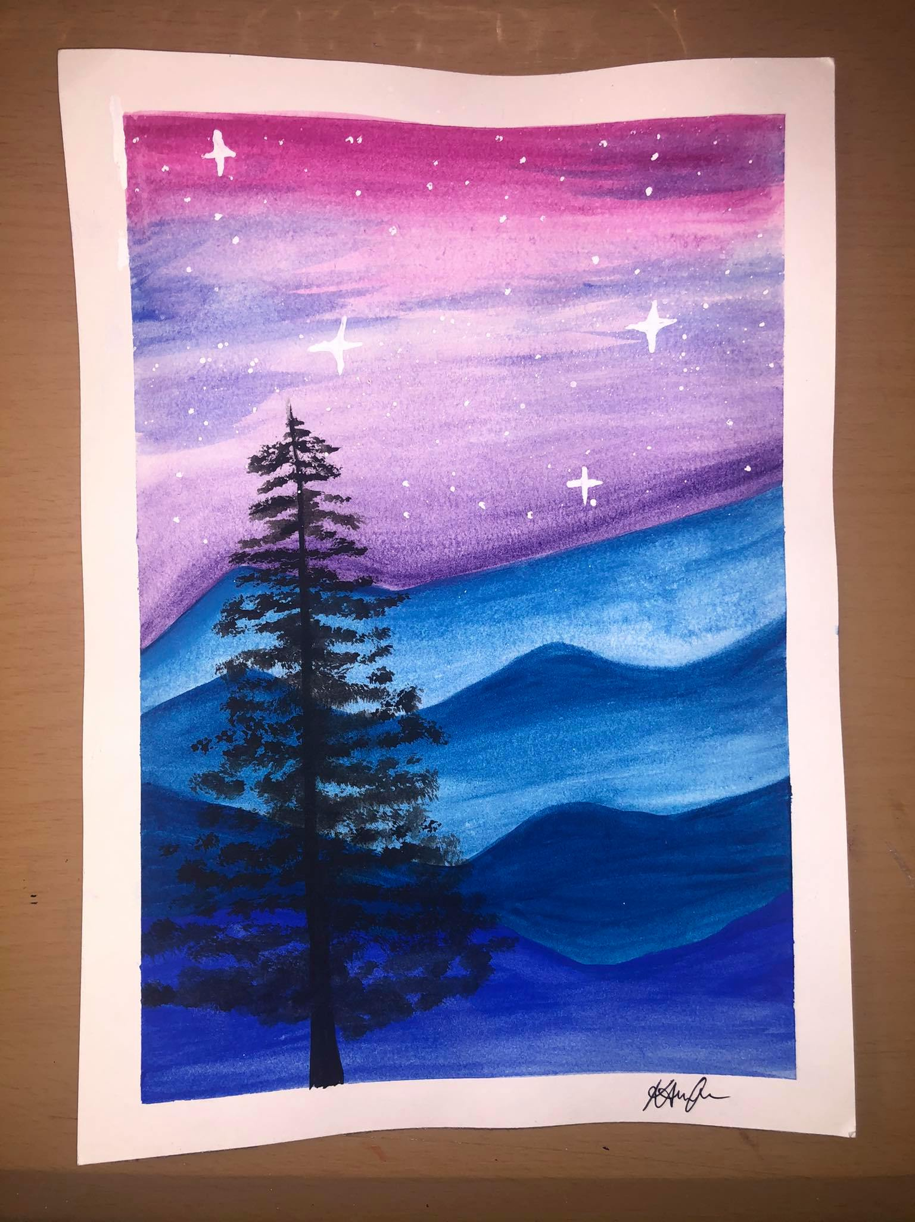
After using half sheets for awhile, I tried using a whole sheet of water color paper. After painting, I see why most tutorials use half sheets or smaller. The paper tends to wrinkle up because of the water. Painting on a whole sheet was quite a challenge. Building layers was harder since I had to work on a bigger space. It took me 2 tries to be satisfied with the result.

Slide 11
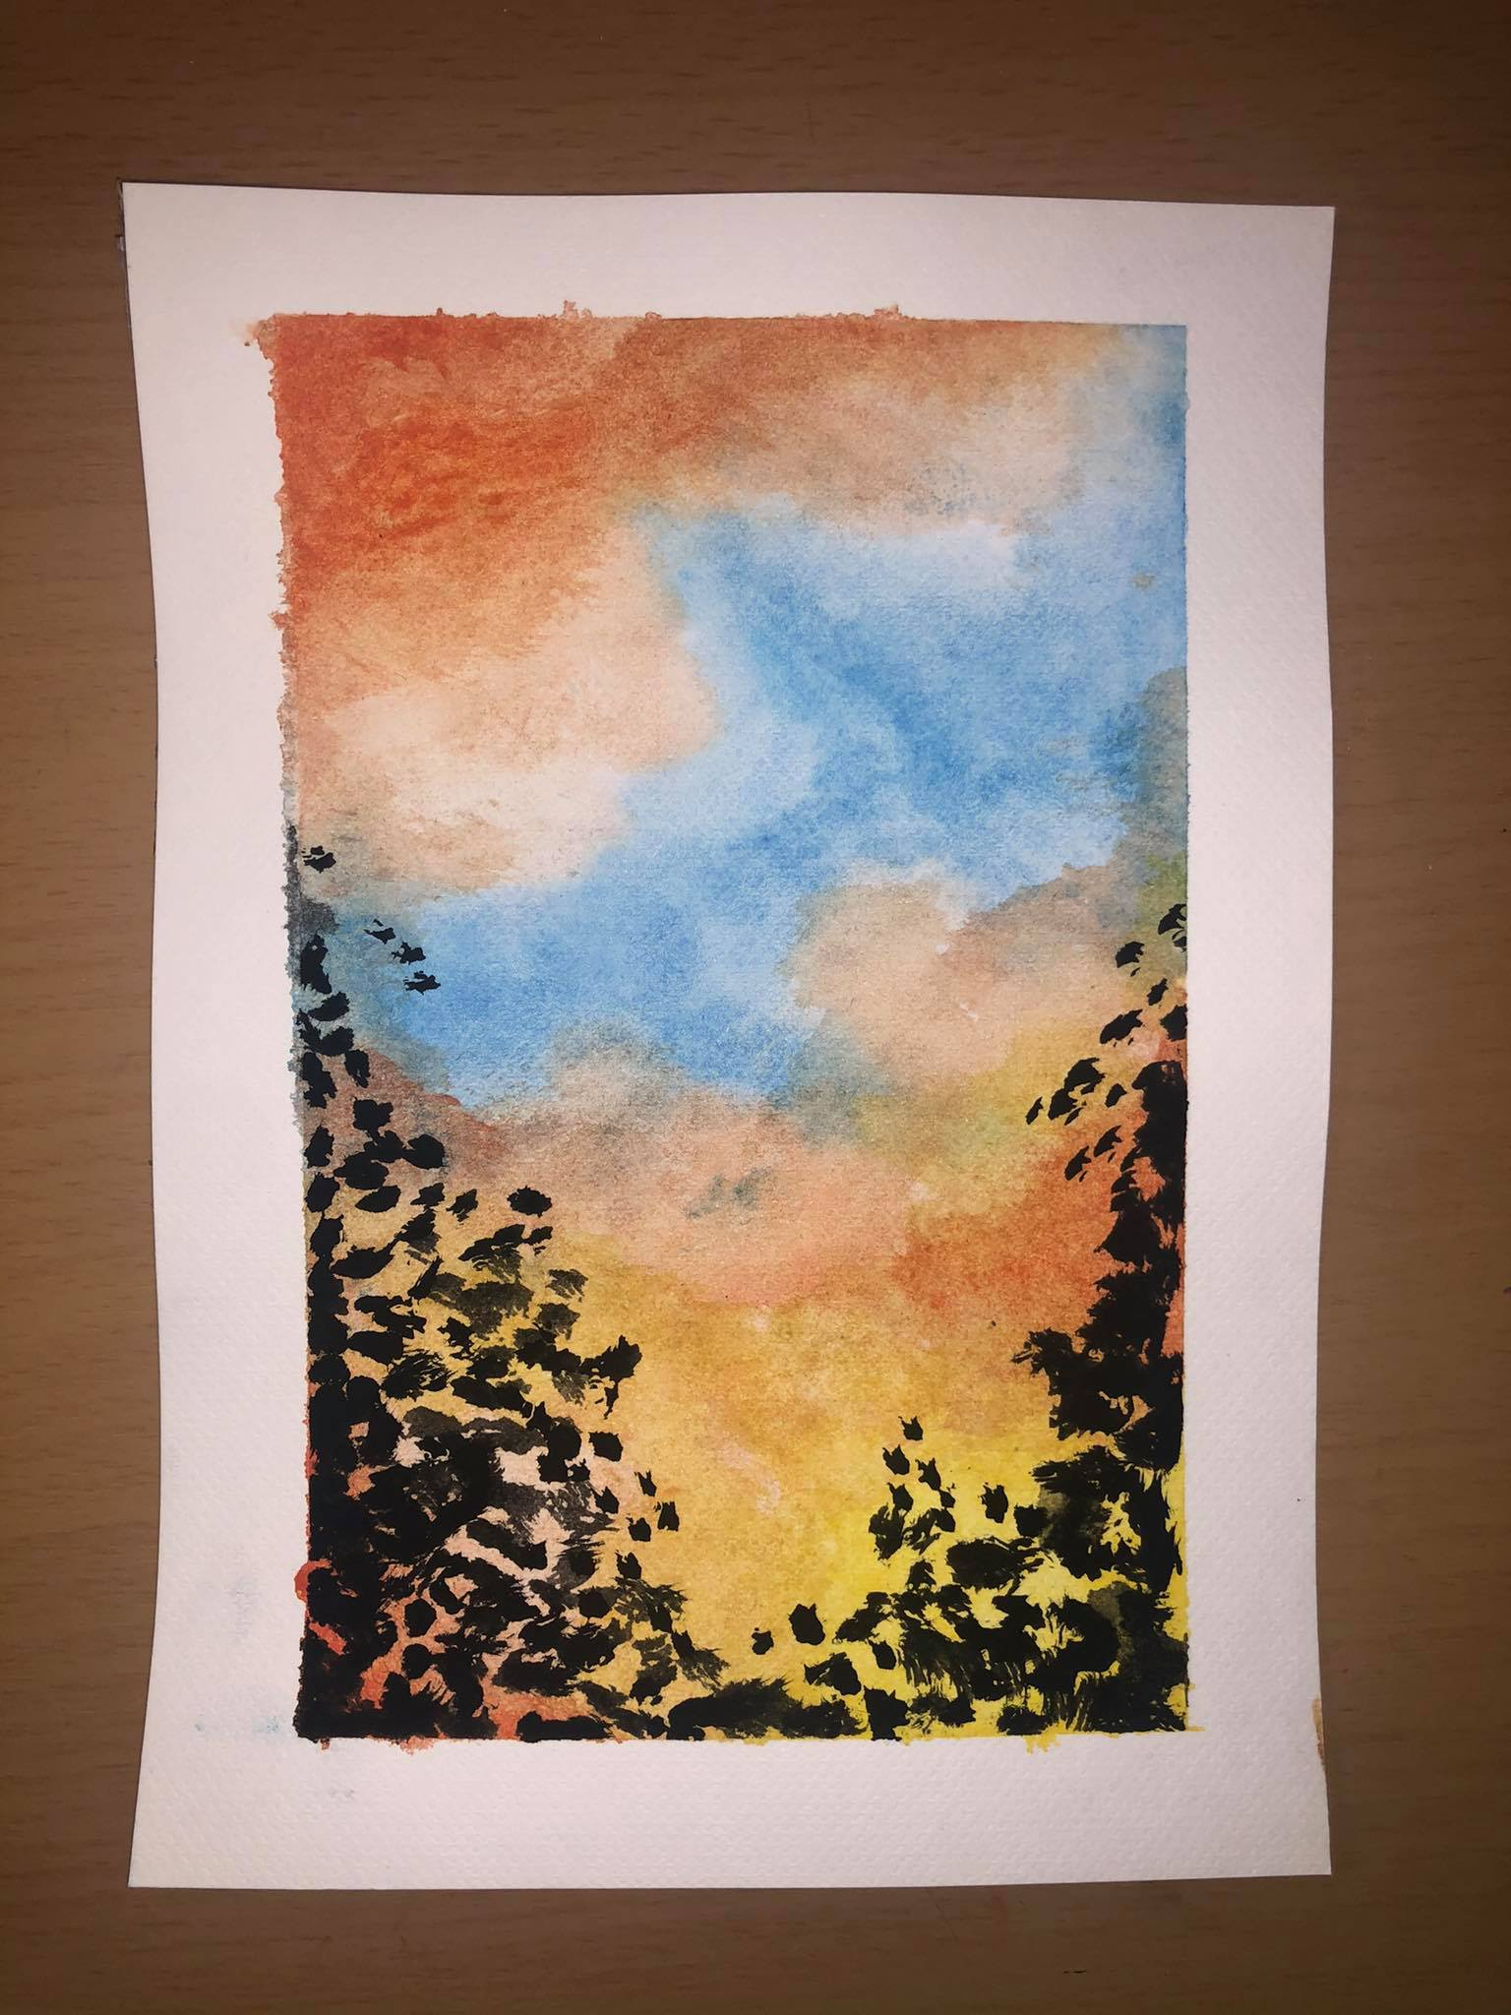
I'm understanding the gist and created a pattern while using water colors. First, wet your paper. It blends the colors well. Second, go soft on the colors for the background and build on layers to create depth. Third, always use small, fine tip brushes for details. This painting took me 2 tries.

Slide 12
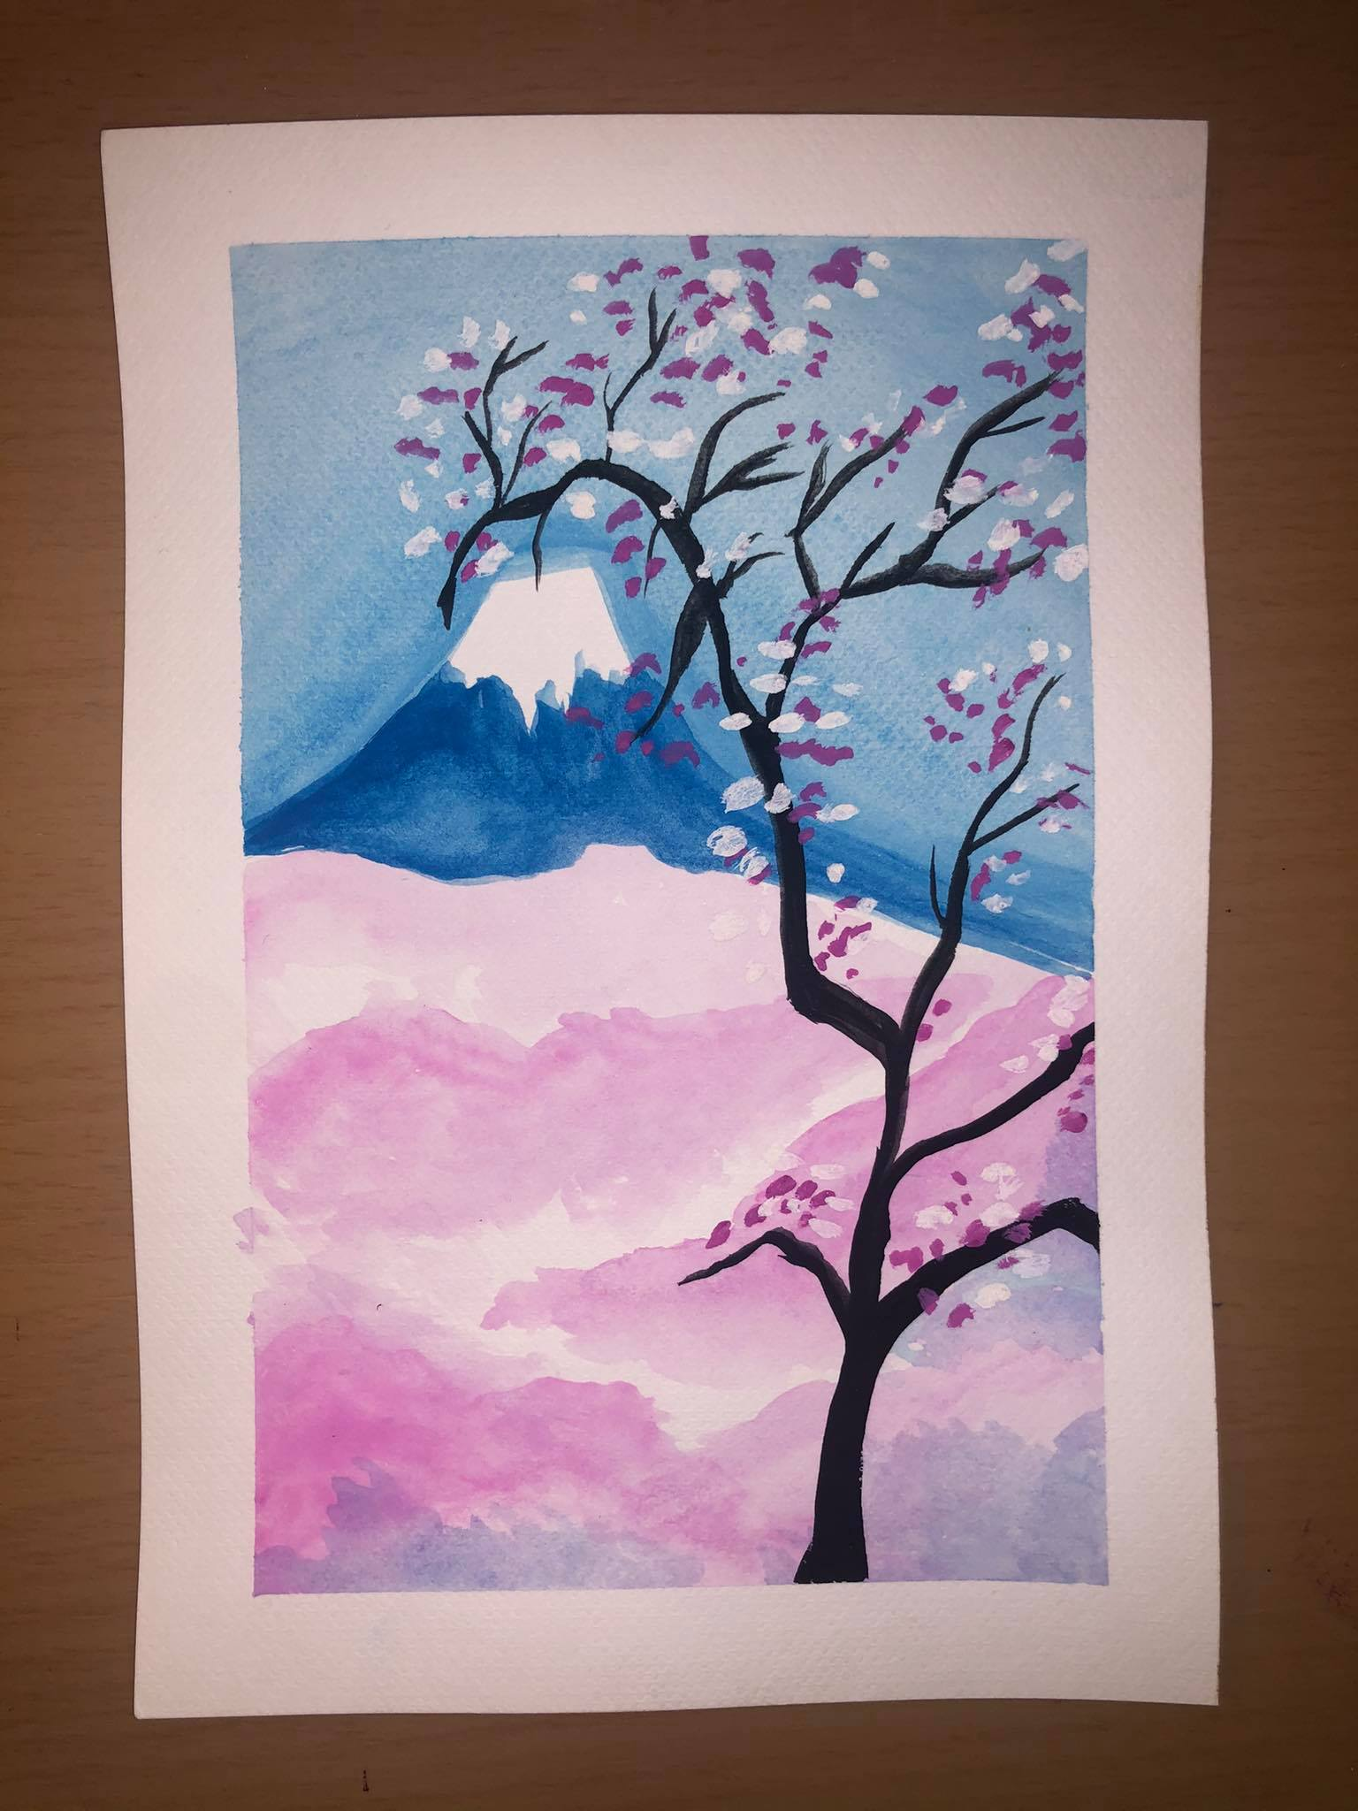
I have an obsession for Cherry Blossom trees so I decided to freehand this one. It happened to turn out great. I definitely see progress throughout my paintings. After countless times of painting, I realized that time was very crucial. Every art piece should not be rushed. Water color painting took more time depending on how complicated the piece was.

Slide 13
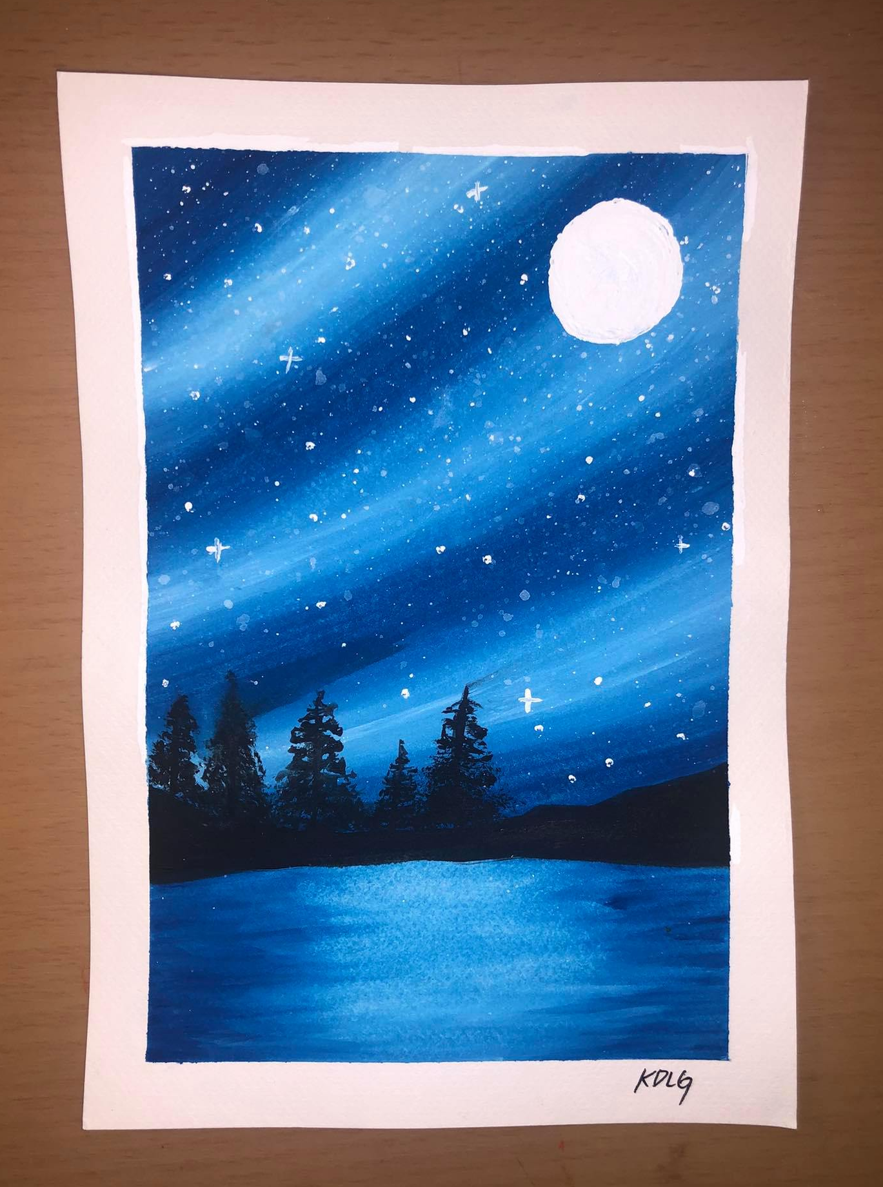
My favorite one yet. I absolutely love the blending pattern I created. In this painting, I kept building on layers and used 3 colors (blue, white, and black). Creating depth for this painting was very tedious and it took a lot of time.

Slide 14
This time, I decided to cut my paper into smaller pieces. That way, my paper will not wrinkle up. My blending has gotten so much better, as you can see in this painting. In this painting, I decided to let it focus entirely on its background. I love butterflies so I incorporated that along with the grass. I learned to let the brush hairs do the work while gently gliding my brush.

Slide 15
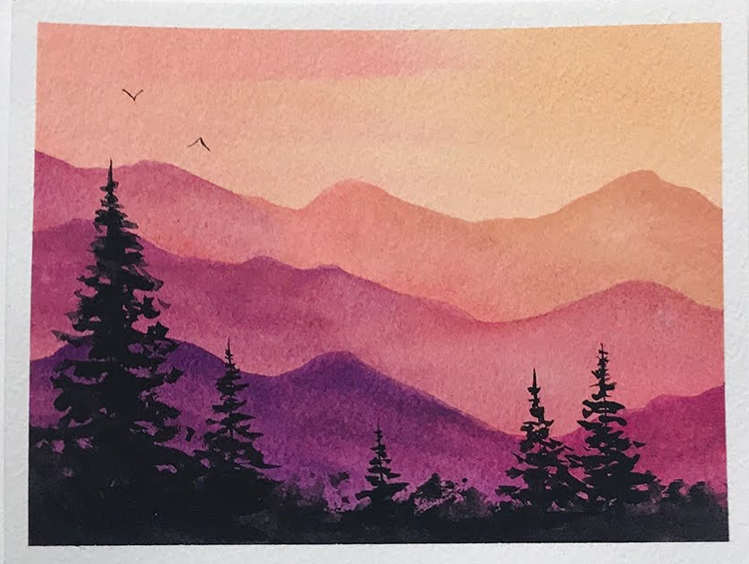
I attempted to try out the mountain scenery again, except with different colors. I had to redeem myself from the first painting I did. I am able to blend the colors within the mountains much better. My paintings are smoother and neater now.

Slide 16
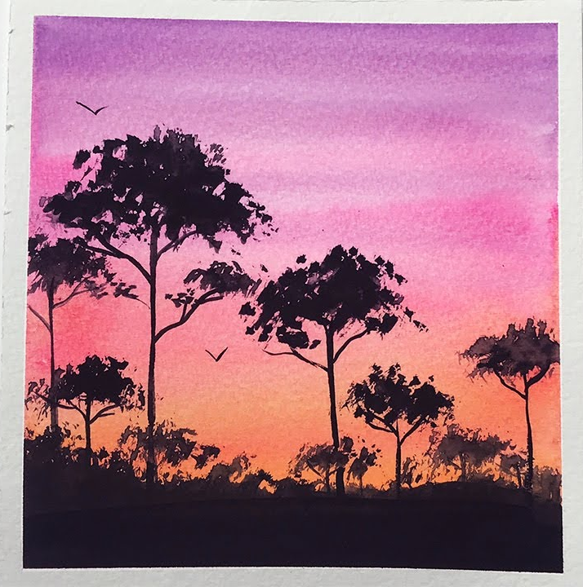
Painting sceneries are my new favorite thing with overlaying sunsets. I took about 30 minutes to finish this painting. The drying process is a key part into creating hard, clean details. Overall, my water painting skills are still just beginning. Overtime, I can practice more detailed paintings , such as animals, waves, and even objects.

