Slide 1
Tourism on Tinian
Micheal John Naputi

Slide 2
Research Questions:
Primary Research Question:
Will bringing back a hotel and casino back to Tinian help bring back tourism?
Secondary Research Questions:
How successful are casinos in staying open for a long period of time?
How much help will the island be getting from a hotel and casino?

Slide 3
Support for Research
I have got the support for my research through
Finding sources online and showing how those sources relate with a literature review.
Using Survey Monkey to make a survey (used on the people of the CNMI)
Letters to experts(currently no replies)

Slide 4
Academic Literature
Online sources have been used in this research project. The student researcher has found resources from books and journals.
Estimating Benefits and Costs of Casino Gambling in Iowa, United States
Economics and Politics of Excise Taxation
The Social, Economic, and Environmental Impacts of Casino Gambling on the Residents of Macau and Singapore

Slide 5
Community Resources - Local Newspapers
There were some local newspapers from the CNMI that talked about tourism, the closure of Tinian Dynasty, and how will it affect the island.
Tinian Dynasty to Close this Month
Private, Public Sectors Feel Crippling Effect of Dynasty Closure

Slide 6
Survey Monkey
Survey Monkey allowed the student researcher to create a survey that could be shared with the people of the CNMI to participate in. The student researcher has used social media to spread the survey. There was 22 people that participated in the survey.

Slide 7
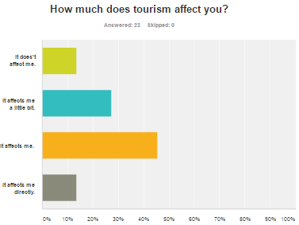
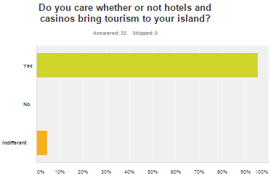
Survey Results

Slide 8
Link to Survey
You can use this link to view the survey the student researcher has used.
https://www.surveymonkey.com/r/DK8BM2M

Slide 9
Findings
In the survey and resources there was some interesting findings:
Survey
Majority of the participants in the survey care about tourism and it affects them.
Online Sources
Casinos have been proven to be bad, but it has show that if the casino was panned out correctly with set rules, it can help the community that it’s in.

Slide 10
How my findings address my questions
Will bringing back a hotel and casino back to Tinian help bring back tourism?
Yes, if utilized and planned correctly.
How successful are casinos in staying open for a long period of time?
They are good at staying open for long periods of time but there are factors that can cause it to close like not following policies that can lead to huge fines.
How much help will the island be getting from a hotel and casino?
They would provide jobs and the local government will receive excise tax.

Slide 11
Analyzation
According to the majority of the findings a lot of the people in the CNMI show concerns for the tourism industry and has seen the differences of having the tourism industry compared to when it was lost.
All of the participants care about whether or not hotels and casinos bring tourism to their island.
The differences are that makes are more affected than females.

Slide 12
Strengths and Weaknesses
The strengths and weaknesses in the approach I took to investigate the research the topic.
Strengths:
Found good sources
Got good data
Weaknesses:
Could have more participants in the survey

Slide 13
What should be done differently?
Talk to a variety of people on the topic and listen to what they have to say.
Find more resources
Send more letters to the experts

Slide 14
What I learned
What I learned about the topic?
I learned that casinos can be good if planned correctly.
What did I learn about research?
I learned that it is hard to find good evidence.
Describe what I learned about academic writing. How did I organize my report?
I learned that you have to write in third person and I organized my report based on the rubric.
What do I feel that I did well?
I feel that I did well in finding good academic resources as well community resorces.

Slide 15
What I learned
Discuss what would I do differently.
The thing I would do differently is to personally hand out surveys and talk to the community on what they think.
What would you like to learn more about in the future?
In the future I would like to learn about all the different factors that will make a casino useful and run and what will cause them to fail.
What skills would you work on further?
The skills that I will work on in the future is my writing skills.
What skills did you improve on?
I would like to improve on my academic writing skills.

Slide 16
Future Plans
The student writer could use this research efficiently by presenting it to the CNMI leaders, mostly to the mayor of Tinian, to show what the people is thinking, how casinos are good, and why we need the reopening of Tinian Dynasty.

