Slide 1
UAS Demonstration
Atdao Rosario
CO-210-07
Dr. Kimberly Bunts-Anderson

Slide 2
What is a UAS?
U.A.S : Unmanned Aircraft System. commonly known as a drone, is an aircraft without a human pilot aboard.

Slide 3
The reason?
In case, someone buys the U.A.S (Drone) purpose for:
Film
Photo Hobbies
Business
Agency
Mapping or GPS
miscellaneous

Slide 4
The Components of the U.A.S. (Drone)
Body of the drone
The propellers
Camera Gimbal
Controller
Tablet or cellphone
Pilot Qualification & Certification (for business only)
Certificate authorization or waiver (for agency only)

Slide 5
Setting up your U.A.S. (Drone)

Slide 6
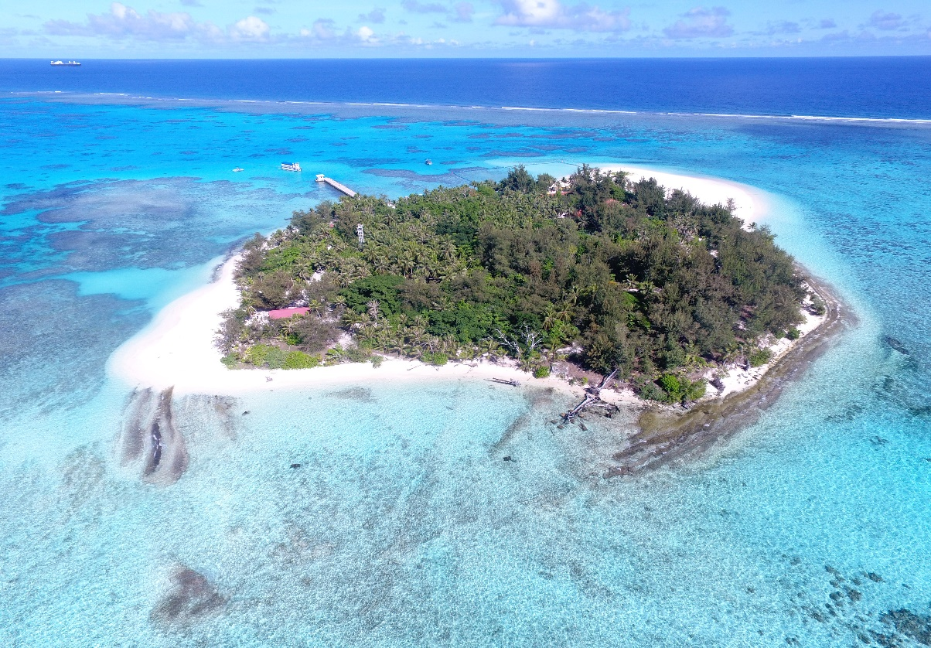
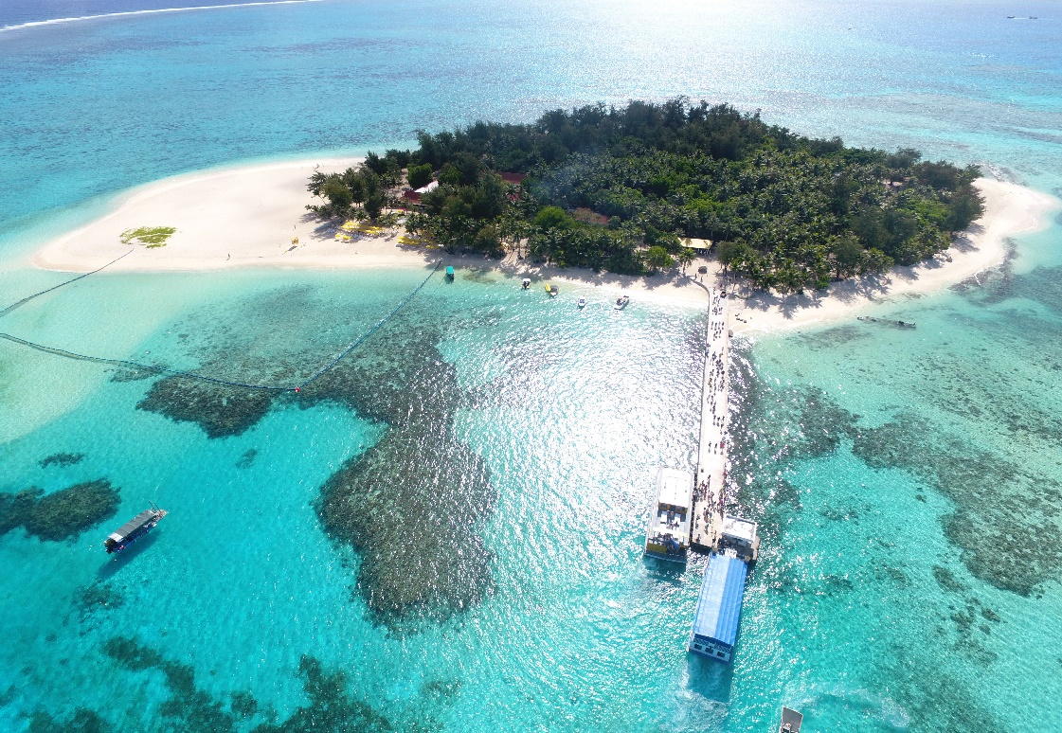
Photo Samples.

Slide 7
Other Tools

Slide 8
ANY QUESTIONS?

