Slide 1
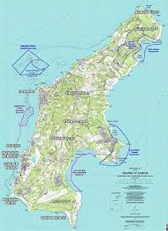
What were the effects of business sales caused by Typhoon Soudelor due to power outage?
By: Lalani Fritz

Slide 2
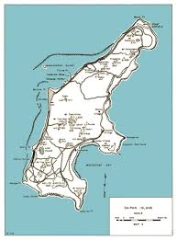

Slide 3
Stores
*HAPPY MARKET * BEST MARKET
*JJ MARKET * SAN ANTONIO MARKET
*999 MARKET * NEW CK MARKET
*LZ MARKET *ZHENG ZHENG MARKET
*PUBLIX MARKET * LN STORE
*BLUE SKY * JIN LI STORE
*COOL MARKET * c market

Slide 4
什麼是小企業因颱風造成的蘇迪羅停電的影響？Shénme shì xiǎo qǐyè yīn táifēng zàochéng de sū dí luó tíngdiàn de yǐngxiǎng?
你有一台发电机在当时台风来袭？Nǐ yǒuyī tái fādiàn jī zài dāngshí táifēng lái xí?
是的Shì de 沒有Méiyǒu
你必須改變你的商店營業時間？Nǐ bìxū gǎibiàn nǐ de shāngdiàn yíngyè shíjiān?
是的Shì de 沒有Méiyǒu
有沒有任何改變你的銷售？Yǒu méiyǒu rènhé gǎibiàn nǐ de xiāoshòu?
增加Zēngjiā
略有增加 È yǒu zēngjiā
保持不變 Bǎochí bù biàn
略有下降 È yǒu xiàjiàng
減少 Jiǎnshǎo

Slide 5
Primary Research Question:
What were the effects of small businesses due to power outages caused by Typhoon Soudelor?
Did you have a generator at the time the typhoon struck?
Yes No
Did you have to change your store hours?
Yes No
Was there any change to your sales?
Increased
Slightly increased
Stayed the same
Slightly decreased
Decreased

Slide 6
Number of Sales in Thousands
2015

